Slide 1
Teen Leadership Track 2022 Teens as Teachers Conference Kathleen Bohde, bohde@purdue.edu Jennifer Haynes, jgovan@purdue.edu Pandora Taylor, pwoodwar@purdue.edu Steve McKinley, mckinles@purdue.edu
Notes:
Steve
Thank you for joining us for the Teen Leadership Track of the 2022 Teens as Teachers Conference! We look forward to sharing some activities and resources that you will be able to use as you teach youth and adult audiences in your home communities. My name is Steve McKinley, 4-H Extension Specialist with Leadership and Volunteerism. I am pleased to introduce you to 3 outstanding colleagues who have helped develop the activities and resources for today: Kathleen Bohde, 4-H Youth Development Extension Educator in Hamilton County; Jennifer Haynes, Lake County 4-H Educator, and Pandora Taylor, Boone County 4-H Educator.

Slide 2
Topics included today are:
Civil Dialogue
Decision Making
My Life Map
4-H Changemakers
Bumper Cars
Action Plans
Back-to-Back
Parliamentary Procedure
Notes:
Steve
Here is a list of topics/activities that we’ll include in today’s Teen Leadership program.
By the end of today’s session, you’ll have several activities that you will be able to teach to youth and adult audiences in your community!
It’s my pleasure now to introduce Jennifer Haynes to lead us in our first activity!

Slide 3
Icebreaker
Notes:
Jennifer

Slide 4
Civil Dialogue
Notes:
Pandora

Slide 5
Civil Dialogue
Notes:
Pandora

Slide 6
Stretch Break!
15 Minute Break!
Stretch
Talk with someone you haven’t met yet
Grab a snack
Take care of business
We’ll start again at 10:45 a.m.!
Notes:
Steve

Slide 7
Back-to-Back
Notes:
Steve

Slide 8
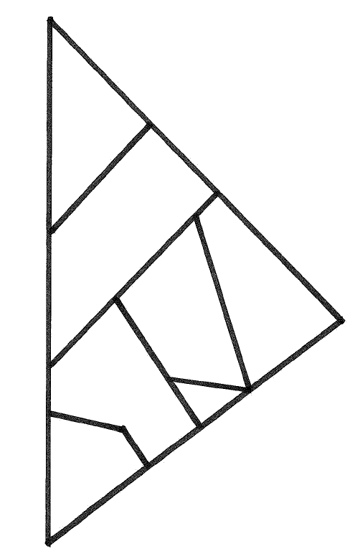
Back-to-Back Activity
Age: K-adult
Time: 30-45 minutes
Materials needed:
Identical sets of puzzle pieces, Legos, etc. – 1 set/person
Description
Notes:
Steve

Slide 9
Decision Making, Quick Thinking
Notes:
Jennifer

Slide 10
Decision Making, Quick Thinking
Notes:
Jennifer

Slide 11
Lunch Break!
We’ll start again at 10:45 1:00 p.m.
Notes:
Steve

Slide 12
My Life Map
Notes:
Pandora

Slide 13
My Life Map
Notes:
Pandora

Slide 14
So What…Now What?
Notes:
Steve

Slide 15
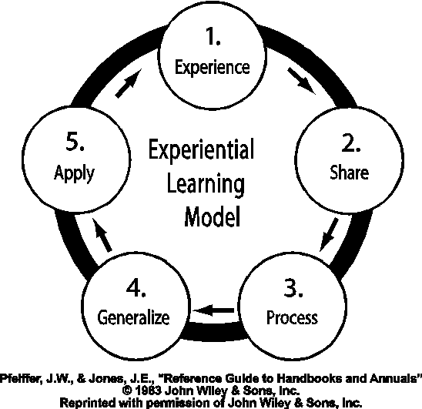
So What…Now What?
Activity
Share-Process-Generalize-Apply
Processing/debriefing questions
Notes:
Steve
As teen leadership instructors, you will likely be leading a number of fun activities for your audiences. While the audience will likely enjoy the activities, by themselves, they really don’t do much to teach leadership characteristics.
However, we can make these activities learning events by adding a series of debriefing or processing questions. This is the application portion of the experiential learning model!

Slide 16
Let’s Practice!
Finger Draw
Notes:
Finger Draw
Find a partner – introduce yourself.
Put your hands behind your back and hold up any number of fingers (both hands) that you choose
When the leader says “1,2,3, Draw!”, bring your hands in front of your body.
Count the total number of fingers on all four hands (yours and your partners).
First partner to get the total correct is the winner.

Slide 17
So What…Now What?
What did you learn from this activity?
What made this activity hard? Easy?
What is a skill that this activity helped you develop?
When would you use this, or a similar, activity?
What other questions can you think to ask about Finger Draw?
Notes:
Now that the activity is completed, we ask questions during the processing time that help us answer the questions…So what? Why did you do/learn from this activity? And, Now what? What will you do as a result?
Let’s practice with the Finger Draw activity.

Slide 18
Parliamentary Procedure
Notes:
Jennifer

Slide 19
Parliamentary Procedure
Notes:
Jennifer

Slide 20
Stretch Break!
15 Minute Break!
Stretch
Talk with someone you haven’t met yet
Grab a snack
Take care of business
We’ll start again at 3:00 p.m.!
Notes:
Steve

Slide 21
4-H Changemakers
Notes:
Pandora with Rachael Smith and Rena Sheldon

Slide 22
4-H Changemakers
Notes:
Pandora

Slide 23
Bumper Cars
Notes:
Steve

Slide 24
Bumper Cars
Objective: Driver escorts vehicle through an obstacle course with a series of nonverbal cues…withOUT crashing!
Person #2 is the driver – you “drive” Person #1 withOUT talking:
Both hands on shoulders…move forward
Remove hands from shoulders…stop
1 tap on right shoulder, turn right
1 tap on left shoulder, turn left
You have two minutes to drive around the course without any crashes – Be Careful with your vehicle!!
Notes:
Steve
Find a partner
Who’s the oldest? That person is #1 is the vehicle first – close your eyes throughout this activity.
Repeat with Person #1 as the driver for Person #2

Slide 25
Teach Backs Tomorrow morning, 7-10 minute presentations as a team Feedback provided Select from the following…
Notes:
Steve
Now that you have learned about some activities that you can teach, it’s your turn to decide what to teach and for whom. In a few moments, we’ll give you a chance to sign up for the lesson that you’d like to teach back to others in the morning. You and a partner will prepare your lesson tonight, then teach a 7-10 minute lesson in the morning. You’ll get feedback from your peers and Adult mentors.
The options for you to choose from are on the next slide.

Slide 26
Teen Leadership Track Teach Back Options
Back-to-Back
My Life Map
Parliamentary Procedure
Selecting Your Cause
Bumper Cars
Notes:
Steve

Slide 27
TAT Business Cards
http://bit.ly/TATBusinessCard
Notes:
Steve
We have a template for Teens as Teachers Business Cards that you can download via Canva and personalize for your use. These can help you make connections for presentation in your local communities.
http://bit.ly/TATBusinessCard
In the next week, you can expect to receive an e-mail from us including some of these details. Also in that e-mail we will ask you to confirm your polo shirt size so that we can get an order placed and get your polo shirts to your county offices for you to start using.

Slide 28
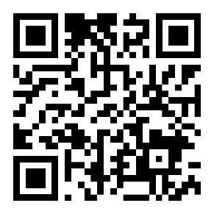
Evaluation Please give us your feedback on TAT 2022! https://bit.ly/TAT2022
Notes:
Steve
Finally, we want to hear from you about your Teens as Teachers experience in 2022. Please take a couple of minutes to visit the url shown on this slide (and included in the chat) http://bit.ly/TAT2022 to give us some feedback about this session today.
Thank you very much!

Slide 30
Thank you!! Best wishes to you and your teams as you teach in your communities!
Notes:
Steve
Thank you for joining us today!
Please let us know if you have questions as you move forward with your teaching experiences. Best wishes!

