Slide 1
What’s That Growing On My Spinach? Bacteria Associated With Fresh Produce
Amanda Deering, Ph.D.
Department of Food Science

Slide 2
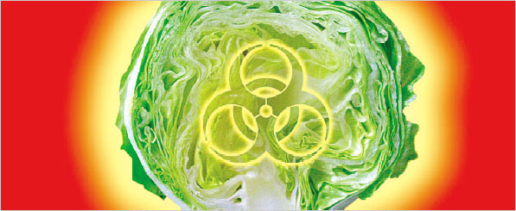
What’s the Problem?
The number of outbreaks associated with fresh produce has been increasing
Spinach and Lettuce
Tomatoes
Sprouts - Mung Bean and Alfalfa
Cantaloupe
Pathogens Involved:
E. coli O157:H7
Salmonella spp.
Listeria monocytogenes
http://www.nytimes.com
“When Bad Things Come From ‘Good’ Food”
January 2, 2007

Slide 3
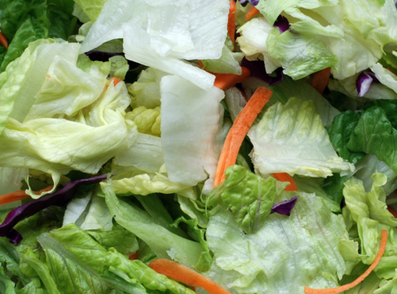
What’s the Problem?
No kill step (such as cooking)
Consumed raw or lightly cooked
Reasons for increased outbreaks:
Increased consumption of fresh produce
Increase in pre-cut, bagged, ready-to-eat products
Transfer of produce over large areas
More automated means of harvest and distribution of fresh produce
www.choosemyplate.gov

Slide 4
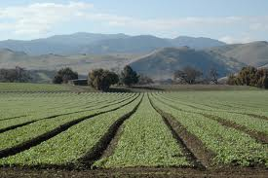
Contamination of Plants/Produce
Pathogenic bacteria can be introduced at any point during the growing, harvest, and post-harvest handling
Plants can be a vehicle for transmission of bacteria to humans
Passive contamination event
Can sometimes be corrected by proper post-harvest sanitization methods
Examples:
Improperly composted manure
Contaminated irrigation water
Breakdown in sanitization treatment

Slide 5
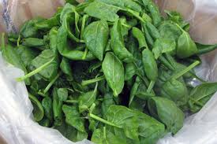
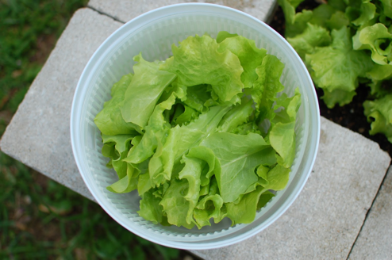
Introduction of Bacteria Through Wounds
Cut or damaged surfaces (bruising) provides a point of entry for the bacteria into the plant
Increases the risk of contamination
Nutrients are released from the plant that provide food for the bacteria
Excess trimming of produce problematic

Slide 6
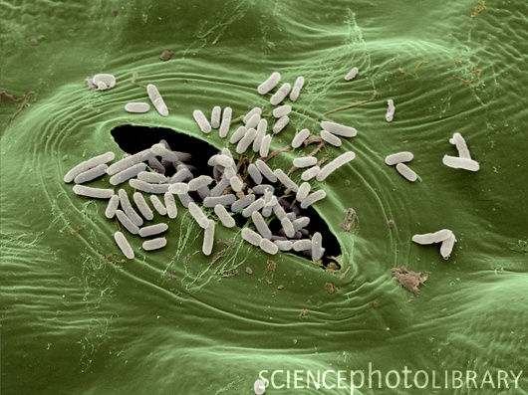
Introduction of Bacteria Through Natural Openings
Stomata are present on the plant surface
Regulates gas exchange by opening and closing
Bacteria can enter during washing using contaminated water or other contamination event
Bacteria protected from sanitizers

Slide 7
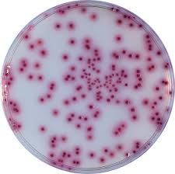
Let’s talk about a bacterium that can make us sick: Salmonella spp.
Each year is estimated to cause about 1.2 million illnesses in the U.S.
23,000 hospitalizations
450 deaths
Causes the disease Salmonellosis with symptoms: diarrhea, fever, and severe abdominal cramping

Slide 8
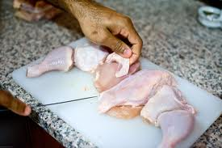
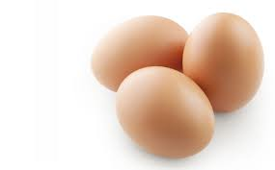
Salmonella enterica
Birds and reptiles are usually reservoirs
Transmission can be from person to person or animal to person through a fecal-oral route.
Also, by consuming food that is contaminated or improperly cook
Raw and undercooked eggs
Raw milk products
Poultry
Uncooked fruits and vegetables

Slide 9
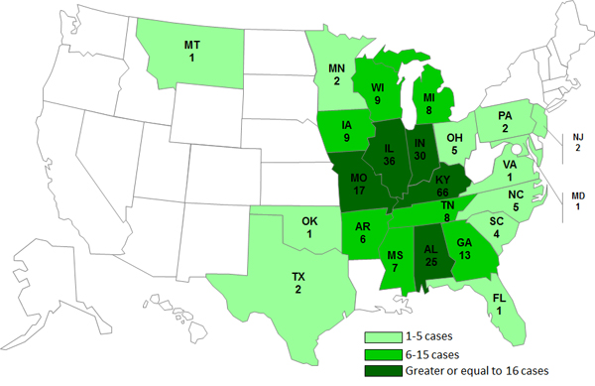
Salmonella Outbreaks - Cantaloupe
Chamberlain Farms, Owensville Indiana in 2012
261 cases in 24 states
3 deaths

Slide 10
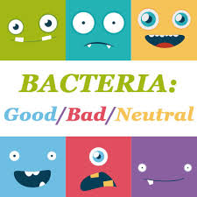
Most Bacteria on Plants are Good!
Plants have bacteria on their surfaces just like humans do.
They are part of the natural microflora of the plant and contain bacteria, yeasts, and molds that do NOT make us sick.

Slide 11
What Are We Doing Today?
Let’s see what’s growing on our spinach.
Come up and pick a piece of spinach from the front– Make sure to label your petri dishes
Plate on the petri dish – Be careful not to press too hard and break the agar!
Seal with Parafilm and take home to incubate 2 days at room temperature

Slide 12
What Should We See After 2 Days?
Sort of round, bigger, and usually not smooth = Yeast
Fuzzy = Mold
Different colors, shapes, and sizes means different microbes!
Round, small, and smooth = Bacteria
Use the key to ID the most abundant bacteria that was on your spinach!

Slide 13
Questions?
Contact Information:
Amanda Deering
adeering@purdue.edu
765-494-0512

