Slide 1
LEADING THE CHANGE
Pandora Taylor - 4-H Educator Boone County
Kathleen Bohde – 4-H Educator Hamilton County
Adapted from Area 6 4-H Youth Development Educators

Slide 2
What is a Changemaker?
Someone capable of taking creative action to solve a social problem
Notes:
Everyone in this room is a changemaker. By giving up a weekend to learn about leadership and programs you can take back to your community, you are making a difference.
When you think of a changemaker, who do you think of?
Make a list of the names of who they are saying on a flip chart sheet.

Slide 3
What is a Changemaker?
Notes:
Reference the Changemakers in the logo from left to right:
Malala is a Changemaker for fighting for the rights of girls and women to obtain an education across the world
Rosa was a Changemaker for refusing to give up her bus seat and sparking a bus boycott that was a turning point in the civil rights movement
Dr. Rev. MLK Jr. is a Changemaker for using peace and nonviolent actions to advance civil rights
Greta is a Changemaker for overcoming a disorder to inspire youth globally to advocate to their governments to act on climate change
Madame C.J. Walker was a local Changemaker who invented a line of hair products to advance the status of African American women
Our Logo for Changemakers highlights people in history that have made global change
One of them is Malala Yousafzai. Malala is a youth activist from Pakistan who fights for the right to education for women and girls. Malala became an activist at the age of 12 when she joined her father to advocate for education for girls, despite resistance from the Taliban. On October 9th 2012, Malala was attacked by the Taliban, a terrorist organization, on her way back from school. She suffered from a gunshot wound and was in critical condition. After the attack, Malala moved to the United Kingdom, where she continues to advocate for girls’ education through her book, movie and foundation. In addition to writing a blog for BBC Urdu under a pseudonym and being featured in a New York Times documentary, Malala travels all across Pakistan to speak about girls’ education rights at rallies and on television. She is the youngest person to have received a Nobel Peace Prize.

Slide 4
What is a Changemaker?
Global Goals
Notes:
A new plan for people and planet has just launched - the UN Global Goals for Sustainable Development.
Overview Video of the Un Global Goals https://www.youtube.com/watch?v=RpqVmvMCmp0
Or https://www.youtube.com/watch?v=cBxN9E5f7pc&t=179s

Slide 5
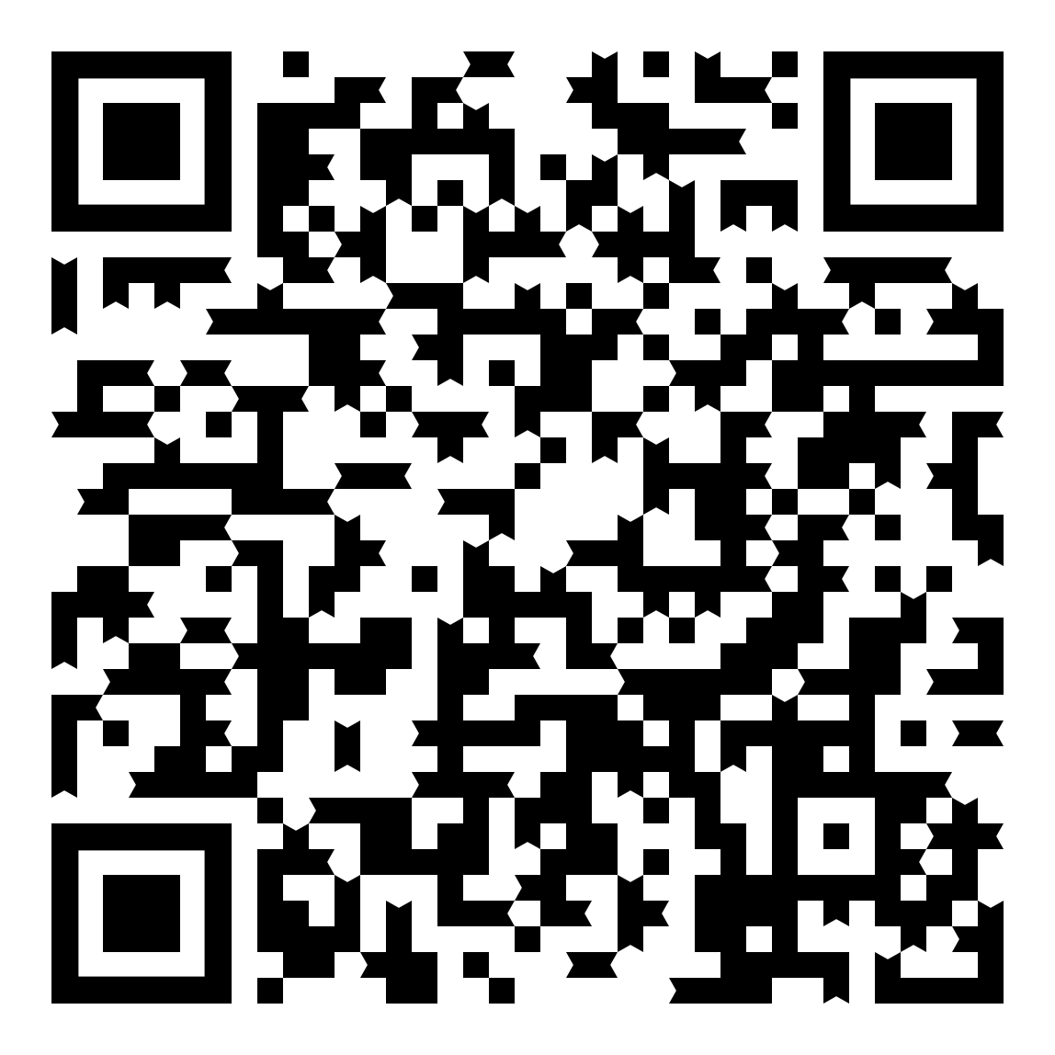
Quiz for Global Goals
How will you change the world?
.
Notes:
Quiz for Global Goals https://www.ubs.com/global/en/ubs-society/togetherband/find-your-goal.html

Slide 6
Selecting Your Cause
Notes:
Review the UN Global Goals- Select one to focus on

Slide 7
Changemakers
Both a noun and a verb:
It’s something you are
It’s something you do
Notes:
Part 2- 30 minutes
Changemakers- both a noun and a verb: It’s something you are, It’s something you do
Now is time to explore and dive deeper into your cause.

Slide 8
Definitions
Beneficiary
Person or group of people who receive benefit from your activity or project
Stakeholder/Partner
People/organizations involved in your project, including:
Those who might want to see you succeed or not
Those who can influence the success of your project
Notes:
Why is this a worthy cause? - Research and Interviewing
Say: Is this cause a need in your community is, so what are specific needs?
Explain that "Changemakers Slide Guide" is just that...a guide. We are providing it to help you collect your thoughts for your pitch, but you can copy, cut, paste, and edit (and be creative).
Community mapping- create something
Give time for them to work on filling out their Guide
Regroup: Share what you put

Slide 9
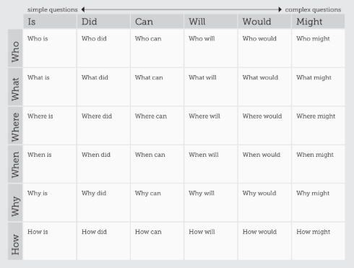
Interviews
Notes:
Asking the right questions.
When researching into a cause it is good to interview people that are currently working on the issue.
If you were going to interview a person what are some questions you would want to ask?
Their history
Their Why
The statistic they use on this issue
Are they partnering with others and how are they partnering

Slide 10
Time to dive deeper into the cause
Community Mapping
Create Interview Questions
Partnerships
Stakeholders
Notes:
Asking the right questions.
When researching into a cause it is good to interview people that are currently working on the issue.
If you were going to interview a person what are some questions you would want to ask?
Their history
Their Why
The statistic they use on this issue
Are they partnering with others and how are they partnering

Slide 11
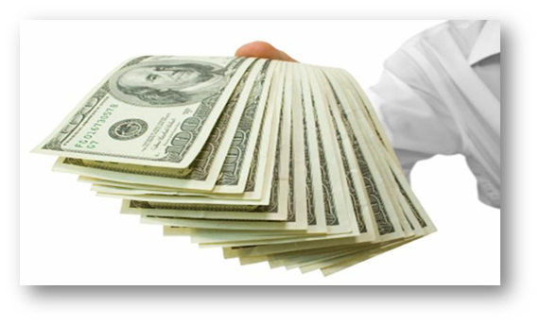
How might you raise funds?
Grants
Crowdfunding/Event fundraising
Product selling
In-kind donations.
Notes:
Part 3- 30 Minutes
How to Fund Your Cause
Ask, “How might you raise money if you need it to implement your project or donate to an organization you are passionate about?” Ideas (links are to examples):
Grants: Different entities that have large amounts of money such as foundations, businesses, or government agencies and institutions, and that want to help solve problems all around the world, usually give out their money in the form of grants. Each donor has its own priorities, requests, and requirements for grants, and the process can sometimes be unpleasant and long. They usually consist of specific forms which you must fill in order to apply, but very often, it all comes down to your idea.
Crowdfunding/Event fundraising: Crowdfunding is the act of raising small amounts of money from a large number of people online. You will be trying to convince a large number of people to support your idea, so you need to do quite creative in drawing the audience’s attention. You create an event which offers something interesting to your audience (such as a theatrical show, food event, or an art-selling exposition), and include a way to raise money, such as having a paid entrance fee, selling products for more than they cost to make, or just inviting people to donate without any requirements.
Product selling: The product can be the solution itself (first aid kits or humane dog leashes) or he product or service can also be unrelated to your project (bake sale or 4-H projects you created in an auction)
In-kind donations: Sometimes, you might not need actual money to implement your project, but you will need different kinds of materials or services for it, or want to donate to a local charity.

Slide 12
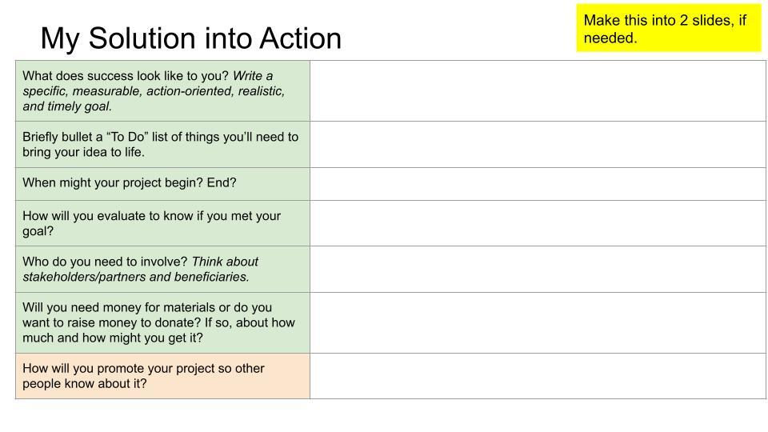
Notes:
Activity: Put into break-out groups to do the first 6 prompts in green from the "My Solution into Action" slide:

Slide 13
How might you raise funds?
Notes:
YES Grant
What is a grant
Application/Guidelines (handouts)
A group application must include at least two youth and two adults
Be sure to include your interview!
Short- and long-term goals
"Don't leave the committee with questions." Provide adequate details.
Continuation and completion of project
From Luke: Encourage team applications (can bring in youth who are not 4-H members, which is encouraged), can enter group/club name (Changemakers), want to see you in action (social media)
Offer to review and remind about deadline.
Question 2: Outline or describe the process your 4-H group went through to determine the concerns, needs, or problems existing in your community.
182 words: I was part of a six-week program called The Changemakers to help me determine the needs and problems in my community. The program was led by Central Indiana 4-H educators. During the program, I connected my passion to both a cause and a United Nations Global Goal so that my local action could have global impact. I conducted research on the internet to find data in order to discover the root problem of the cause I was interested in. [Insert one data point.] I looked at maps of my county's resources to discover assets we already have and where there might be gaps. I learned about empathy and the importance of including the community, both stakeholders and beneficiaries, as I designed my community service project. I wrote and asked interview questions to help me better understand the community problem. [Insert who you interviewed and a brief summary.] With help from my fellow Changemakers, I interpreted my data in order to get to the root cause of my problem and brainstorm possible solutions, including the project I'm pitching as part of this grant.
4-H entity to write check: Area 6 Youth ED Fund
Deadline: March 15th
How to write a budget / what would go into a budget

Slide 14
Where do we go from here?

Slide 15
Where do we go from here?

