Slide 1
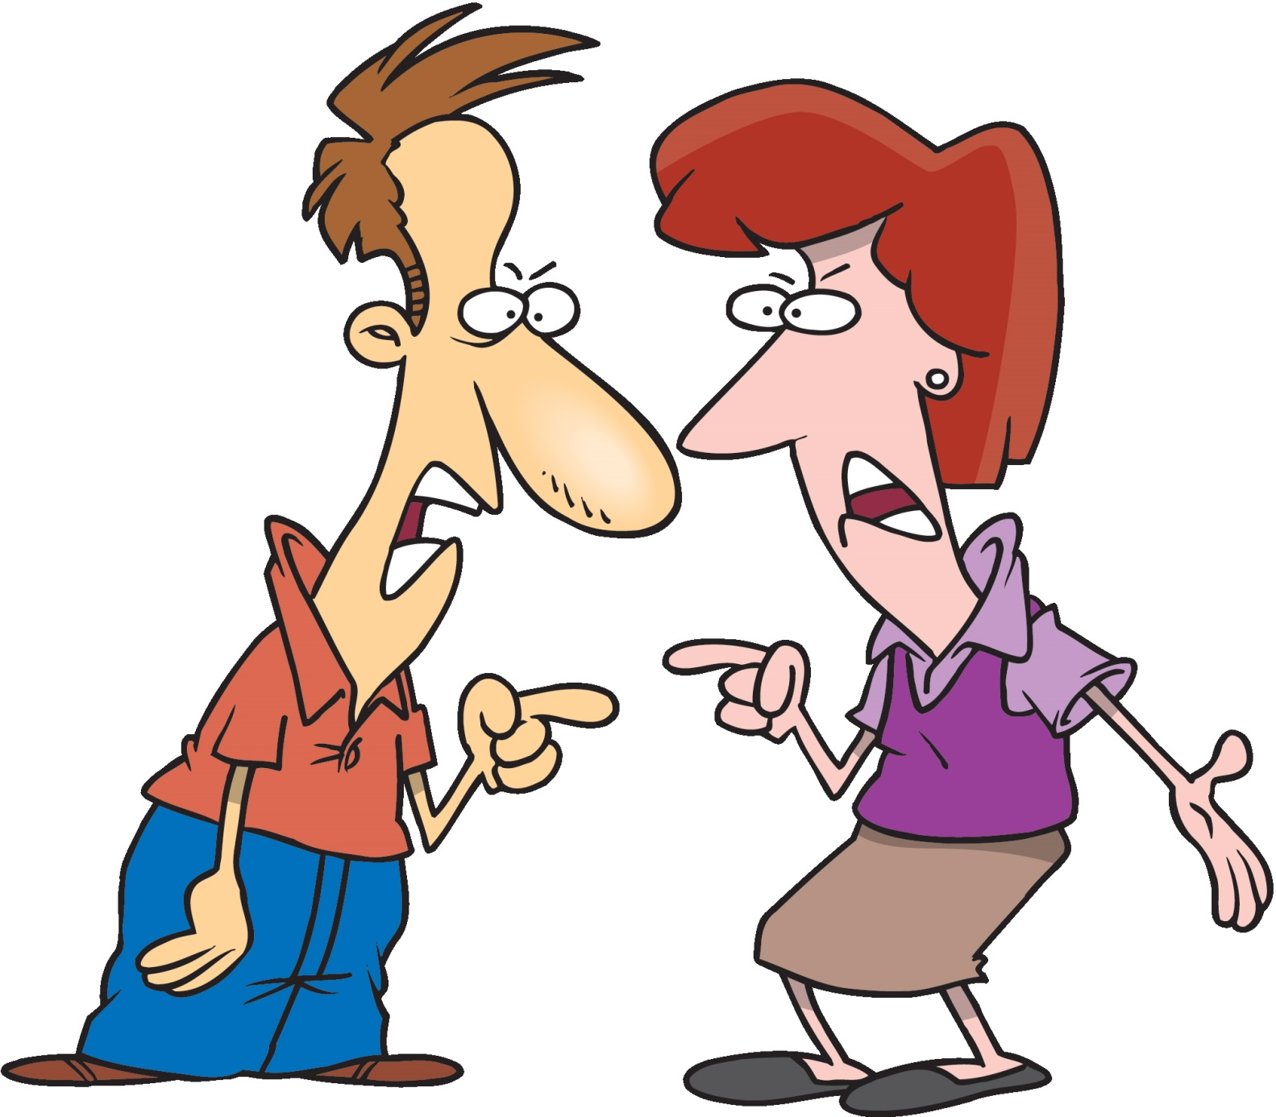
Positive Civil Dialogue How to disagree and keep your friends
Presented By: Pandora Jo Taylor, 4-H Youth Development Extension Educator
Adapted From: Dr. Debbie Nistler, Iowa State Extension
Purdue University is an equal opportunity/equal access/affirmative action institution.

Slide 2
Communication is more of an art than a science
How Miscommunication Happens (and how to avoid it)
Adapted from 50 Garber, P.R. 2008. Communication activities, icebreakers, and exercises. HRD Press, Inc. 254pp.
Notes:
There are a lot of things that each of us bring to a conversation. We can have a conversation on the same topic with 2 different people and have a very different conversation with each person. There are some basic tools we should use in all conversations to make it a successful and respectful conversation. Lets watch this video why we have issues of miscommunication and how to avoid miscommunication in the future.

Slide 3
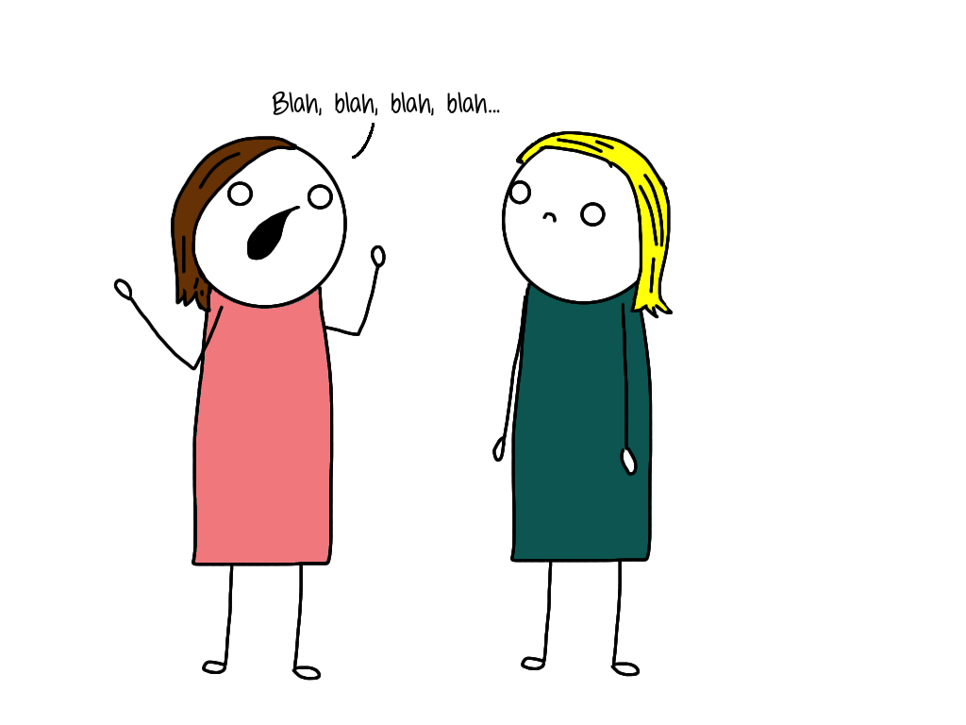
How do we spend our time?
We spend about 70% of our time communicating with others
16% Reading
9% Writing
30% Talking
45% Listening
Adapted from 50 Garber, P.R. 2008. Communication activities, icebreakers, and exercises. HRD Press, Inc. 254pp.
Purdue University is an equal opportunity/equal access/affirmative action institution.
Notes:
So this video just shared with us that we all will have miscommunication in our lives. As you can see here we spend about 70% of our time communication with people and a majority of the time (45%) is spent listening. So does it make sense to you that in order to remove miscommunication in our lives would be to learn to be better listeners?

Slide 4
Communication is the key to achieving all of our goals
Purdue University is an equal opportunity/equal access/affirmative action institution.
Notes:
Think of a time you were working on a project with a group of people. Would you have been ale to complete the project if your group didn’t communication? Why not?
Was there a time you did a project with a group and you had communication issues? Why do you think you had communication issues.
Examples of Miscommunication if students don’t participate in the questions above: 4-H club officers preparing for meeting, a class science project, members of a basketball team

Slide 5
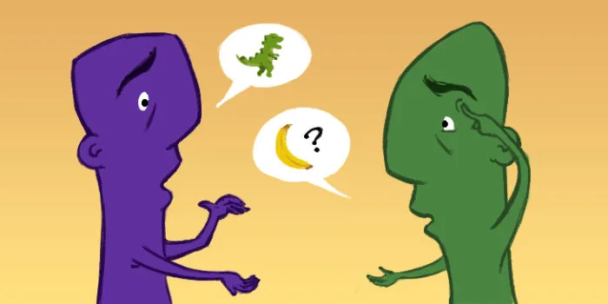
“I know that you believe you understand what you think I said, but I am not sure you realize that what you heard is not what I meant!”
Quote from a U.S. government official
Purdue University is an equal opportunity/equal access/affirmative action institution.
Notes:
Many times miscommunication is not done purposefully, it is many times an accident by one or both people in the communication. So it is not only important to listen, but to make sure when you are the one talking that you are communicating effectively. This about the game “Telephone”. How many times does the statement made at the beginning is the same statement made by the last person?

Slide 6
An effective Communications Model
1. Sends message
2. Hears & Responds
3. Clarifies
4. Confirms
Adapted from 50 Garber, P.R. 2008. Communication activities, icebreakers, and exercises. HRD Press, Inc. 254pp.
Purdue University is an equal opportunity/equal access/affirmative action institution.
Notes:
How do we solve this problem? Communication can not be a one way street, both people need to be a part of the conversation. The first person sends the message, the second person hears and responds back based on what they heard. The first person should then clarify anything that the second person misinterpreted and then the second person confirms that they understand the clarification.

Slide 7
The Listening Dilemma
We speak at a rate of about 150 wpm
We can hear at a rate of about 1,000 wpm
That gives us a lot of extra time!
What do we do with this time?
The Listening Dilemma video
Purdue University is an equal opportunity/equal access/affirmative action institution.
Notes:
We have a dilemma because we listen faster than we speak. That gives us a lot of time what do we do with this extra time? Think about our to-do list, or what dress we are going to buy for the prom, or figure out what we want for lunch. Our minds are always going,!!! I have a video here on just want the Listening Dilemma is all about and why it is a problem.
https://www.youtube.com/watch?v=FGztjdRxzIA START VIDEO AT: 1:30 in video END VIDEO AT: 4:12
So now that we know we have to be good listeners to avoid communication, how to we improve our listening skills???? (next slide)

Slide 8
Interactive Listening
Paraphrase
Repeat
Probe
Clarify
Remember
This helps ensure you have heard and understood what was said.
Active Listening Example
Let’s Practice!
Adapted from 50 Garber, P.R. 2008. Communication activities, icebreakers, and exercises. HRD Press, Inc. 254pp.
Purdue University is an equal opportunity/equal access/affirmative action institution.
Notes:
Interactive Listening is just like the video ended, with the person “actively” listening. Now is ease dropping the best form of active learning? NO. Interactive listening is where you are focus on the conversation, but you also make sure that you are hearing what the speaker is saying. (Remember the earlier slide on assuming you know what the speaker meant without clarifying?)
As the listener during the conversation you can say things like
“if I am hearing you correctly…”
Did you just say…
Tell me more about…
I’m confused. What did you mean by…
Video https://www.youtube.com/watch?v=3_dAkDsBQyk
Practice Activity: See Active Listening Ice Breaker

Slide 9
Active listening Activity
Split into groups of 2 people from different counties
Person1 tells Person 2 the following items
Name
Favorite Food and why
Person 2 needs to actively listen and will share back the information to the whole group
We will share around the room and then switch roles
Person 2 tells Person 1 the following items
Name
Favorite Animal and why
Purdue University is an equal opportunity/equal access/affirmative action institution.

Slide 10
Listening Bad Habits
I interrupt often or try to finish the other person’s sentences.
I jump to conclusions
I am often overly parental and answer with advise, even when not requested.
I make up my mind before I have all the information.
I am a compulsive note taker.
I don’t give any response afterward, even if I say I will
I am impatient.
I lose my temper when hearing things I don’t agree with.
I try to change the subject to something that relates to my own experiences.
I think more about my reply while the other person is speaking than what they are saying.
Adapted from 50 Garber, P.R. 2008. Communication activities, icebreakers, and exercises. HRD Press, Inc. 254pp.
Purdue University is an equal opportunity/equal access/affirmative action institution.
Notes:
Here are some things that we want to avoid doing when we are being the listener. Now do we all do these things? Yes, but now we can be more aware of our listening skills and try to avoid these bad habits when we realize we are doing them.

Slide 11
Tricky Conversations
What is Civil Dialogue
Mutual discussion of views
It promotes understanding
Respectful of the other person’s and his or her views
It is fact based
What Civil Dialogue is NOT
Hostile
Personal
Disrespectful (name calling, using profanity, use of derogatory terms, etc.)
Contest
Adapted by National Council for the Social Studies, Document: Guide to Civil Discourse for students https://www.socialstudies.org/sites/default/files/guide_to_civil_discourse_student_version.pdf
Notes:
Now that we know more about being a good listener lets talk a little bit about what happens when we are being an active listener, but we hear something we don’t agree with. Have you ever been in a situation where this has happened? Share an example. My example: Baby shower theme
How has heard of the term Civil Dialogue or Civil Discourse before today?
Definition is a conversation in which there is a mutual airing of views without bitterness or resentfulness. It is a discussion that is respectful of the other person and their opinions. We don’t have to agree in the end, but we don’t walk about hating the other person.

Slide 12
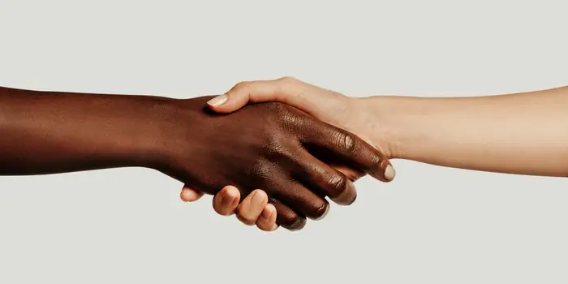
What is the goal of civil dialogue?
Seek understanding and common ground
Purdue University is an equal opportunity/equal access/affirmative action institution.
Notes:
Here are the ground rules for a good debate or conversation over a controversial topic

Slide 13
What is real news Anyway?
“I saw on Facebook that……”
“My neighbor said……”
What makes news or information credible?
Ask yourself these questions:
Can you verify?
Does the site have other news that can be verified?
Is it a site ending in .edu or .gov?
Can you find information on this on multiple reputable websites?
Is there research to support it?
Purdue University is an equal opportunity/equal access/affirmative action institution.

Slide 14
Sample Issue Statements
I believe school should not be required
I believe that the voting age should be lowered to age 16.
I believe all cars should be electric
I believe we should stop flying to save the environment
I believe…………………..
Purdue University is an equal opportunity/equal access/affirmative action institution.
Notes:
Issues can be broad or they could be as simple as carrots should be eliminated from the earth. We all have opinions on lots of topics.

Slide 15
Putting it into action!
Break up into groups, you can stay with someone from your county.
Take a 3x5 index card with an issue on it.
Decide amongst yourself who is for and who is against the issue.
Spend a total 4 minutes debating each side using civil dialogue & active listening skills.
Purdue University is an equal opportunity/equal access/affirmative action institution.

