Slide 1
4-H/FFA Crops Career Development Event
2011-2015
Crop Plant Identification
Photos Courtesy of Purdue Agronomy and Google Images

Slide 2
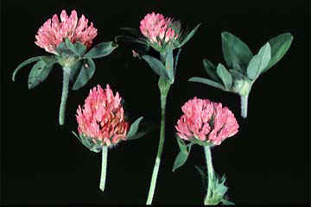
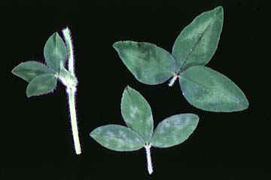
Red clover
hairy stems and petioles
inverted “V” water mark on broad leaves
leaves directly below flower

Slide 3
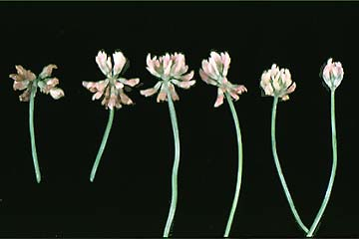
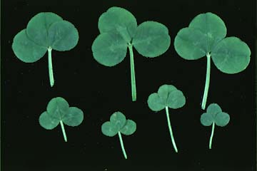
White clover
Flower grows on peduncles from base
No hairs

Slide 4
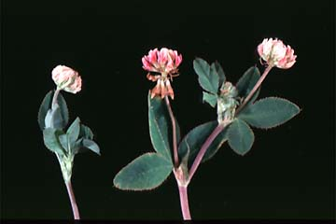
Alsike clover
Flower grows from junction of 2 leaflets or leaflet and stem
shorter peduncle than white clover

Slide 5
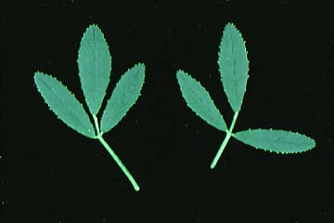
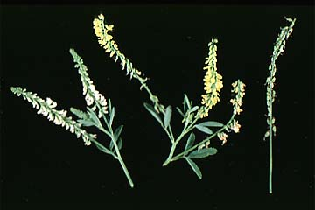
Sweetclover
leaflets are serrated the entire length of the leaflet

Slide 6
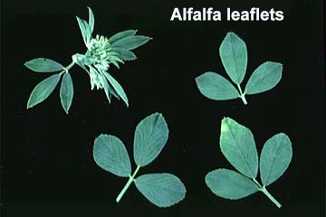
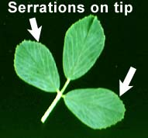
Alfalfa
trifoliolate or multifoliolate
Leaflets with serrations on leaflets
only on the top 1/3.

Slide 7
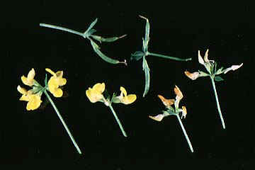
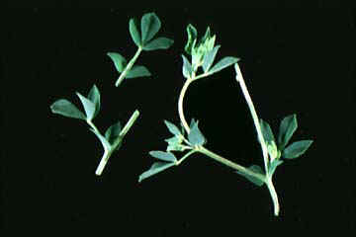
Birdsfoot trefoil
yellow flowers
Leaflet looks like bird’s foot

Slide 8
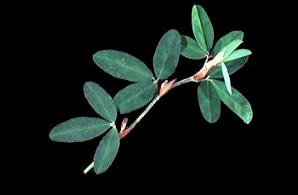
Korean lespedeza
trifoliate leaves with large, yellow stipules
leaflets may have brownish spots on them
noticeable parallel veination

Slide 9
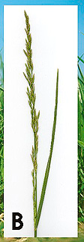
Tall fescue
Leaf blades are glossy on the underside
Blades serrated on the margins
inflorescence is a compact panicle, 3 to 4 inches long

Slide 10
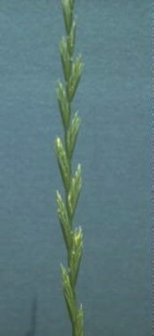
Ryegrass
two-ranked inflorescence in that seeds grow from both sides of the rachis

Slide 11
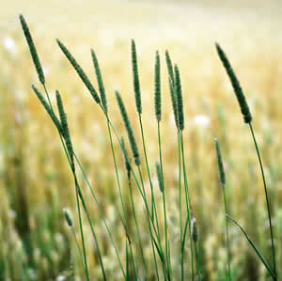
Timothy
Single flower, pale green turning tan
Narrow leaves

Slide 12
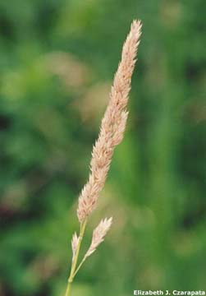
Reed canarygrass
blades are blue-green when fresh and straw-colored when dry
Seed head looks bunched, but not in clumps like orchardgrass

Slide 13
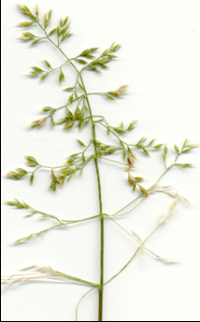
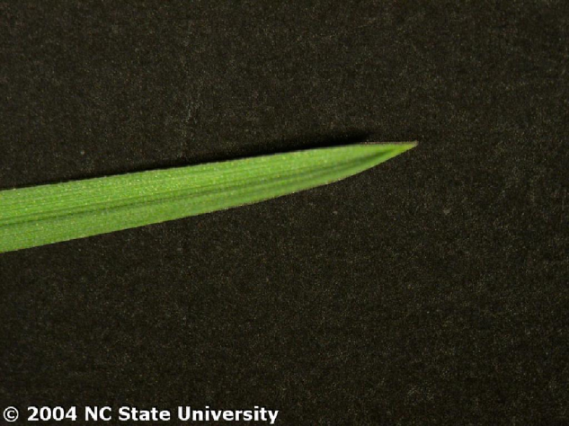
Kentucky bluegrass
inflorescence is an open, fine panicle with 5 branches at each node of the central axis
boat shape of the blade tip

Slide 14
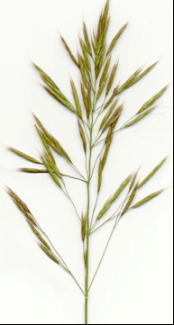
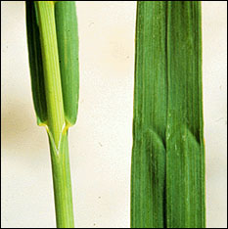
Smooth bromegrass
"W“ found imprinted at about the center of the leaf blade
open, erect panicle
no awns
elongate spikelets

Slide 15
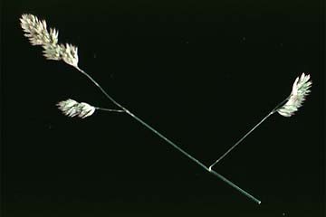
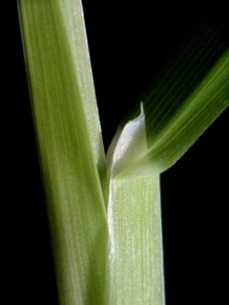
Orchardgrass
spikelets grouped close together at ends of panicle branches
seeds have very short awns,
leaf blades are bluish green, long, rough on surfaces on margins,
strongly keeled and V-shape in cross section

Slide 16
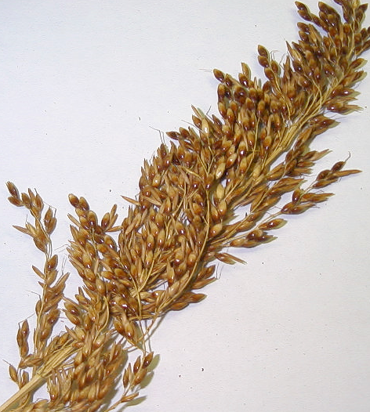
Sudangrass
Grain not always exposed at maturity
Larger stalk than johnsongrass

Slide 17
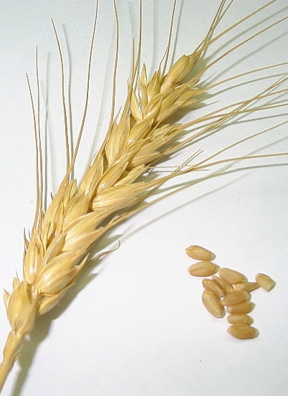
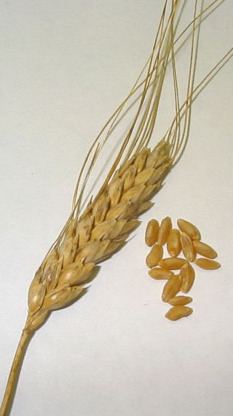
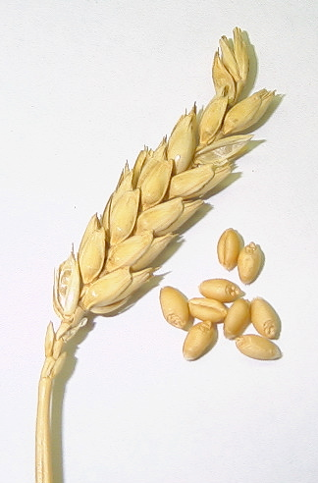
Wheat
Variety of colors
Can be awned or have no awns
Smooth glumes
Head is usually long and skinner than barley

Slide 18
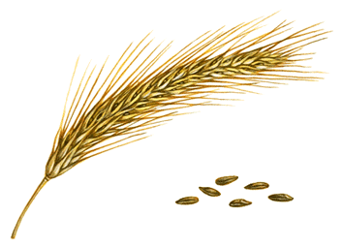
Rye
teeth on glumes
seed can be partially exposed in the seed head
head long and drooping
tiny hairs on glumes

Slide 19
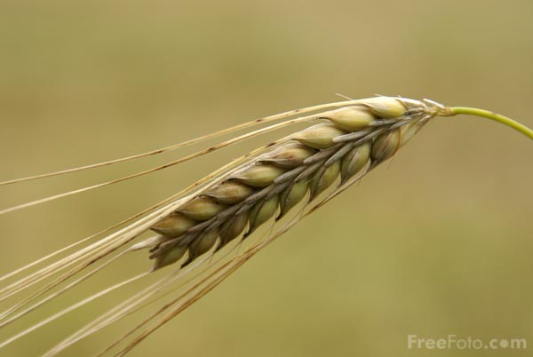
Barley
Plumper looking that wheat
Kernels can be arranged as 2-row or six row
Kernel is plump

Slide 20
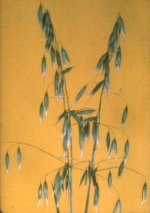
Oat
Panicle inflorescence

Slide 21
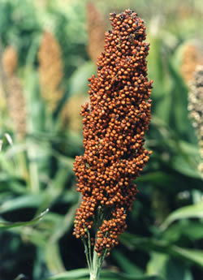
Grain sorghum
Seeds can be a variety of colors

Slide 22
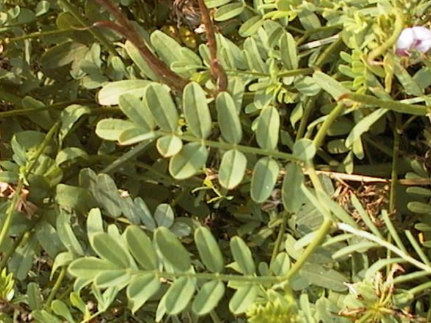
Crownvetch
leaf is “crowned” with a terminal leaflet
leaflets usually end in a small point
flower is arranged in a head-type seed

Slide 23
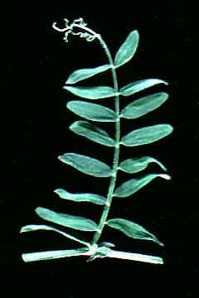
Hairy vetch
leaflets end in terminal tendril
leaf tips are pointed

Slide 24
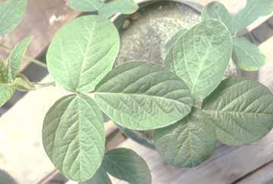
Soybean
Leaflets arranged in trifoliate
Hairy petiole

Slide 25
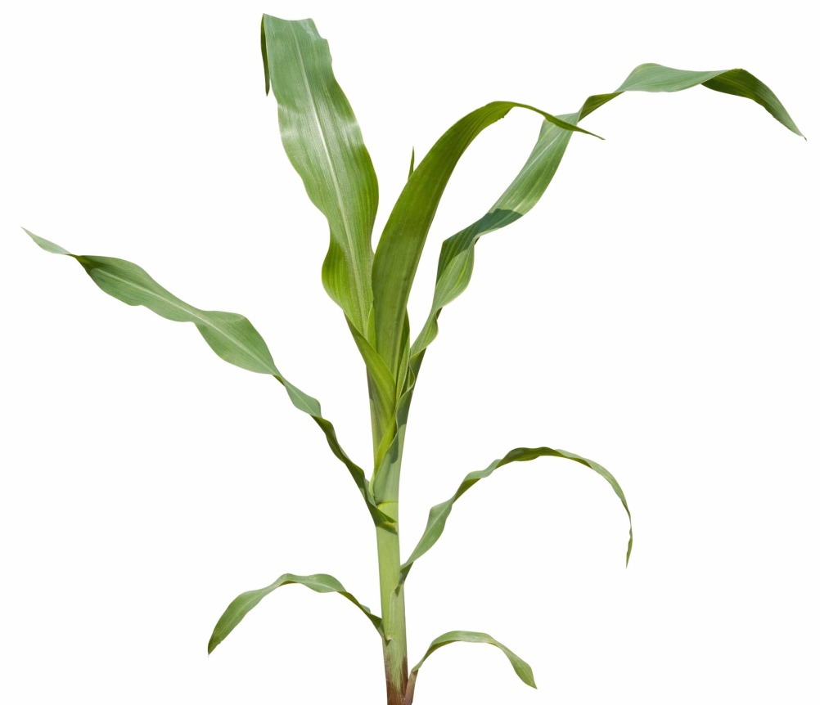
Corn
Large leaf with prominent midvein

Slide 26
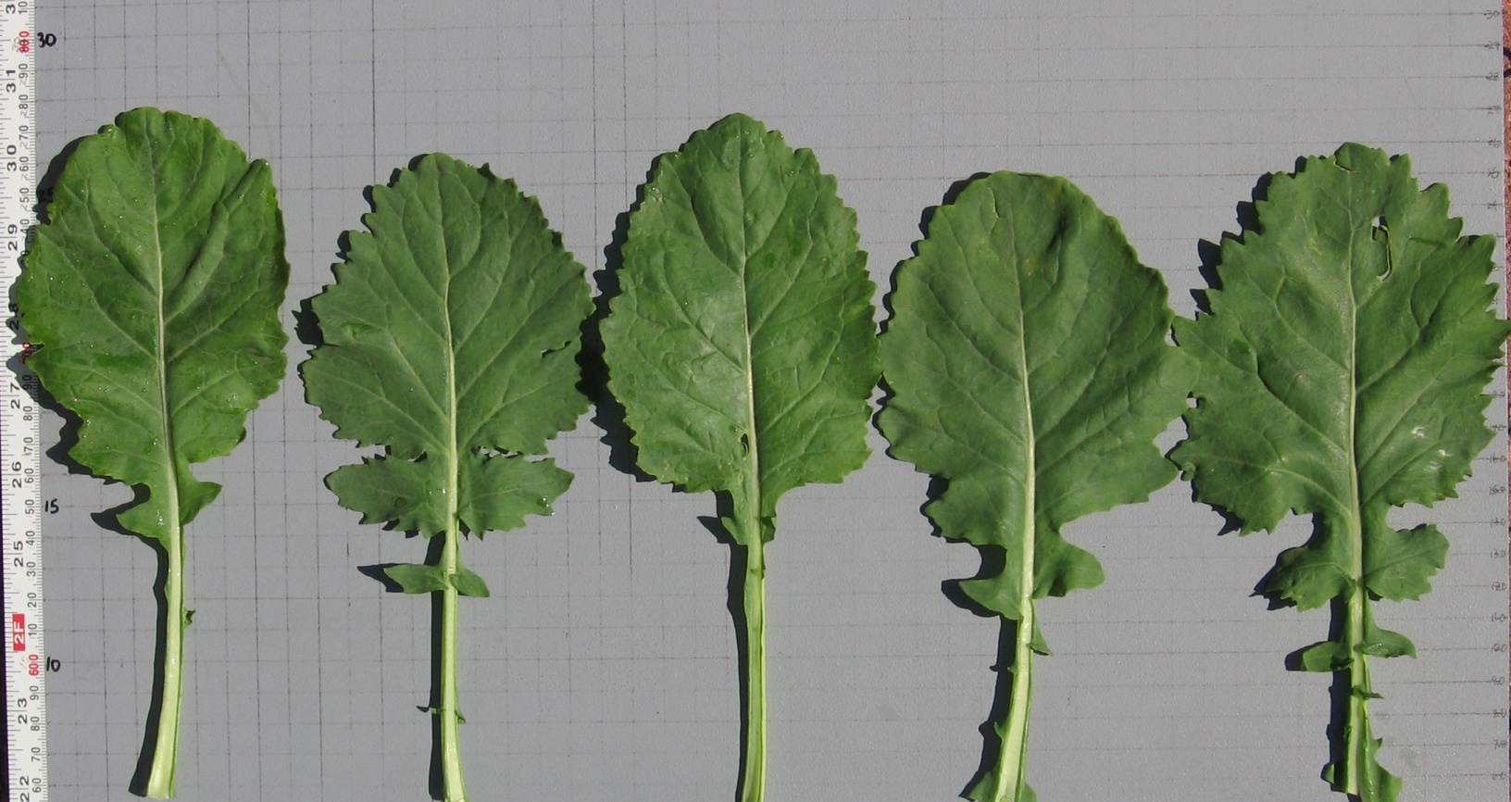
Canola
Serrated edges
Leaf tampers on the sides

