Slide 1
4-H/FFA Crops Career Development Event
2011-2015
Crop Seed Identification
Photos Courtesy of Purdue Agronomy

Slide 2
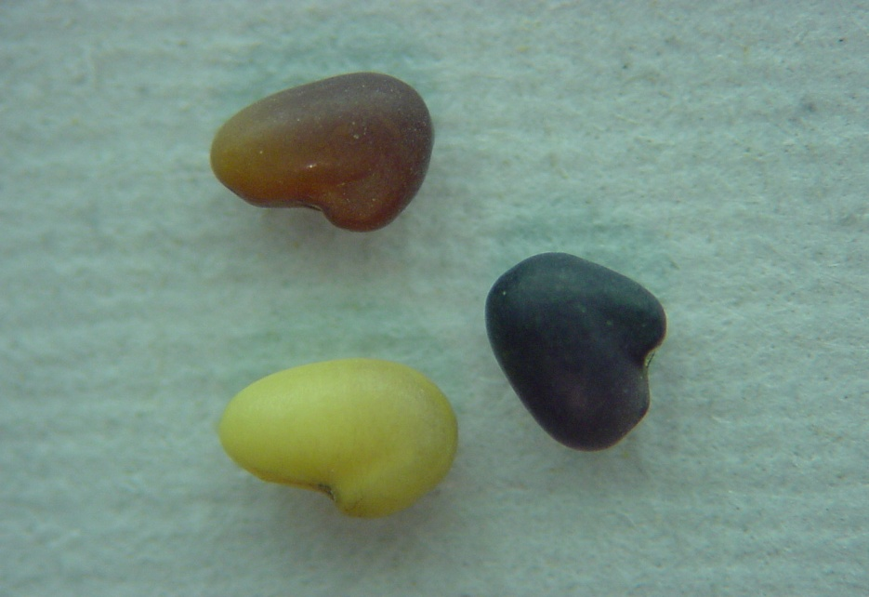
Red clover
boxing glove shape
thumb is ¼ as long as mitt
generally two colors on single seed darker on the bottom, lighter on top-green to light brown

Slide 3
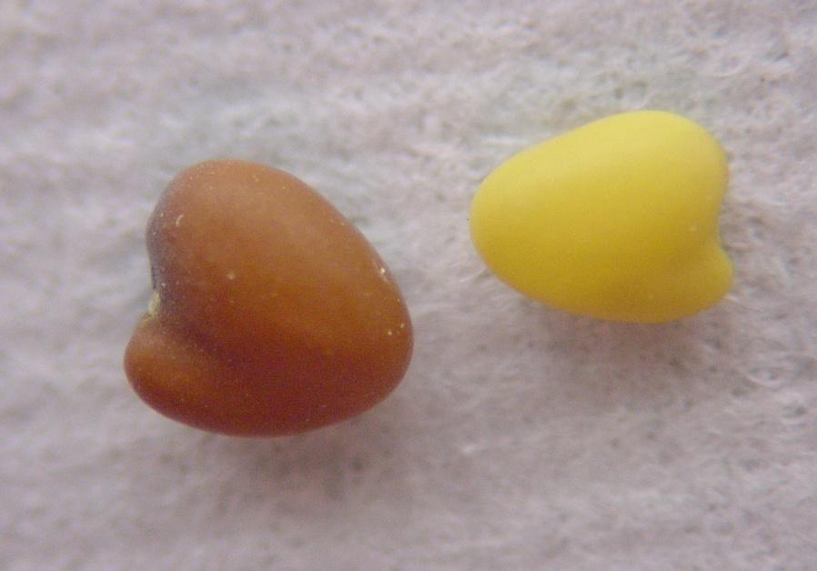
White clover
heart shaped
yellow or red seed coat

Slide 4
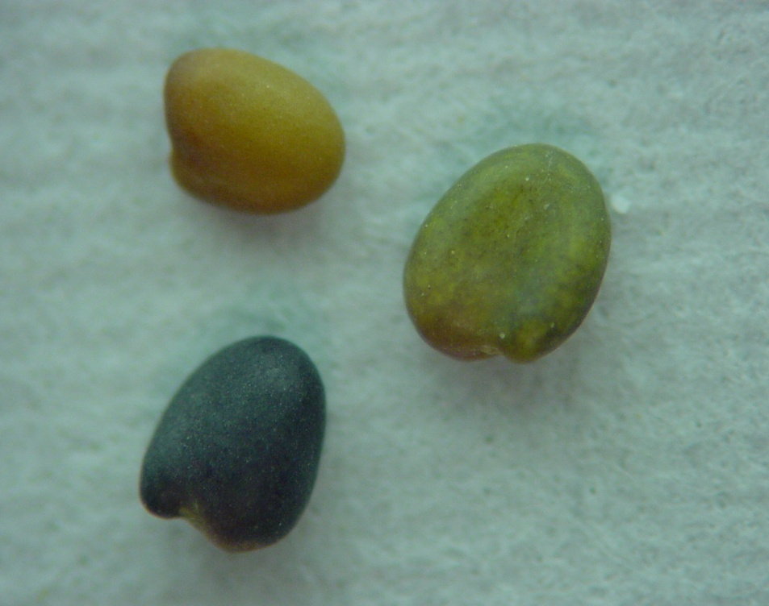
Alsike clover
seeds are heart-shaped
dark green to brown

Slide 5
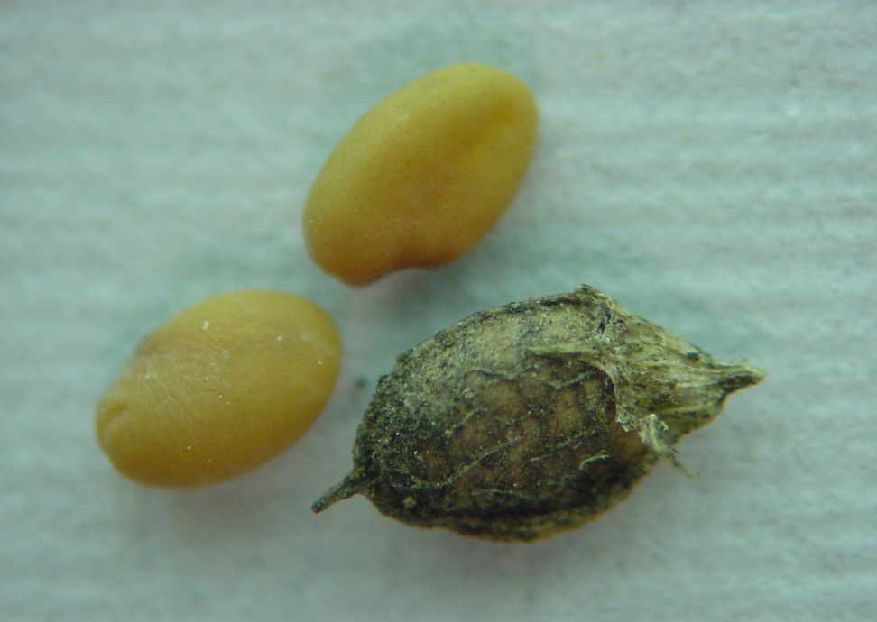
Sweetclover
shape of baseball mitt thumb is 2/3 as long as mitt

Slide 6
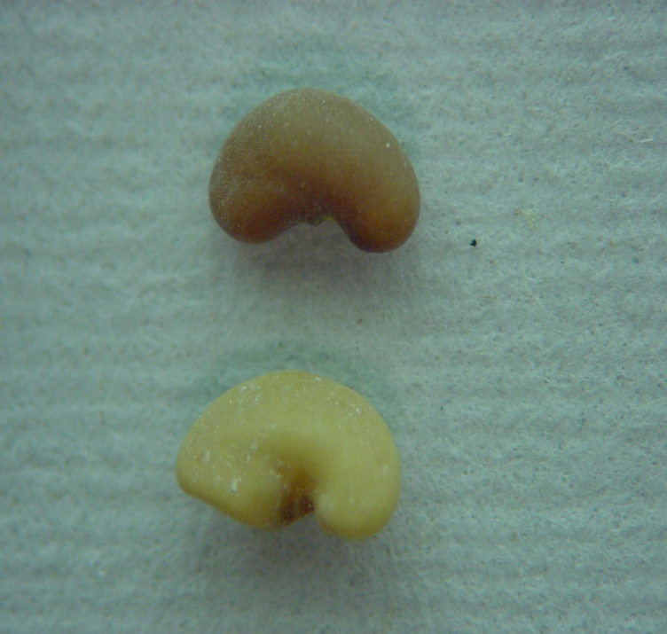
Alfalfa
smooth, kidney-shaped
yellow-green to light brown

Slide 7
Hairy vetch
dark ridge through wedge shaped hilum
Large, dark purple

Slide 8
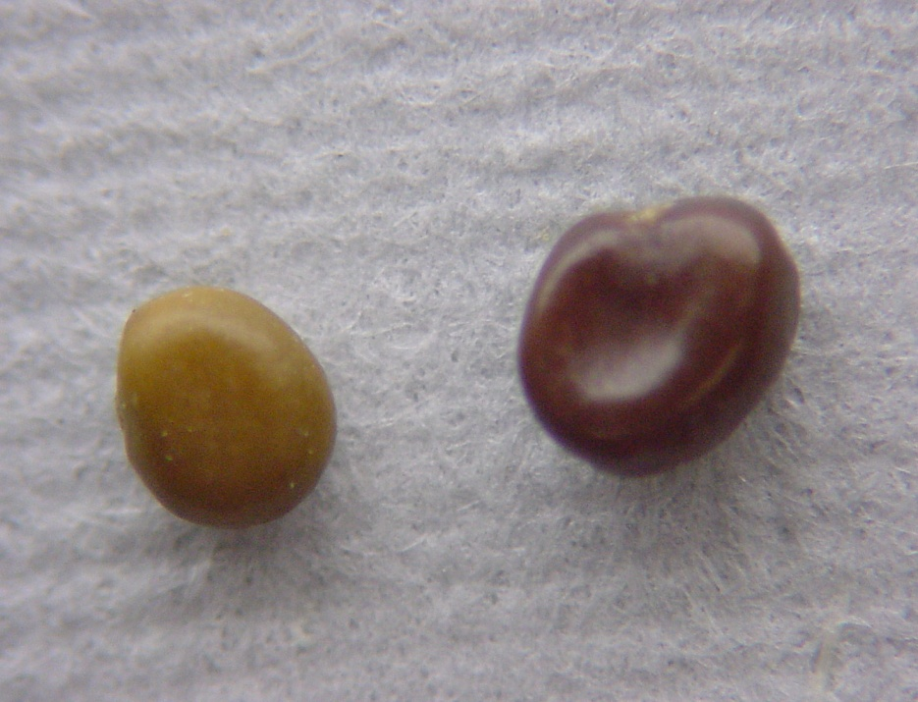
Birdsfoot trefoil
Olive to chocolate brown color
Mottle appearance
Dent in one side, “like a bird stepped in it”

Slide 9
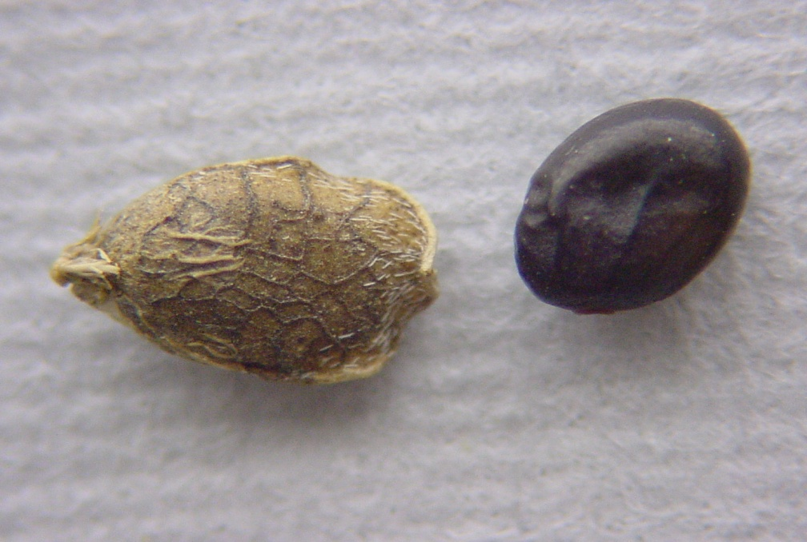
Korean lespedeza
seed is shiny, black, and oval
can see tiny veins in the seed pods

Slide 10
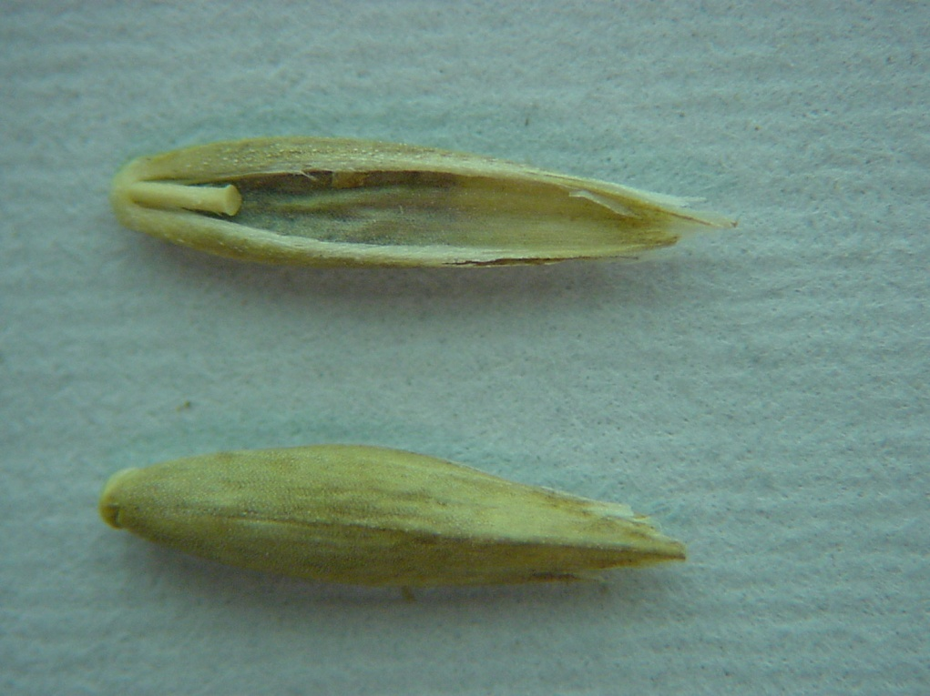
Tall fescue
same size as perennial ryegrass
dark straw-colored
rachilla is knobbed
flat seed

Slide 11
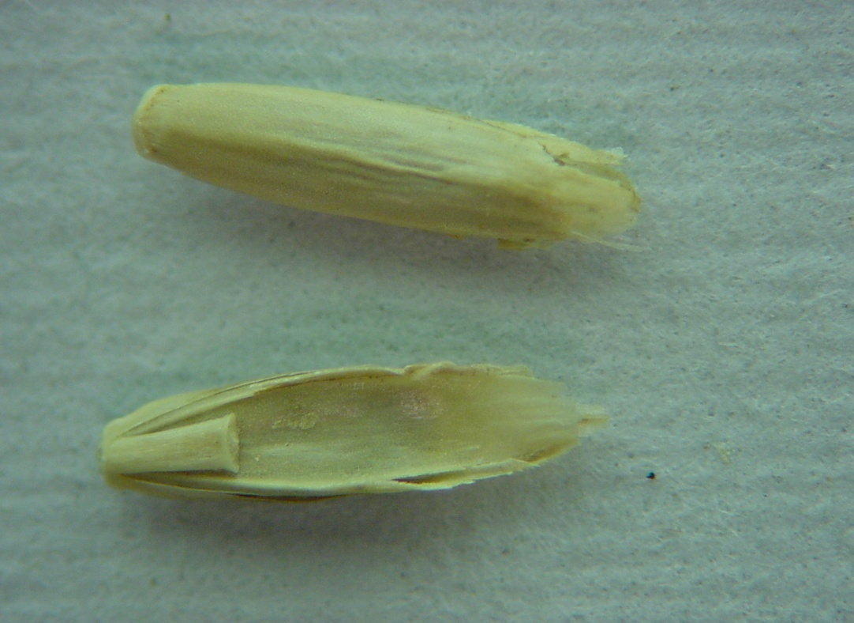
Ryegrass
tan to brown
narrow oblong
flat rachilla, flat backed
Tip is rounded

Slide 12
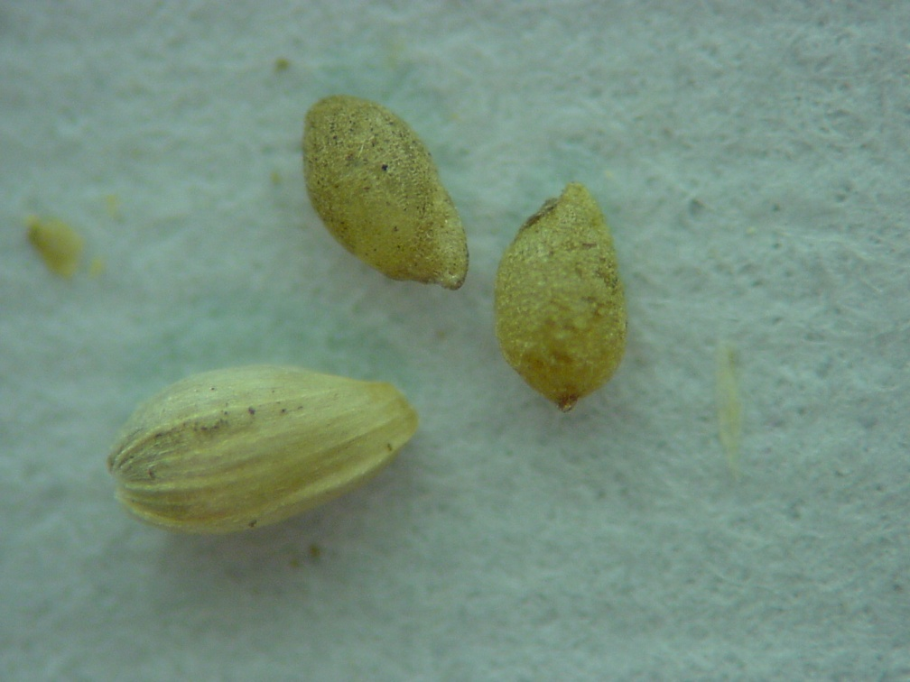
Timothy
round to oval, like a football
tan to grayish brown
tiny- maybe hulled or hulless

Slide 13
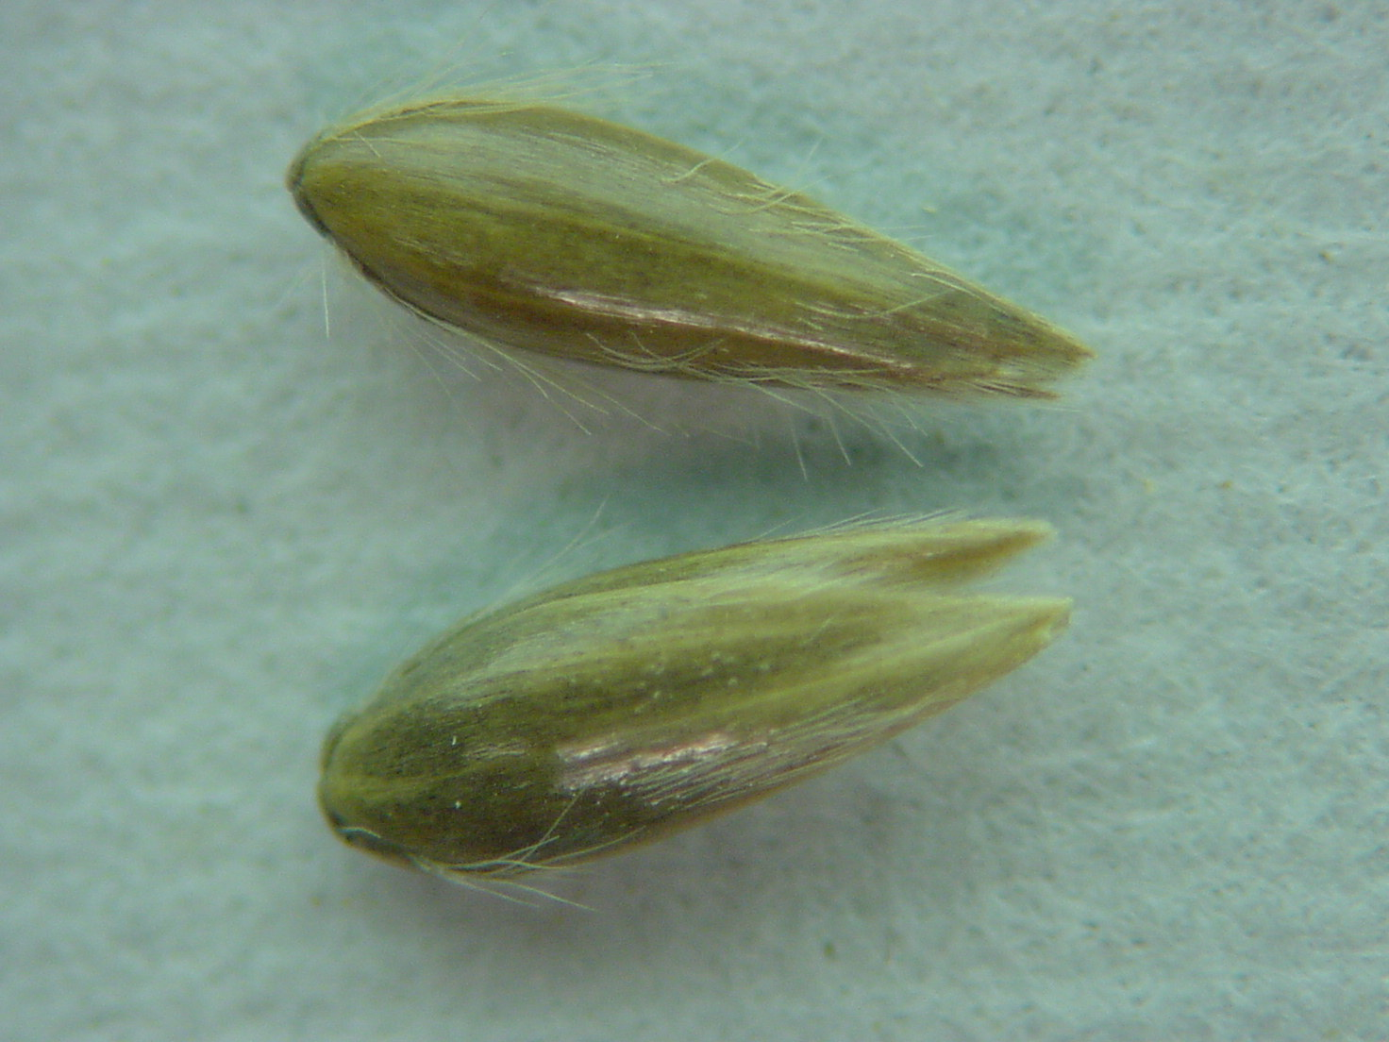
Reed canarygrass
light to dark grayish brown in color
very glossy
very sharply pointed

Slide 14
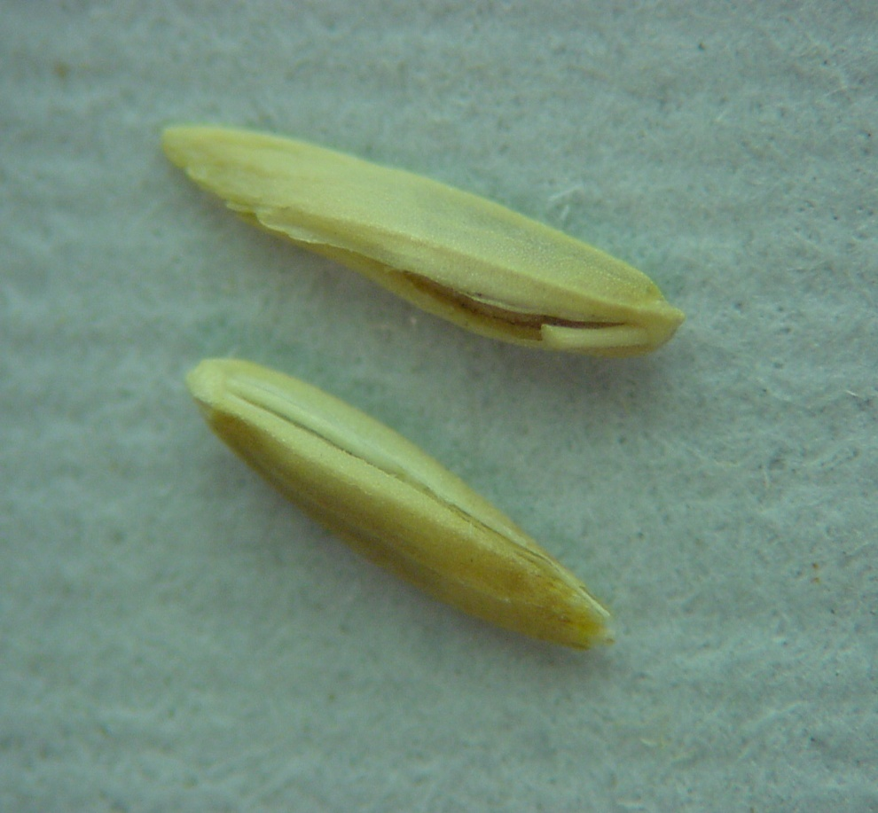
Kentucky bluegrass
dark, straw-colored
broadest point is in center

Slide 15
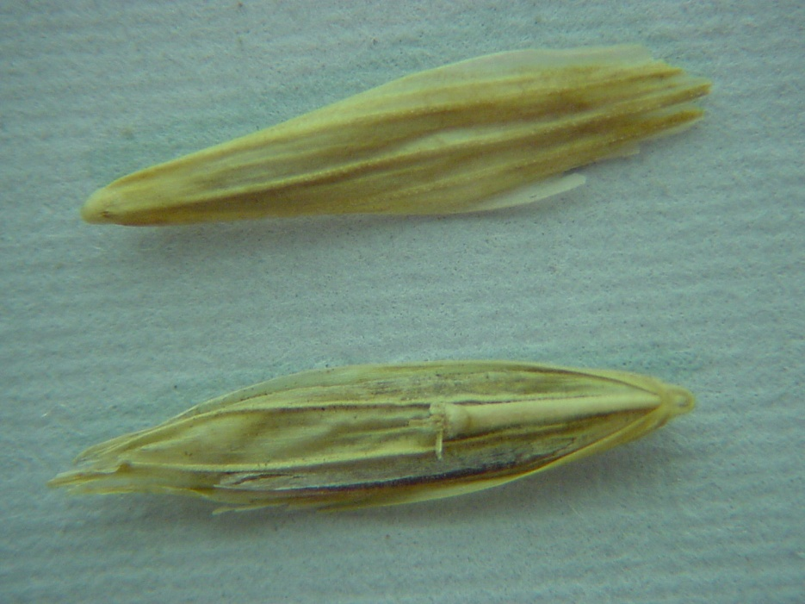
Smooth bromegrass
brown to straw colored
blunt, ragged “snowshoe” shape tip
very flat with distinct veins showing on lemma

Slide 16
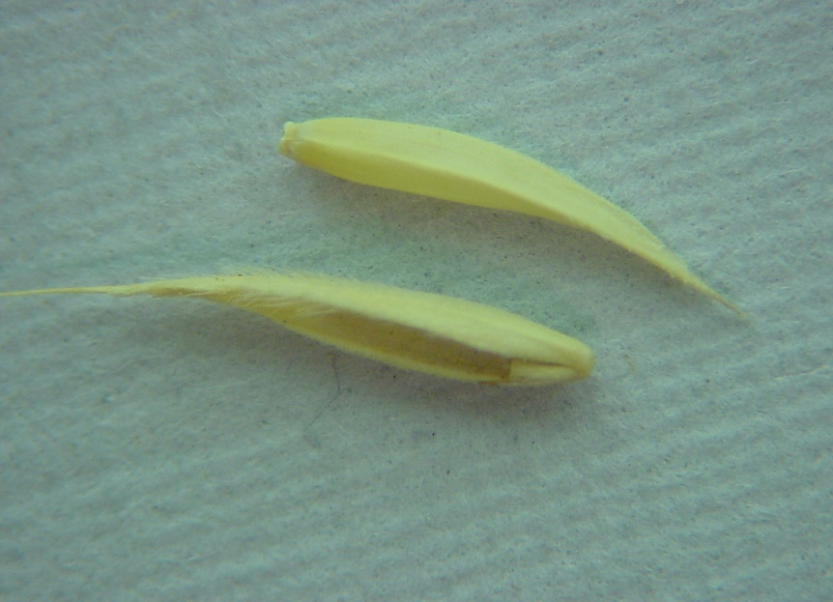
Orchardgrass
light, straw-colored
lemma ends in sharp curved point

Slide 17
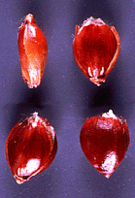
Sudangrass
elliptical, not round
tan to reddish-brown
no knobs on the rachilla

Slide 18
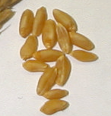
Durum wheat
long kernel
humped back
amber color and translucent

Slide 19
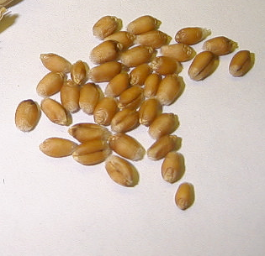
Soft red winter wheat
prominent brush
rounded cheeks
orange color

Slide 20
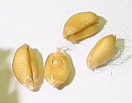
White wheat
kernel is white to cream

Slide 21
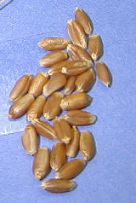
Hard red winter wheat
long, narrow kernel
narrow cheeks
dark brown color
hard vitreous

Slide 22
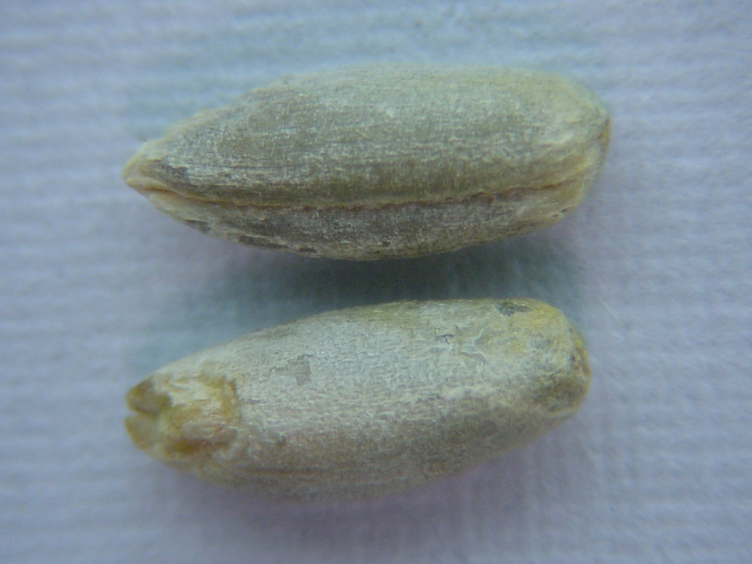
Rye
Greenish-gray in color
Long & pointed on one end
Seed coat has small scales

Slide 23
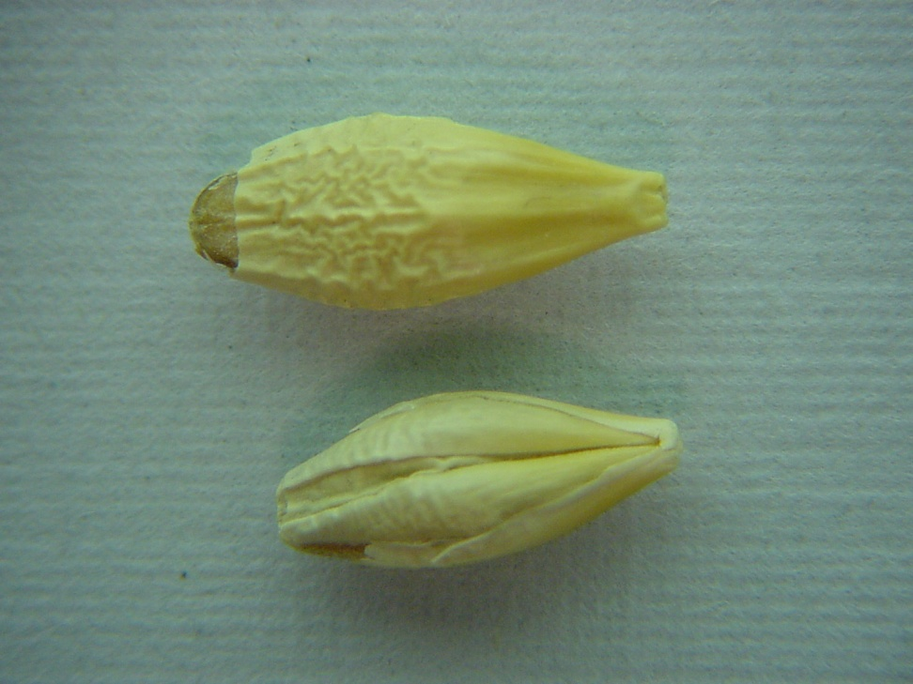
Barley
Ridge on one side
Tear-drop shaped
plump

Slide 24
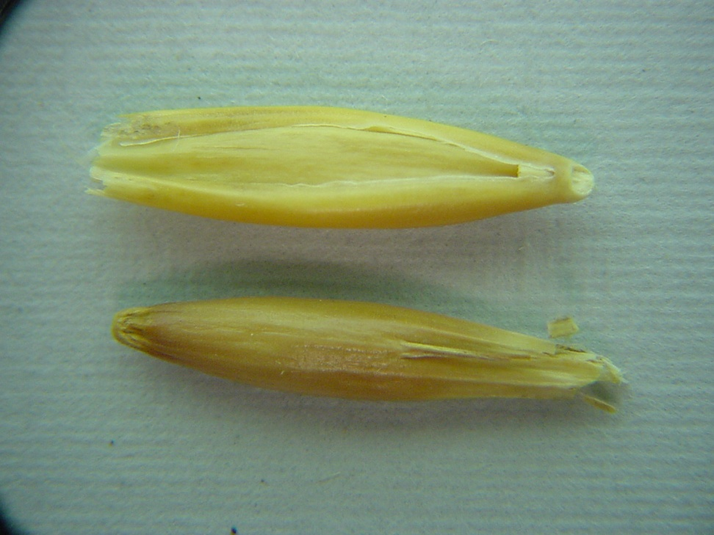
Oats
Yellow, white, or red in color

Slide 25
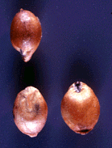
Grain sorghum
Color can range from white to dull orange
Round or oblong shaped

Slide 26
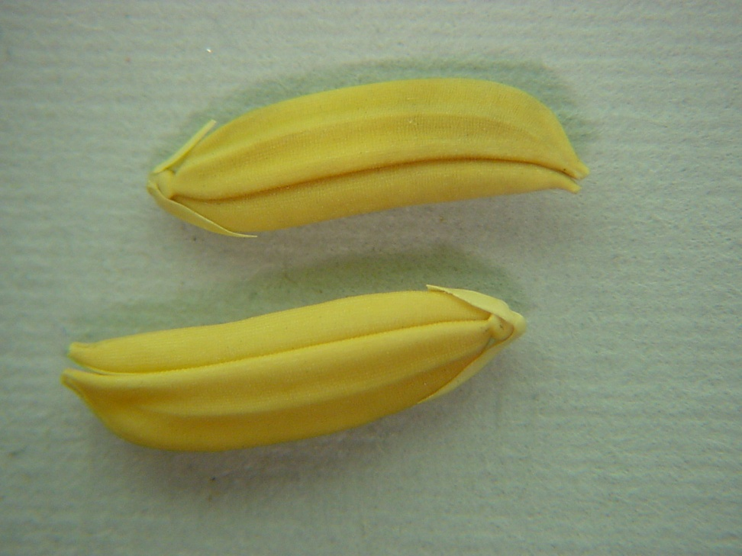
Rice
Long, narrow, and flattened
Dark yellow color
Ridges

Slide 27
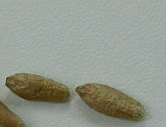
Triticale
Similar to wheat but has shriveled appearance

Slide 28
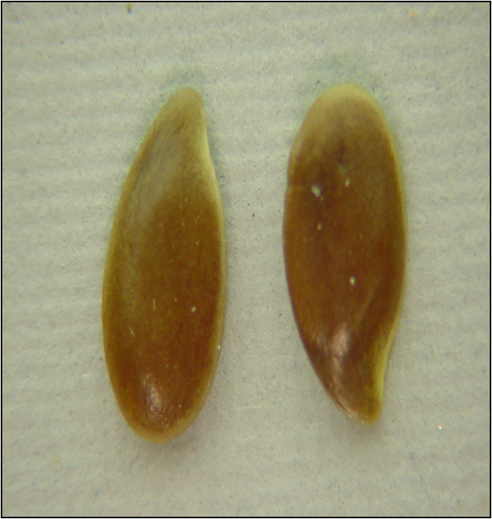
Flax
Reddish brown in color
Glossy
Tear-drop shaped
Flat

Slide 29
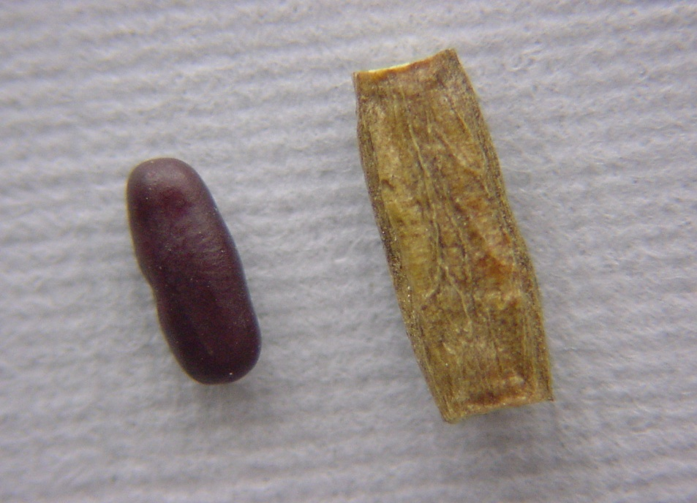
Crownvetch
reddish-brown looks like sprinkles
Hull is elongated

Slide 30
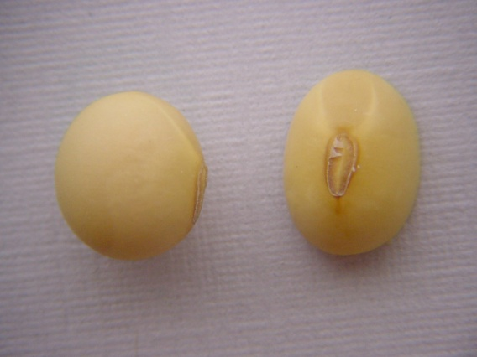
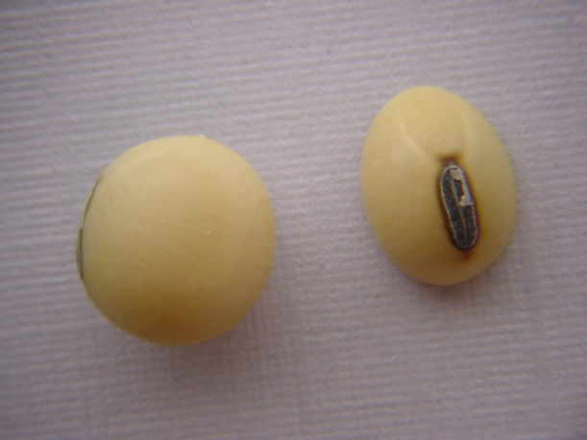
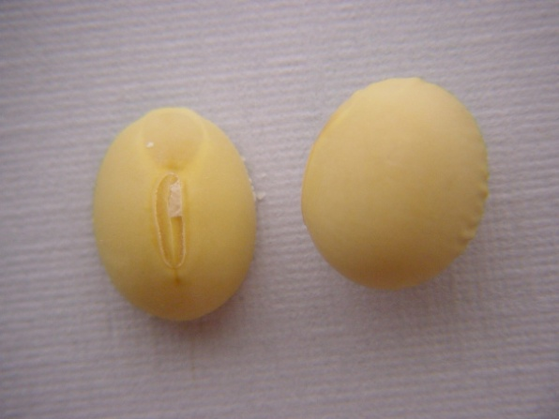
Soybean
Rounded seed, can have a variety of colored hilums

Slide 31
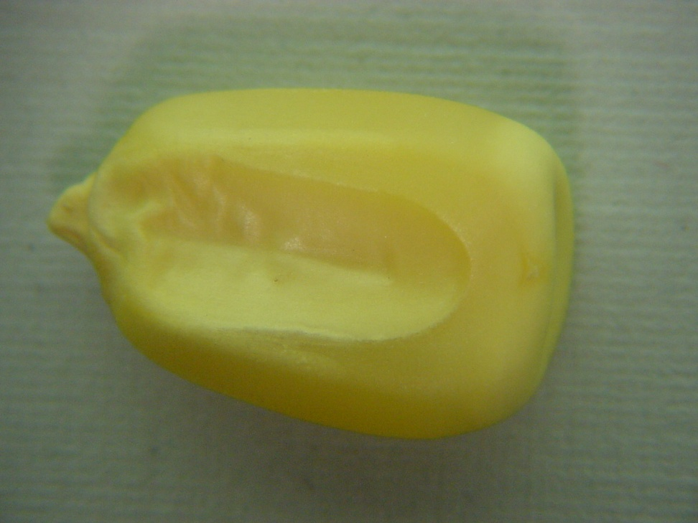
Dent corn
Yellow, white or red in color
Broad end of kernel has a dent in the top
Wedge-shaped

Slide 32
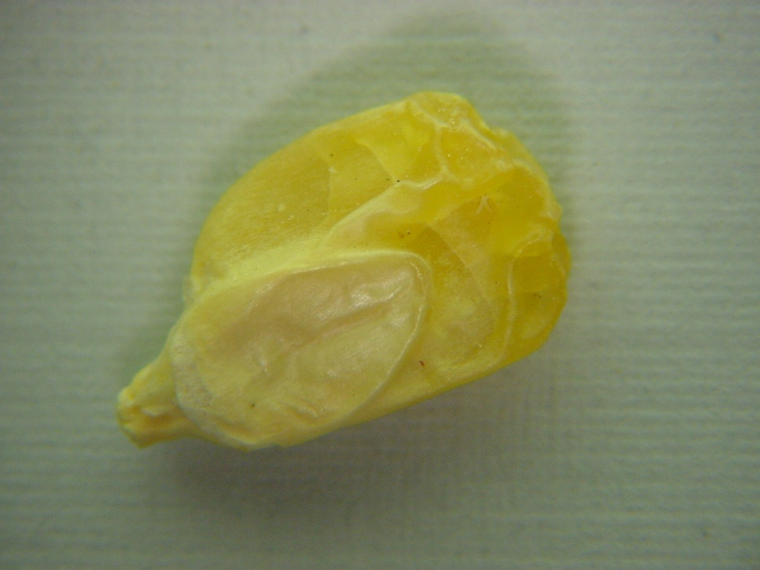
Sweet corn
Usually yellow or white in color, but can be blue
Shriveled

Slide 33
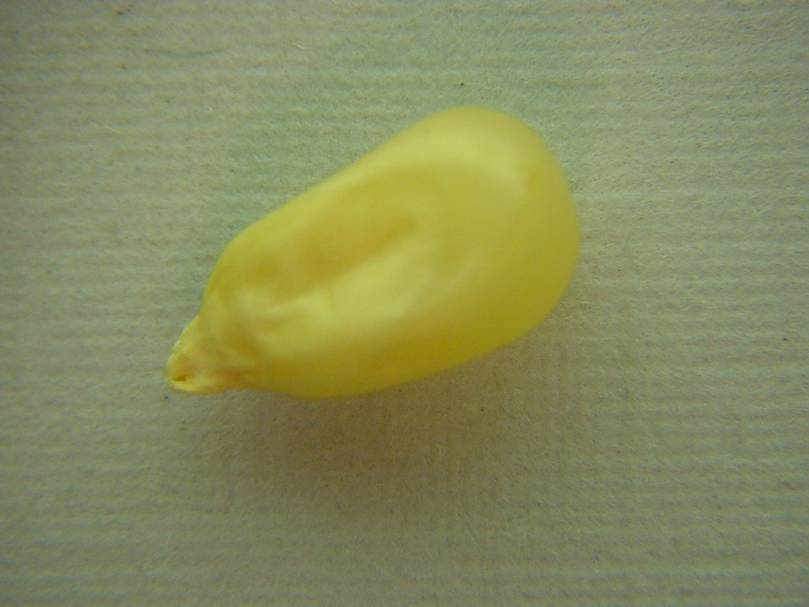
Popcorn
Various colors
Small and very hard
Hard flinty outer covering around entire kernel

Slide 34
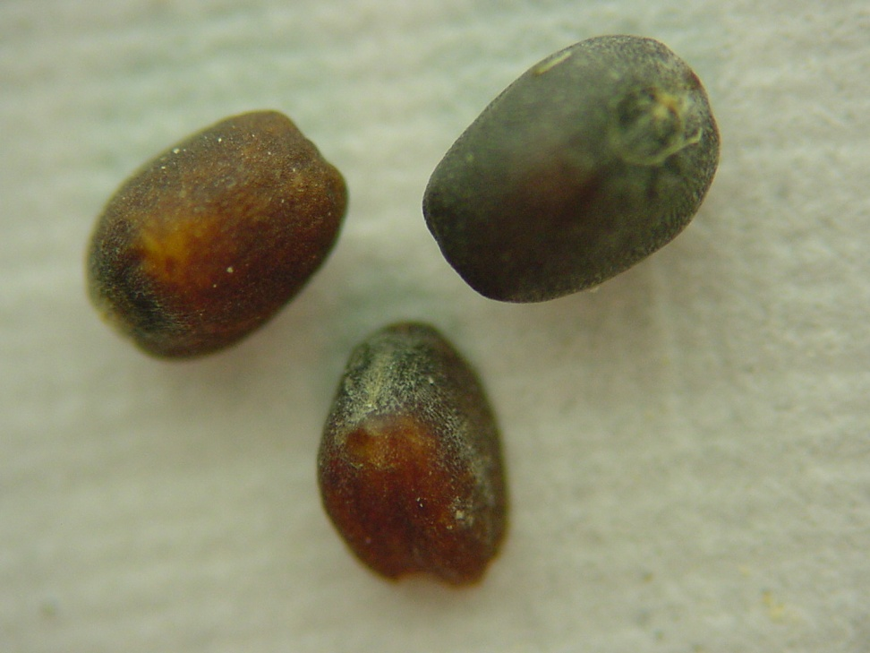
Canola
Dark brown, black, or reddish in color
Very small
Hilum has 3 ridges

