Slide 1
Bad Slides
Bill Decker, Indiana 4-H, 3/26/2025

Slide 2
Boring
White Background
Little Contrast Between Background and Words
Bullet Point
Followed By Bullet Point
Followed By Bullet Point
Followed By Bullet Point
Followed By Bullet Point………

Slide 3
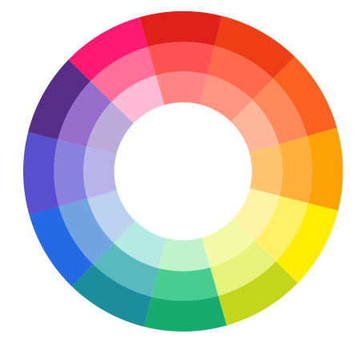
Colors
What colors complement each other?
What colors attract attention?
What colors may be difficult to read?
What color choices will help your display board communicate information best?

Slide 4
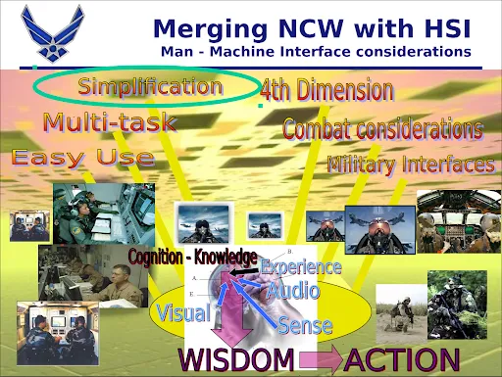
Too Much of Everything
(Photos, Words, Background)

Slide 5
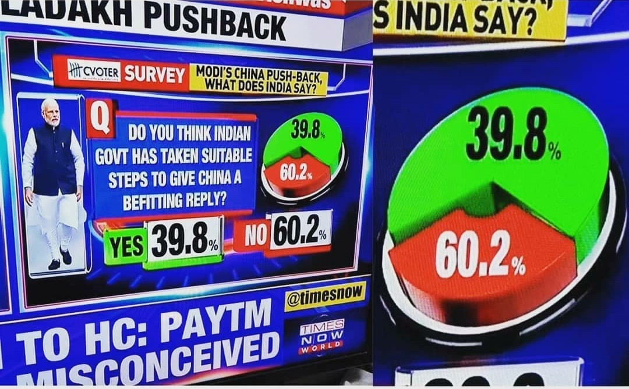
Misleading Graphic
Is 39.8 really more than 60.2?

Slide 6
Pretty Font
However it is hard to read!
George Washington Carver
  Born a Slave
  Studied to Become an Artist
  Changed College Studies to Botany
  Became America’s Most Important Agricultural Scientist

Slide 7

Font Almost Unreadable
Bad Idea to Put Writing In Front Of Most Graphics

Slide 8
Don’t Write Your Speech on the Slide!
Did you know that chocolate was once used as a currency? The ancient Maya civilization had a unique approach to currency. While they didn’t use actual coins, they exchanged items like tobacco, maize, and clothing as a form of currency. Cacao, the plant from which chocolate is made, played a significant role in their society. It was considered sacred and consumed in rituals. Surprisingly, cacao was also used as a form of currency. Traces of cacao show up in ceramics from various neighborhoods and dwellings, challenging the previous belief that its use was restricted to the elite. Researchers found the compound theophylline (which is present in cacao) on ceramic shards dating from A.D. 600 to 900. These shards came from different social contexts, including residential and ceremonial areas. Fascinating, isn’t it?

Slide 9
Don’t Write Too Much on a Slide!
Pre-European Contact and Native American Tribes: The story of Indiana begins long before European settlers arrived. Native American tribes inhabited the region as early as 8000 BC. These migratory tribes succeeded one another in dominance over several thousand years. During the Mississippian culture, which reached its peak around 1000 AD, the region saw significant development. These indigenous peoples built complex societies, with large earthen mounds, extensive trade networks, and sophisticated agricultural practices.
European Exploration and Statehood: In the 1670s, the first Europeans arrived in Indiana, claiming the territory for the Kingdom of France. However, little settlement occurred during the French rule. After the French and Indian War (also known as the Seven Years’ War), Great Britain took control of the land east of the Mississippi River. For over two decades, British rule persisted until the American Revolutionary War. Following Britain’s defeat, the entire trans-Allegheny region, including present-day Indiana, was ceded to the newly formed United States. Indiana Territory was established in 1800 and gradually developed. By December 11, 1816, it became the nineteenth state in the Union. The state founders embarked on an ambitious plan to transform Indiana from a frontier segment into a thriving state, leading to the construction of roads, canals, railroads, and state-funded public schools.

Slide 10
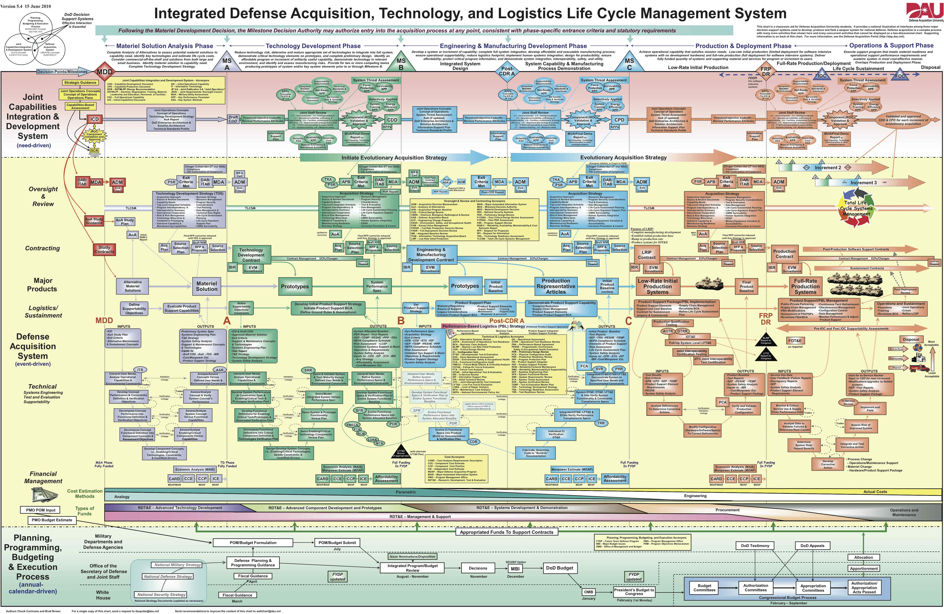
Too Much Data!

Slide 11
Run Spell Check!
If you mistspell your wrds nobuddy will tke you serrioussly.

Slide 12
Bad Colors and Annoying Animation
This is an Example
Of a Color Scheme That Looks Bad
And Animations That Annoy Your Audience.

Slide 13
Hints
Test your presentation before the show.
Have a print of your presentation ready, in case your technology fails.
Don’t read your presentation off the slide.

Slide 14
Hints
Look at the audience.
Proof your slides!
Cite sources on the slide or on the last slide.
Keep your presentation simple and clean.

Slide 15
Thank You

