Slide 1

Designing Your Slides: The Good and The Bad!
© 2023 The Henry Ford
creativecommons.com

Slide 2
Before You Start, Think of This!

Slide 3
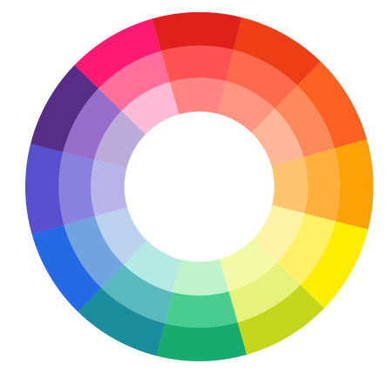
Colors
What colors complement each other?
What colors attract attention?
What colors may be difficult to read?

Slide 4
Can They See My Slide? (Font Size)
Can They See My Slide? (10 Point)
Can They See My Slide? (20 Point)
Can They See My Slide? (30 Point)
Can They See My Slide? (40 Point)
Can They See My Slide? (50 Point)

Slide 5
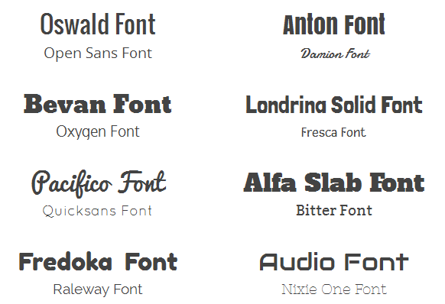
Font Styles
Which fonts work for titles?
Which fonts work for sentences?
Which fonts don't work?

Slide 6
Good
Examples

Slide 7

International Fashion
By: Mirjam Nilsson​

Slide 8

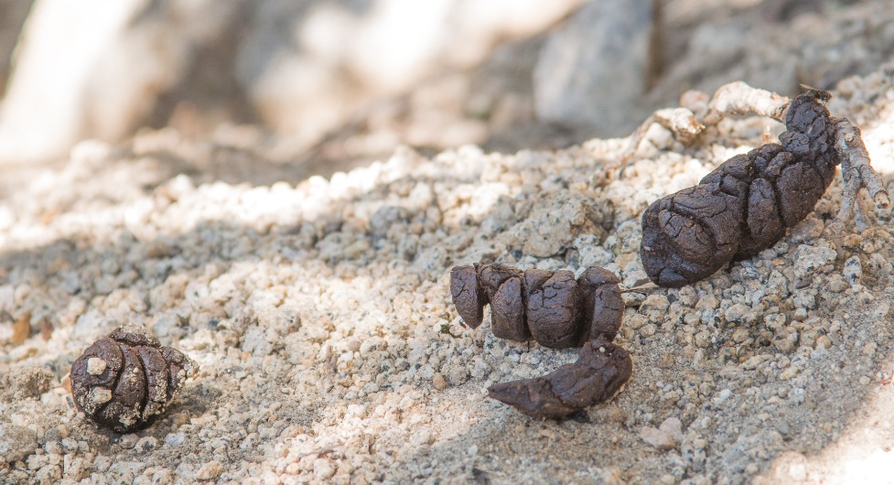
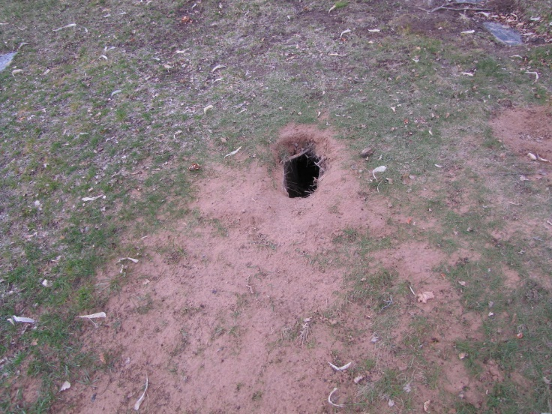
Does A Fox Live Near You?
Clues:
Tracks
Scat
Dens
This Photo by Unknown Author is licensed under CC BY-SA

Slide 9
Safe lab practices
The three Cs of lab safety
Careful conduct
Correct equipment
Chemical awareness

Slide 10
Bad Slides

Slide 11
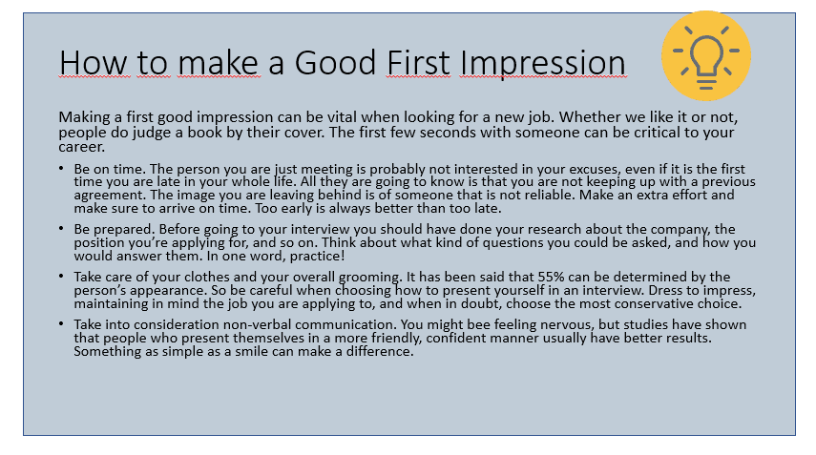
Overcrowded Slide
Tell Me Why This Is Bad?

Slide 12

You Tell Me…

Slide 13

Tell Me…

Slide 14
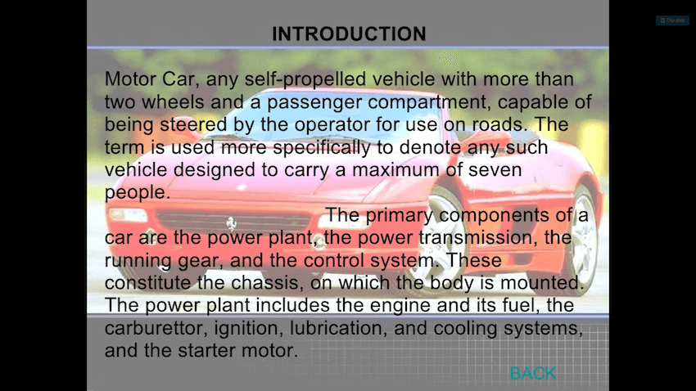
Tell Me…

Slide 15
Hints
Test your presentation before the show.
Have written notes ready!
Don’t “read” your presentation off the slide!!!!!!!!!!!

Slide 16
Hints
Look at the audience.
Proof your slides!
Cite sources.
Keep your presentation simple and clean.

