Slide 1
It Is On The Internet
So, it must be true!

Slide 2
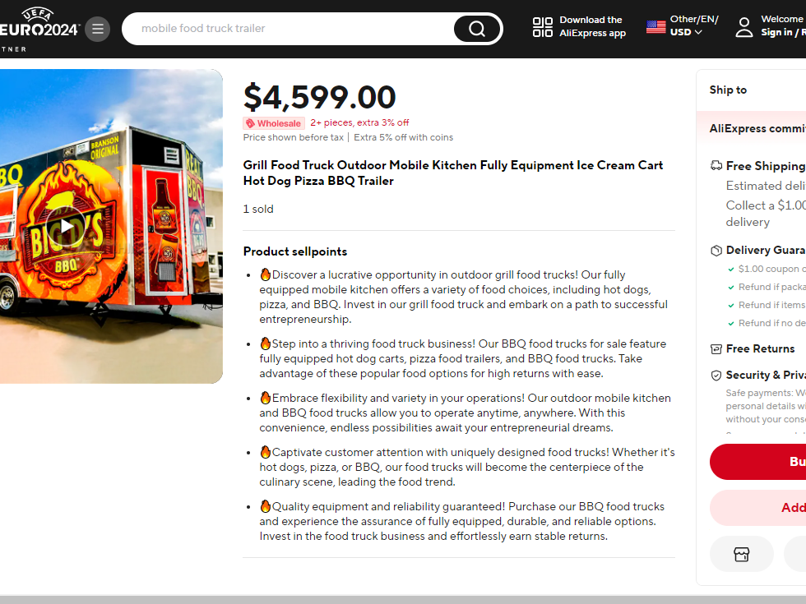
Title, Franklin Gothic Italic 40
A New Mobile Kitchen Only $4,599!

Slide 3
Ok….Some Questions That Need To Be Asked
What Site Did I Find This On?
  AliExpress, China
  It Does More Sales Than Amazon!
  Anyone Can Sell On Site!
  AliExpress Does Not Background Check

Slide 4

Is ThIs This Too Good To Be True?
The average mobile food kitchen costs between $50,000 and $180,000
  This Offer: $4,599
The average cost to ship a 20-foot container from China to the US is $2,000.
  This Offer: Free Shipping
The average time for a container to arrive from China, 30-40 days.
  This Offer: Delivery in 9 Days

Slide 5


OK…I’m Starting To Worry!
Let’s Use Google “Find Image Source” To See If This Appears Anyplace Else On The Internet.
Wow! Same Trailer, ONLY $2,399, from another dealer on AliExpress

Slide 6

HEY, Wait a Minute!
There is a company in Virginia who claims to make custom mobile restaurants…and here is a picture of one they made a few years ago.

Slide 7
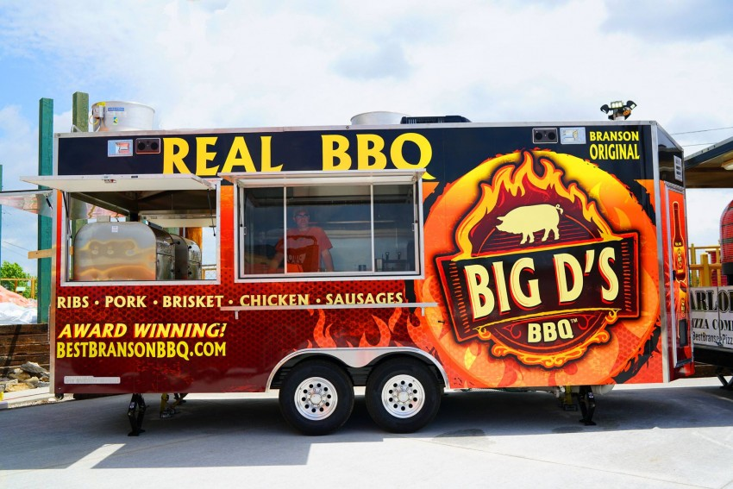
Here is that Same Trailer
Being used by the owner, who had the company in Virginia make it custom. “Custom” would seem to mean, only one exists.

Slide 8
So…What do You Think?
A. I should buy the Chinese mobile kitchen for $4,599.
B. I should buy the Chinese mobile kitchen for the better price of $2,399
C. I should get as far away from this deal as possible…it is a rip-off!

Slide 9
Thank You

