Slide 1

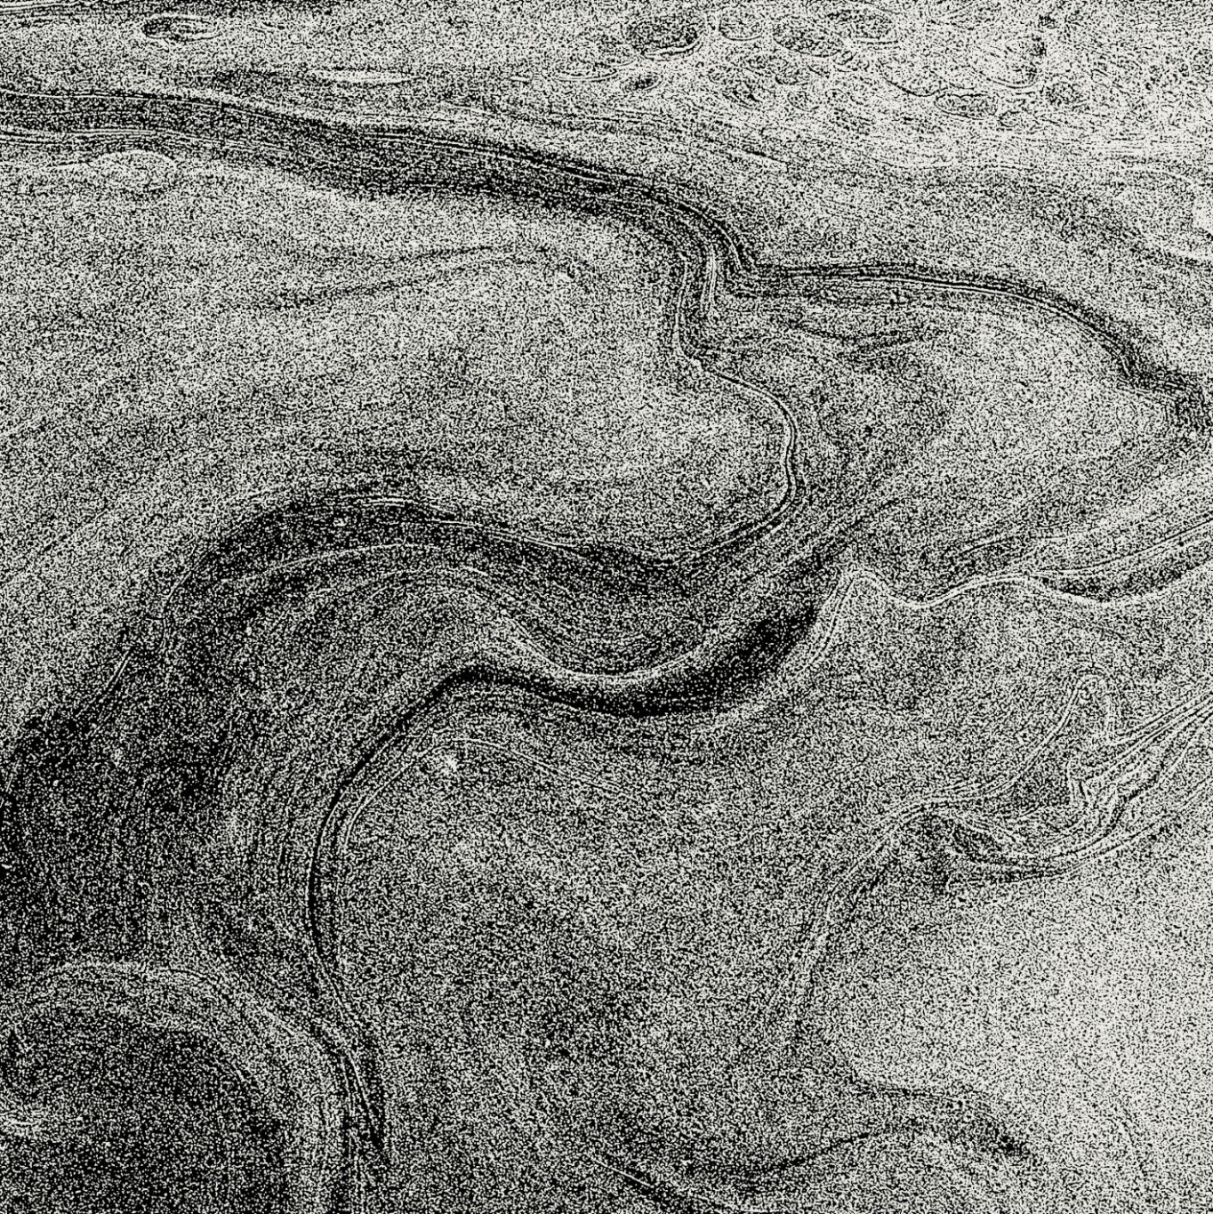
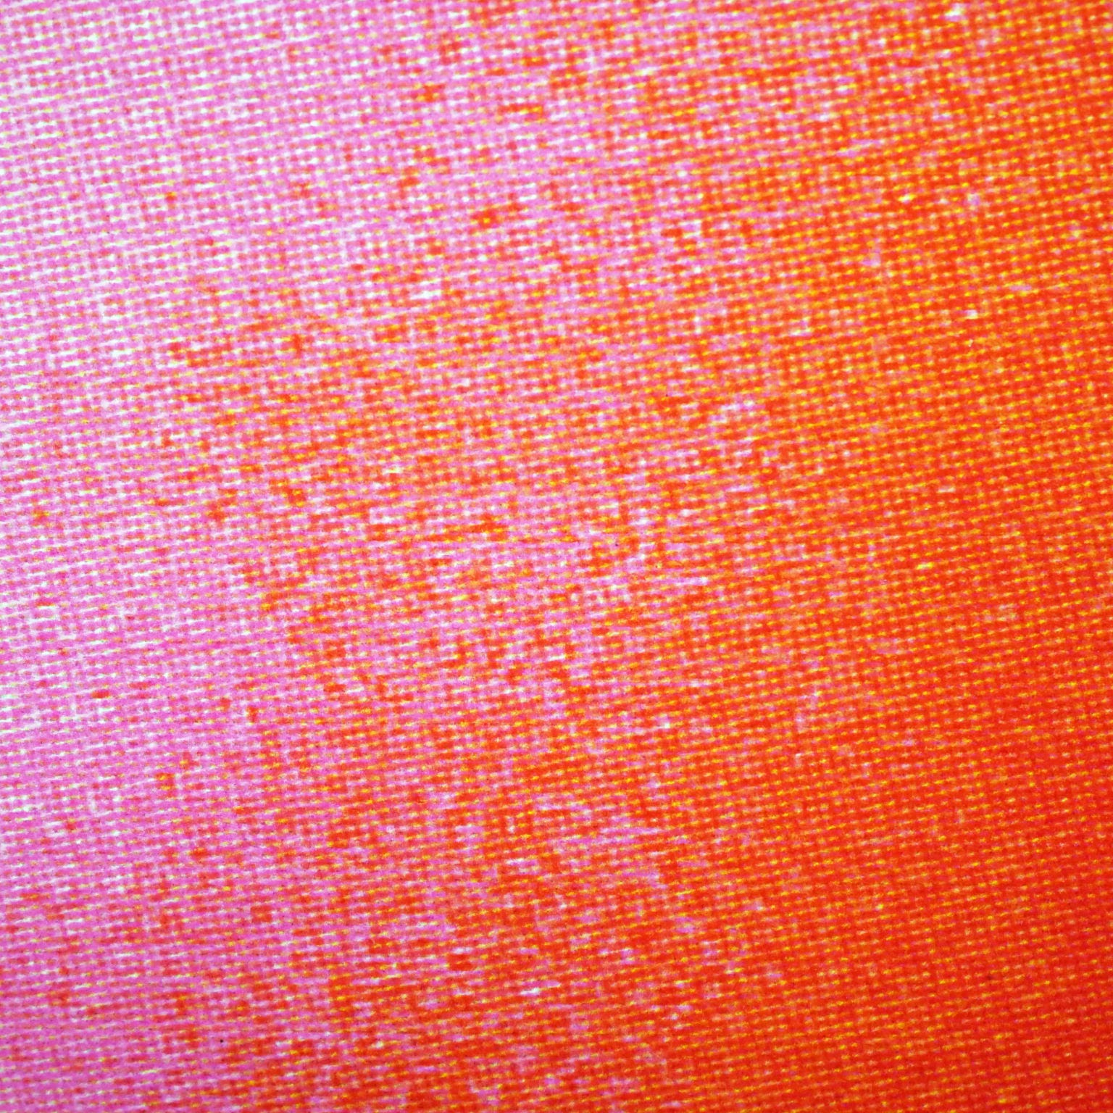
Minerals RocK!
ALEXIS VIDAL

Slide 2
Sources/Works Cited
Klein, C., & Dutrow, B. (2007). The manual of mineral science (23rd ed.). John Wiley & Sons.
Perkins, D. (2019). Mineralogy. Pearson.
Nesse, W. D. (2012). Introduction to mineralogy (2nd ed.). Oxford University Press.

