Slide 1
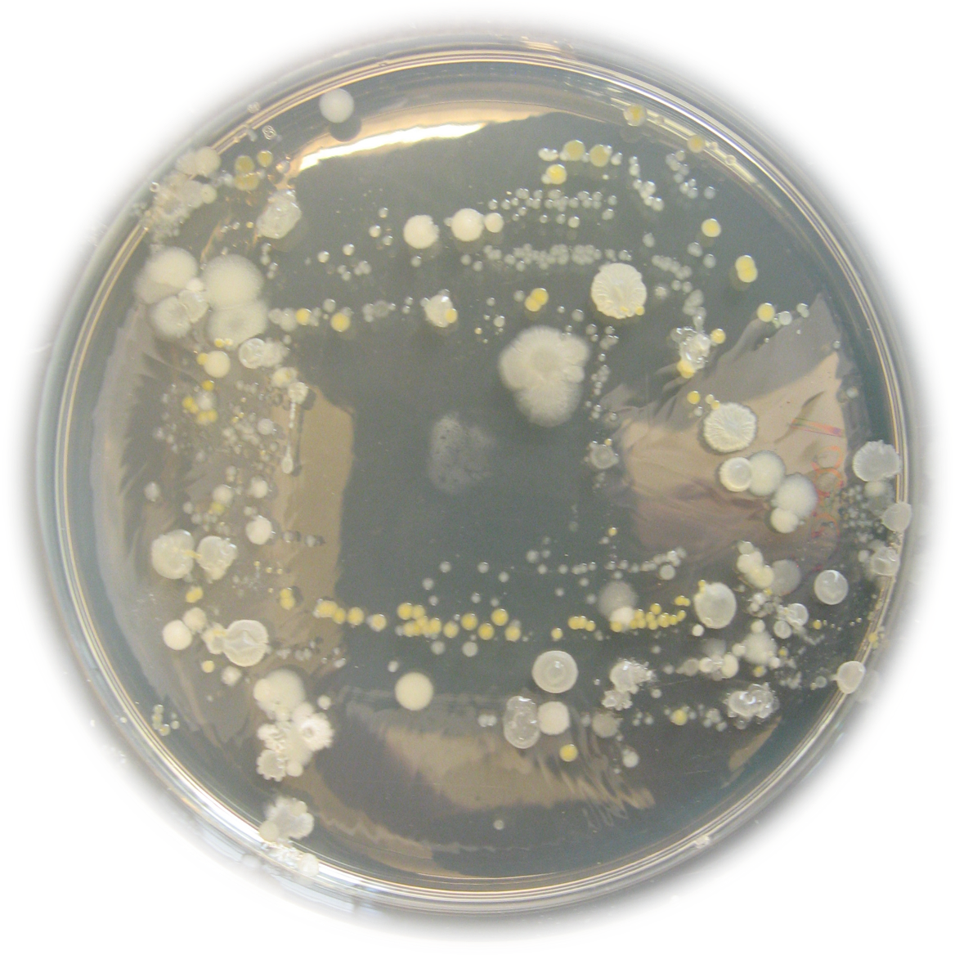
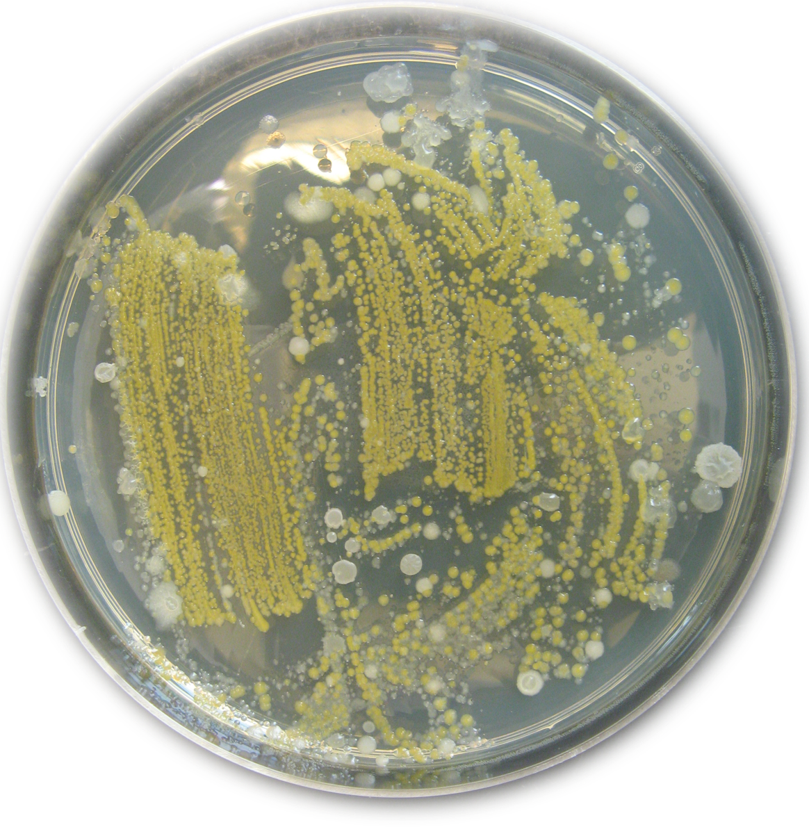
What’s That Growing On My Spinach?
Did you know:
A spinach leaf from the grocery store has between 100,000 and 10,000,000 bacteria on it.
An average human has 100,000,000,000,000 bacteria on or in their body.
Almost always the bacteria found on fresh produce are harmless to humans, but can cause decay of the produce.
Bagged salads usually have 10 to 100 times fewer bacteria on them compared to commodity greens.
Remember to keep fresh produce away from raw meats that are more likely to have harmful bacteria!
Always wash your produce to remove as many bacteria as possible (just in case).
1

Slide 2
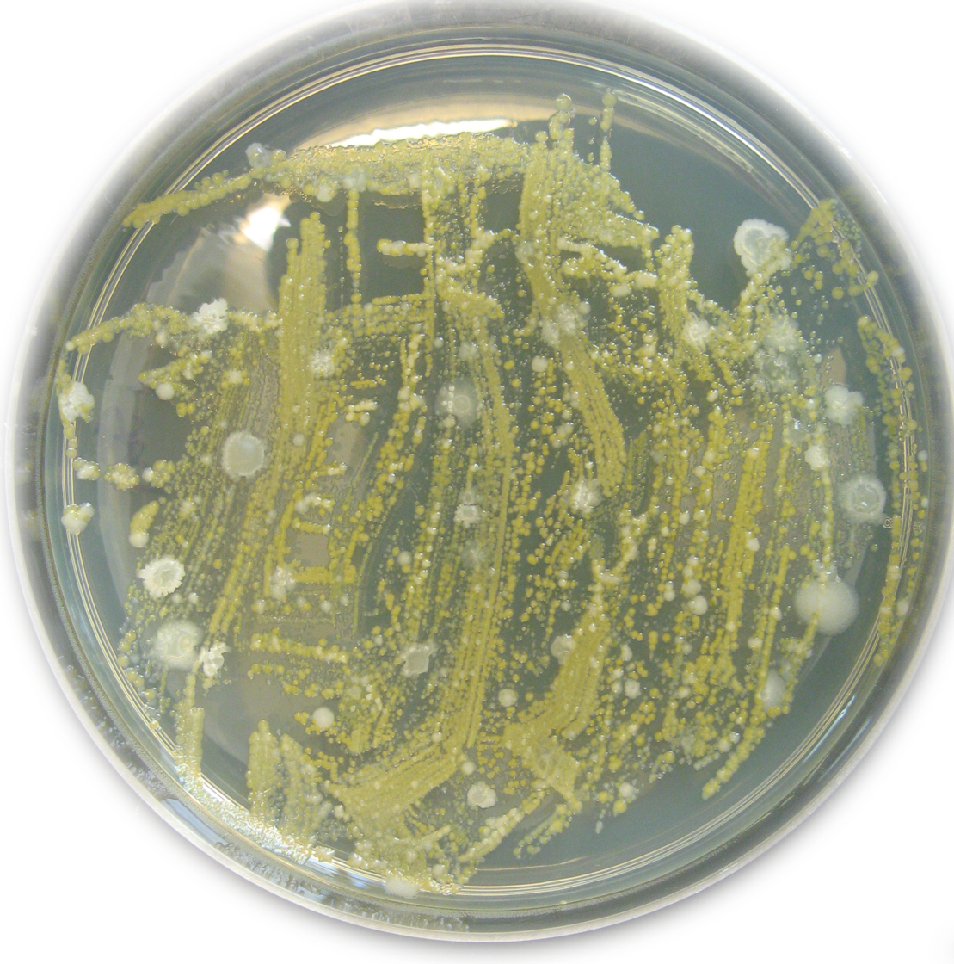
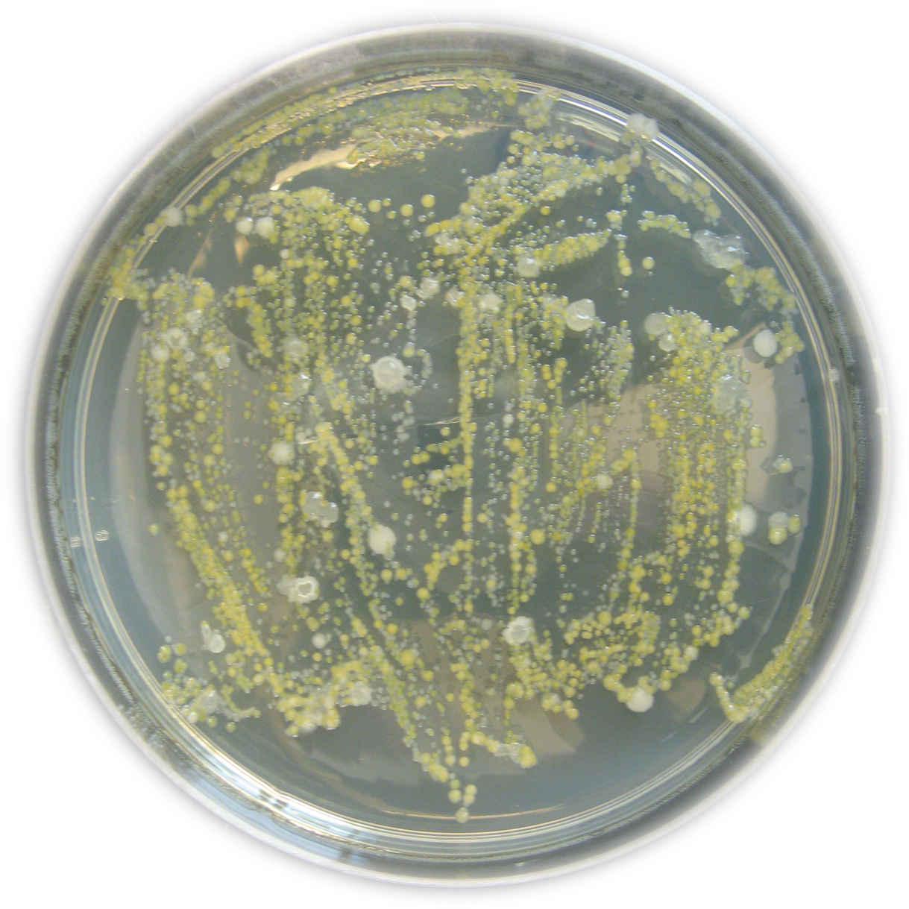
What’s That Growing On My Spinach?
Most bacteria are on the outside of the leaves, but some are inside and can’t be washed off.
Grow your own!
Get a spinach leaf and a petri dish from one of the volunteers
Holding the spinach leaf by the stem, streak it lightly across the surface of the media in the dish
Have a volunteer seal the dish for you
Take it home and see what grows!
Bacteria found on plants are there naturally during the entire time the plant is growing.
We have naturally occurring bacteria on our skin and outside surfaces of our bodies just like plants do!
2

