Slide 1
4-H/FFA Crops Career Development Event 2011-2015
Insect Identification
Photos Courtesy of Google Images

Slide 2
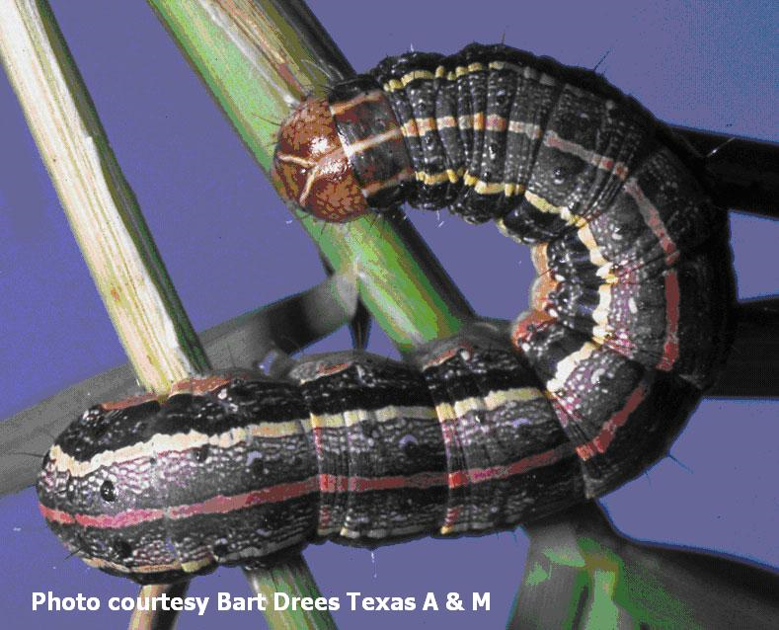
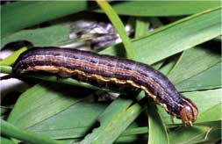
Army Worm
Sleek body with small head
Brown net-like pattern on head
Broad, dark band along top of body
Body varies from brownish to dark green with alternating and contrasting stripes

Slide 3
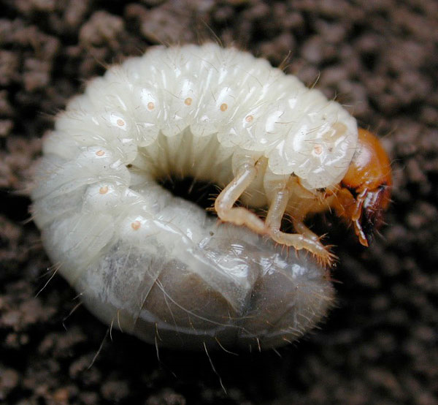
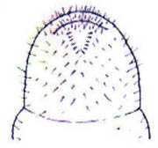
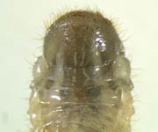
Japanese Beetle
Grub
White, C-shaped with 6 legs
2.5 cm in length
Hair forms distinctive V-shape on hind end of abdomen

Slide 4
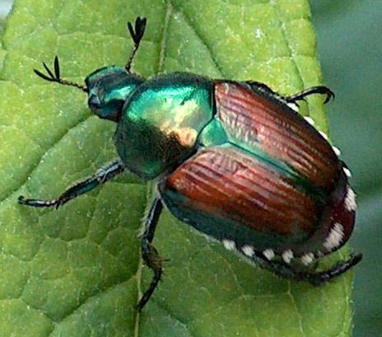
Japanese Beetle
Adult
Metallic green with coppery-brown wing covers
Whitish hair patches along sides
Oval shaped

Slide 5
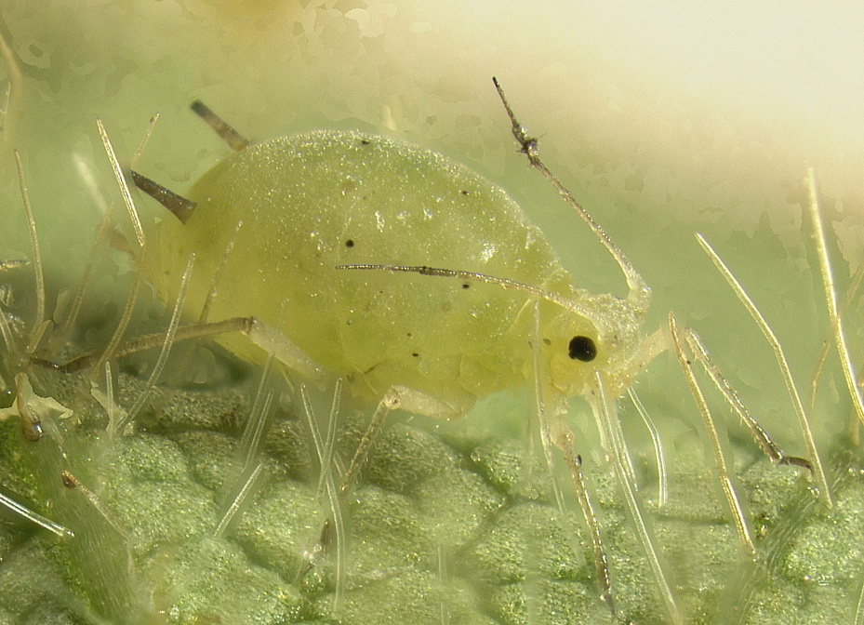
Soybean Aphid
Piercing-sucking mouth parts
1/16th inch, pear shaped body
Bright yellow to green with dark tips on the cornicles
May be winged or wingless
Cornicles

Slide 6
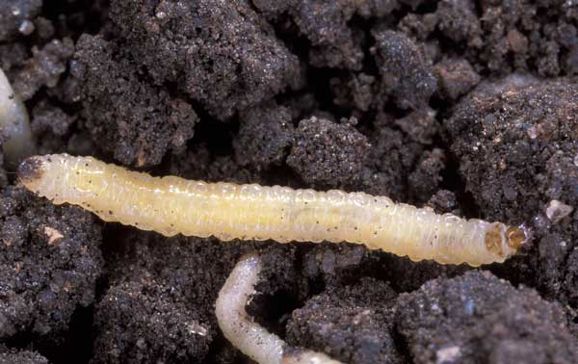
Western Corn Rootworm
Larvae
White worms less than 1/8 inch long
Brown heads and brown markings on the top last abdominal segment

Slide 7
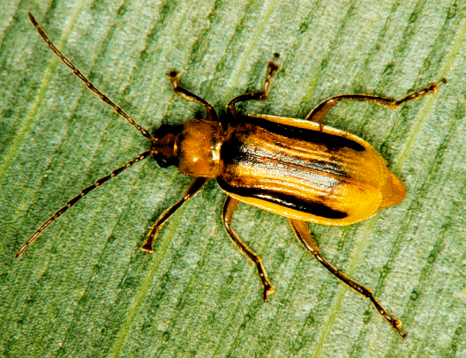
Western Corn Rootworm
Adult
¼ inch long
Yellowish with a black stripe on each wing cover

Slide 8
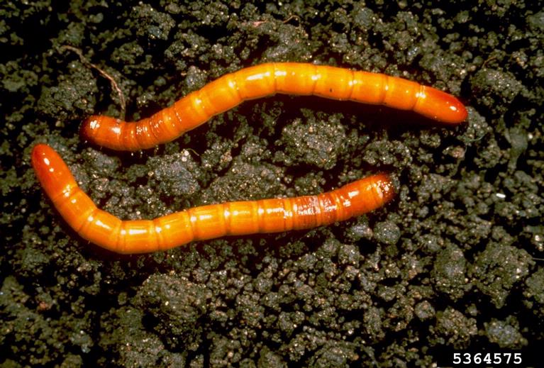
Wireworms
Hard bodied worm
Ranges from yellowish brown to orange

