Slide 1
Schemes, Scams, and Ploys
Deconstructing the Hoax
Adapted from LifeSmarts by the National Consumers League

Slide 2
First Comes the Scheme
The grand plot to take your money.
Notes:
Intrigue, deception, and things not as they appear are the basis of fraud. Since the beginning of mankind con artists have convinced unsuspecting victims to deny reality.

Slide 3
scheme (skēme) n.
a plan, design, or program of action
to be followed; project
an underhand plot; intrigue
http://dictionary.reference.com
Notes:
Intrigue, deception, and things not as they appear are the basis of fraud. Since the beginning of mankind con artists have convinced unsuspecting victims to deny reality.

Slide 4
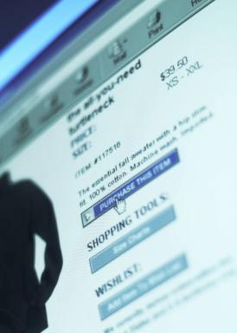
Act One: Make Contact with the Victim
Mail and email
Phone
Web sites
Social networking sites
Advertising
Want ads
Notes:
Con artists are looking for people who will trust them. They establish contact with their victims any way they can. These are a few ways, but there are many more. Scammers groom victims by going where the potential victims are and then establishing contact. They find a place where their fraud will appeal to an audience.

Slide 5

Physical Health Activity
Introduce and develop the scam
Answer the victim’s questions
Appeal to the victim’s desire to believe
Notes:
Scammers have all the answers to the questions they prompt you to ask. They have the skill to avoid the questions they do not want to answer as they gain their victim’s trust.

Slide 6

Act Three: Play the Con
Use the ploys needed to keep the victim involved
Keep the sense of urgency in play
Take the money
Notes:
The scammers have a large repertoire of ploys to keep the victim involved. These ploys are all part of the scheme. They are designed to look authentic and to keep the scam moving toward their goal-to take the victim’s money.

Slide 7
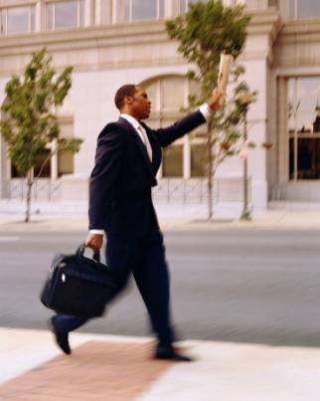
Act Four: Take the Money & Run
    Use a disposable phone
    Create a fake identity
    Leave no real contact information behind
    Change address or email account
Notes:
Scammers who ask you to wire money sometimes want the wire to be protected by a secret test question instead of forcing them to produce identification. This means when they go to pick up the wired funds they simply give the answer to a security question and are not required to show identification. Because the “test question” has been misused, some countries and businesses are eliminating or restricting its use. Scammers also use false names, stolen or disposable cell phones, and remote email addresses, and then they vanish. Finding and prosecuting a con artist is very difficult.

Slide 8

Group Brainstorming
The scheme is like a soap opera; a plot that can take days, weeks, or months to unfold.
Just like any drama, it is well planned and the actors are convincing.

Slide 9
Scam
scam (skăm)
a confidence game or other fraudulent scheme, esp. for making a quick profit; swindle
v. cheat or defraud with a scam
    http://dictionary.reference.com
Notes:
Scams come in all shapes and sizes; designed to appeal to the needs of all kinds of people. There are usually several different scams in the overall scheme used by a con artist. For example-If a victim is told they have won a foreign lottery, the scam artist may produce:
an attorney to verify the winnings,
tickets or prize awards,
telephone contacts to reassure the “winner” and confirm the taxes and fees the “winner” must pay, and
receipts or other documents.
Each piece is a scam.

Slide 10
Scam Basics
Advance Fee Fraud
  You send money for goods or services you will never receive.
Fake Check Fraud
  You receive a check for more money than expected. After depositing the check, you are asked to forward the “extra” money to the scammer or a third party.
  You sell something online and receive a check that looks authentic, but is a fake.
Notes:
Now for some specific examples. Let’s look at how scammers work and some how common frauds play out.

Slide 11
Ploys—Tricks of the Trade
ploy (ploi) n.
a maneuver or stratagem, as in conversation, to gain the advantage
http://dictionary.reference.com
Notes:
The scammer keeps the victim involved by a range of tactics; all designed to make the con seem real. The ploys are designed to look and feel authentic and to reduce doubt on the part of the victim.

Slide 12

Points of Contact
Scammers search for victims in many ways. They troll the Internet looking for friends and databases. They may know more about you than you realize.
Notes:
Scammers use the Internet and information that you provide the world to find their victims. For example, they pose in chat rooms, join dating services, and friend you on social networking sites. They join list-serves and add their name to databases in order to access the email addresses of people who have a special interest. Then, they use that affinity to make the con seem legitimate.

Slide 13


Actors
Anyone necessary to
advance the plot:
  Business people
  Cyber friends
  Detectives
  Partners
  Company executives
Notes:
Scam artists create any character they need to make their scam move forward. If they need a company executive to call you, it happens. If you ask for a reference they have a “satisfied customer” call you. They adapt their “business” to reduce your doubt. They become your friend or your love interest—Lydia online may be Lionel in real life.

Slide 14

Working the Internet
Spoof Web sites
Malware
Phishing email
Spam
Notes:
If you have a filter through your Internet Service Provider and/or security on your computer, you have probably seen the junk mail that scammers send .

Slide 15
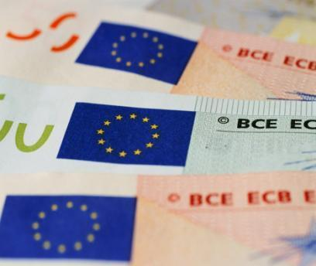
Paper and Paperless Ploys
Email
Letters
Fake checks and money orders
Certificates
Forged documents
Photos
Notes:
You name it, they can create it. False documents, that in some cases, even the experts cannot detect. Think about it—banks do not take fake checks on purpose.

Slide 16
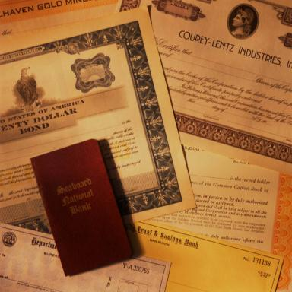
RSOT – Real Seal of Truth
Something that makes a forged document look authentic such as letterhead, a crest, watermark, seal, or logo.
www.urbandictionary.com
Notes:
Scammers add the authentic touches to reassure the victim that the document is real. They even have a name for this process. They call it the RSOT or Real Seal of Truth.

Slide 17
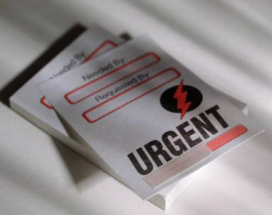
Tip-Off Phrases
Urgent or act immediately
Your help is needed…
Special offer
Once-in-a-lifetime
You are lucky!
Over payment
Notes:
Scammers want you to think and feel that there is a hurry to take advantage of their offer. Remember legitimate offers will be there tomorrow and the next day and the next.

Slide 18
Putting it all together…
When you are able to deconstruct the hoax, understanding the schemes, scams, and ploys of con artists, you are less vulnerable to fraud.
Notes:
The best defense is education. Education about all the components of fraud; education about the common schemes and knowing where and how con artists approach their potential “customers”.

Slide 19
It’s Showtime…
Here are some common examples of fake check and advance fee frauds.

Slide 20

You’ve Won the Lottery
“All you need to do is to wire money to pay the prize taxes and handling fees and your winning check for $5,000,000 will be wired to you immediately.”
Notes:
The con artist might even send you a fake check to deposit, but there are no winnings and you lose whatever you send to claim your prize.

Slide 21

Grandparent Fraud
“Hi, this is your grandson. I’m in trouble.”
Notes:
Grandparents receive a call from a young man. The caller spun a tale about wrecking a car in Canada and said he immediately needed $3,000. In fact, the grandson was safe at home. Cons posing as relatives try to convince elderly victims to wire cash to help pay for emergency car repairs, medical bills – or even post bail.

Slide 22

Be a Mystery Shopper
“You have been chosen to act as a mystery shopper.”
Notes:
The mystery shopper letter includes a cashier’s check to deposit in your account. The check amount is large enough to purchase merchandise, to pay you for the work, and there is money left over. You are instructed to help them by wiring the “extra” money to another person.
The check is fake and the con is that you will complete your mystery shopping assignments before you realize the check is bad.

Slide 23

Romance
“I think we should meet so we can strengthen our relationship, but I will need your help with the airfare.”
Notes:
…or help me with another type of expense-anything from, “I have lost my job and need help,” to “I need to pay doctor bills.”

Slide 24

Emergency
“Your friend has been in an accident in a foreign country. She needs your help to pay for medical care. Please wire money to…”
Notes:
Scammers hack into social networking sites and send a mass email to all “friends” announcing that help is desperately needed. Victims are convinced they are helping someone they know. Another version of this scam is that the person who needs your help is being detained in a foreign country and must pay fines before they can leave.

Slide 25
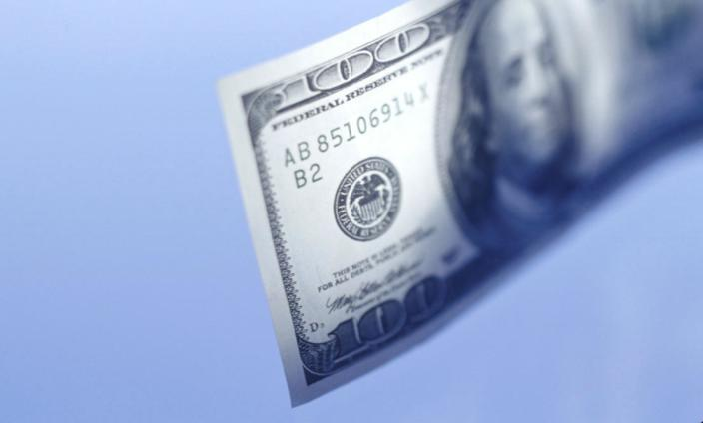
Government Grant
“You are eligible for a grant from the Federal Government. Please fill out the grant recipient form and we will send you a check.”
Notes:
The information you provide for the grant may help a scammer steal your identity. Another version of this scam does not want to steal your identity, just your money. You are asked to pay application and handling fees to receive the grant award. The grant scam comes in many varieties and could appear to come from a non-profit organization, charity, or a corporation. Carefully check the source independently before you complete any grant application.

Slide 26
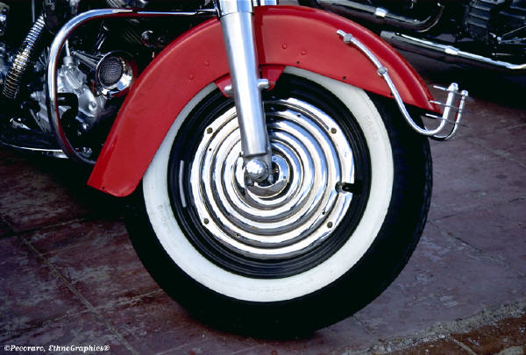
Overpayment
“The cashier’s check is for more than you asked for the motorcycle. It was my mistake. Please take the money I owe you and wire the remaining money back to me.”
Notes:
The scammer contacts you about an item you are selling online or in the paper. They arrange to purchase the item and send you a check for more than the purchase price. You deposit the check, send the item, and wire the extra money back to the scammer. Scammers know that banking rules often give customers access to the funds they deposit before the bank knows the check is valid. You are wiring money that you will never receive and it comes out of your bank account balance.

Slide 27
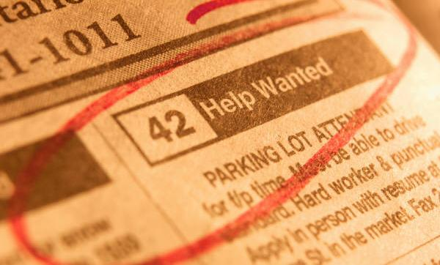
Work From Home
“You have the job! Just send money to cover the supplies and materials you will need to work from the comfort of your own home.”
Notes:
Most employers do not require advance payment to work.

Slide 28

We Found Your Dog
“We found your dog, but the poor thing was injured. We will get Rover to you as soon as possible if you will just pay for the vet’s bill.”
Notes:
Lost item recovery fraud can be any item you have lost and made public information that could help you recover your loss. Anyone who posts lost pet notices around a neighborhood can be caught in this con. The scammer may even be bold enough to call back reporting additional medical expenses. One scammer convinced the victim that the cat jumped in their car and they discovered it after they had driven 500 miles.

Slide 29

The Best Apartment
“This apartment is a real bargain. I just want someone to take good care of the place. I will send you the contract, the keys, and you can just wire me the first and last month’s rent.”
Notes:
There is probably also a security deposit!
Scammers post rentals on Craigslist or other rental listing sites. They know that people sometimes need to move to a new city without being able to travel in person to secure housing. The listings are full of pictures and the apartments are desirable. The only problem is they aren’t really for rent.

Slide 30
The Lost Inheritance
“We are so glad to have finally found you. Your long-lost great uncle died and you are the only living relative. You have inherited a large sum of money.”
Notes:
All you need to do is pay the taxes and the attorney fees to handle the will. Please wire money to cover these expenses and we will deposit the inheritance in your bank account.

Slide 31
Online Auction
“You’ve won! You were the highest bidder. I will put your ‘stuff’ in the mail as soon as I receive your payment.”
Notes:
You wire the money or send a check and the merchandise never arrives. The listing and the seller’s information vanishes from the Internet. You have been duped.

Slide 32
Remember…
The key to avoiding fraud is understanding all of its parts.
Notes:
For most Americans a scam from a non-English speaking country is fairly easy to spot in your email. You notice the quaint grammar and the spelling errors and think “I won’t fall for that.” But over 65% of scams reported come from the United States and the scam artist is just as smart as you are. Con is their game and they practice the game every day.

Slide 33
Student Activity
Use the graphic organizer to deconstruct a hoax.
Discuss in your small group the possible components of a scheme. Include the scams and ploys that a con artist might use to make this fraud a success.
Explain your results to the large group.

Slide 34
Student Activity
“I found your dog. I saw the notice you posted in the neighborhood and thought I would call you to let you know Fido is safe. However, there is a problem. I had to take him to the vet because he was injured. I need you to wire me the reward, the money for the vet bill, and the fare to send Fido back to you. I can fax you the bills if you want to see them.”
Notes:
You wire the money or send a check and the merchandise never arrives. The listing and the seller’s information vanishes from the Internet. You have been duped.

Slide 35
Student Activity: Schemes, Scam, and Ploys Graphic Organizer
scheme ( skēme)
n. a plan, design, or program of action
to be followed; project
an underhand plot; intrigue
scam ( skăm)
n. a confidence game or other fraudulent scheme, esp. for making a quick profit; swindle
v. cheat or defraud with a scam
Scam
Scam
Ploy
Ploy
Ploy
Ploy
Ploy
Ploy
Ploy
Ploy
ploy (ploi)
n. a maneuver or stratagem, as in conversation, to gain the advantage.

Slide 36
Student Activity EXAMPLE: Schemes, Scam, and Ploys Graphic Organizer
Scheme: I found your dog. I saw the notice you posted in the neighborhood and thought I would call you to let you know Fido is safe. However, there is a problem. I had to take him to the vet because he was injured. I need you to wire me the reward, the money for the vet bill, and the fare to send Fido back to you. I can fax you the bills if you want to see them.
Capture Personal Information
Doggie Injuries
Veterinary Fraud
Victim’s lost dog flyer
Personal information
Pet description
Injury story
Estimate of treatment cost
Create an emergency
Actor for vet
Treatment story
Fake invoices for treatment, drugs, etc.
Money
Wire money so Fido can come home
Test question no ID

Slide 37


Sources
LifeSmarts is a program of the National Consumers League:
https://lifesmarts.org/resources/lifesmarts-powerpoints/
NCL would like to thank Western Union for an unrestricted educational grant that helped produce these materials.

