Slide 1
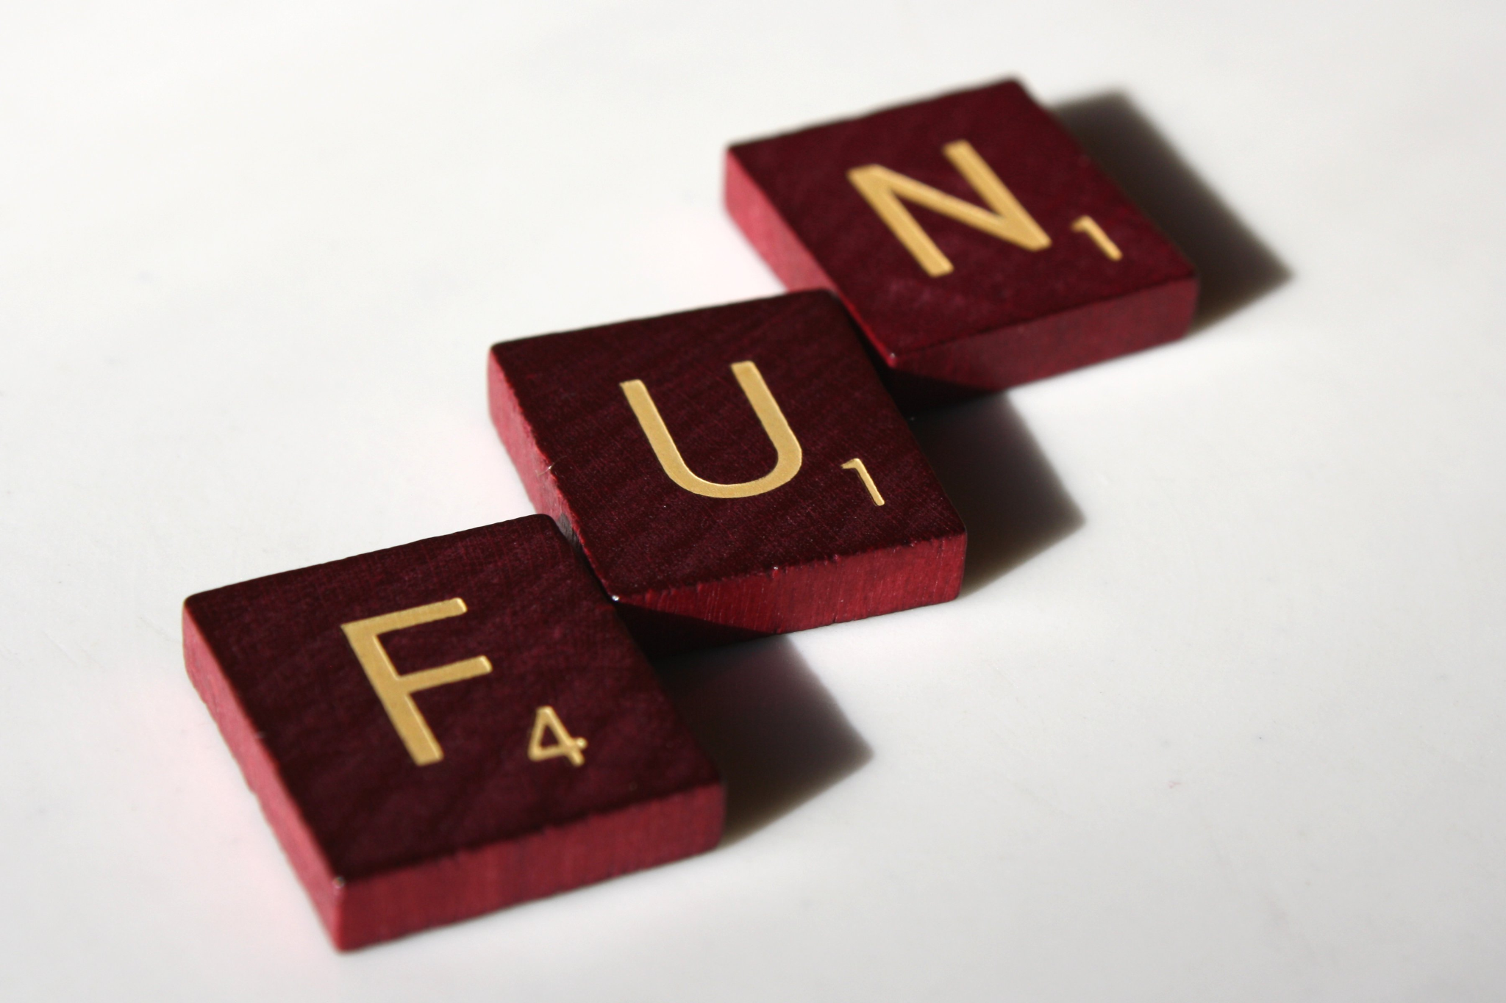
Putting the Fun Back into Club Meetings
We can do fun activities that still teach and keep
youth involved in club meetings

Slide 2
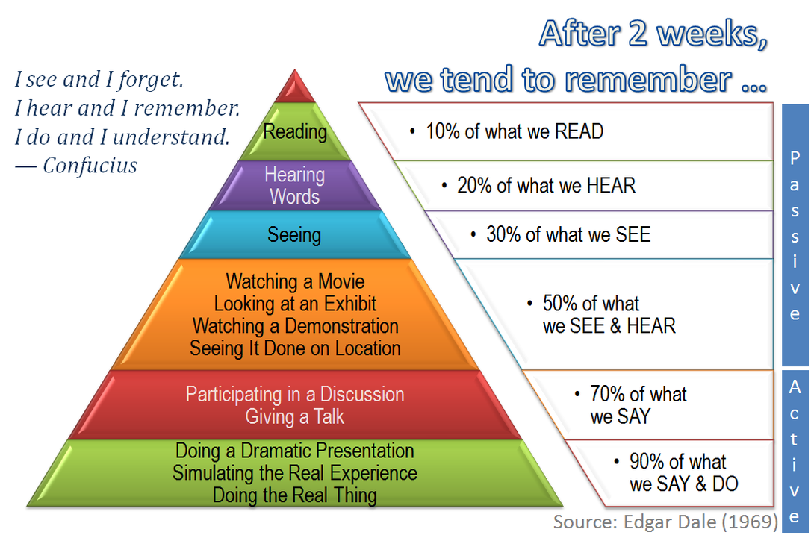
The Cone of Learning
Notes:
Edgar Dale’s Cone of Learning
5%-15% Verbal or Written
10%-20% Visual
40%-50% Visual and Verbal
60%- 70% Discussion
90% of what you experience

Slide 3
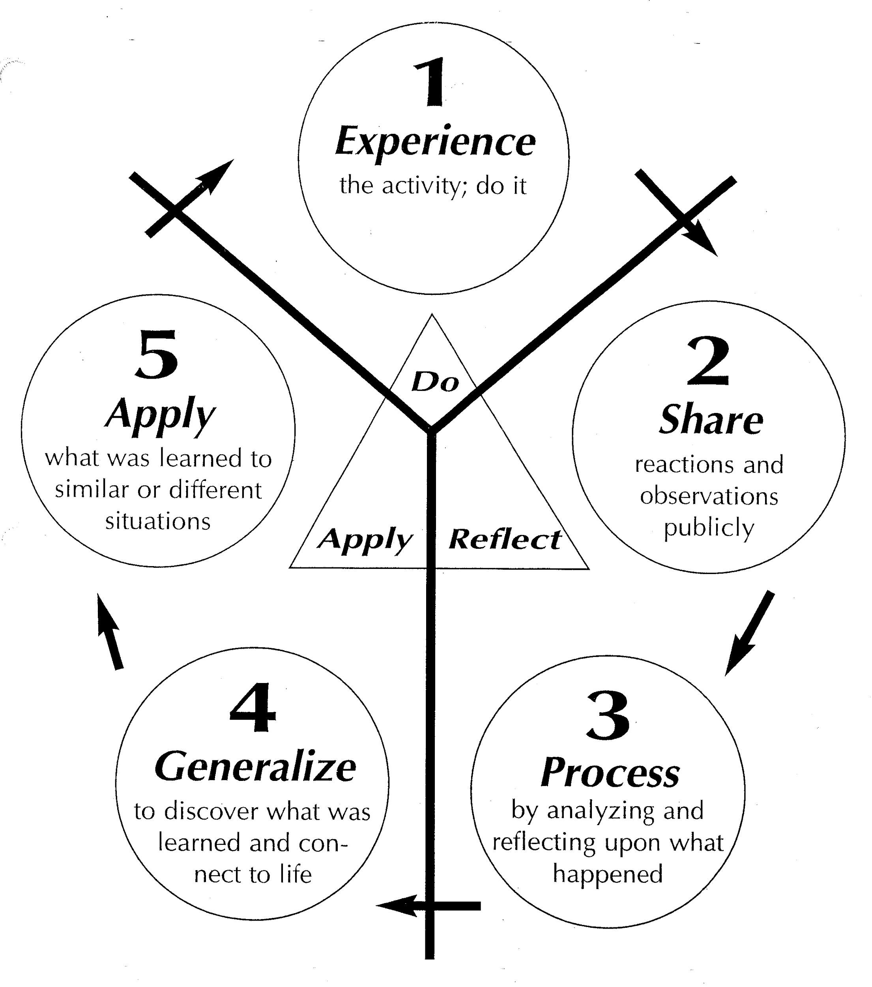
Discussion= Taking Recreation to the next level
“What”, “So What?”, and “Now What”.
What- what happened during the activity
So What- what could have gone better or different? How would you do it now since you have been through the activity?
Now What- how to act on the experience by choosing the best alternative and reapplying them to other situations. How do I apply this to my life?
Notes:
The key part of taking a game into a learning experience is the discussion after the activity.
You must utilize the experiential learning model and complete the circle of how do I apply what I just did in a 4-H club meeting to my life.

Slide 4
Different Types of Recreation
Mixers- Starters, creating a welcoming environment
  Get to know your 4-H Club members
    M & M Madness
    Inquiring Minds
    Would You Rather
    Group Juggle
    I Love This Game

Slide 5
Activities
Socialize and Teambuilding
  Brain Teasers
    Crossed/Uncrossed
  Get the group moving again
    Simon Says

Slide 6
Socializers and Teambuilding Activities
  A big part of your program
    Tower Building
    Raccoon Circle
    Add a Word
    Risk
    Line and Circle Dancing
    Magic Carpet

