Slide 1
Creating a Safe 4-H Environment
For 4-H Volunteers

Slide 2
What is Risk Management?
Risk is a situation involving exposure to danger.
Risk management is the identification of potential risk and finding the best path forward to ensure a safe environment for all.
Every risk that is identifiable is also manageable!
Notes:
Have participants define risk and risk management. Think, pair share.
Risk Management is the identification of potential risks we could or are facing, and then finding the best path forward to ensure the safety for our organization, you the volunteer or educator and the youth in our programs.
With those of us who work in the area of youth programs, we must be aware of potential RISKS, and how to best manage them to ensure a safe and equitable opportunity for all in our programs.

Slide 3
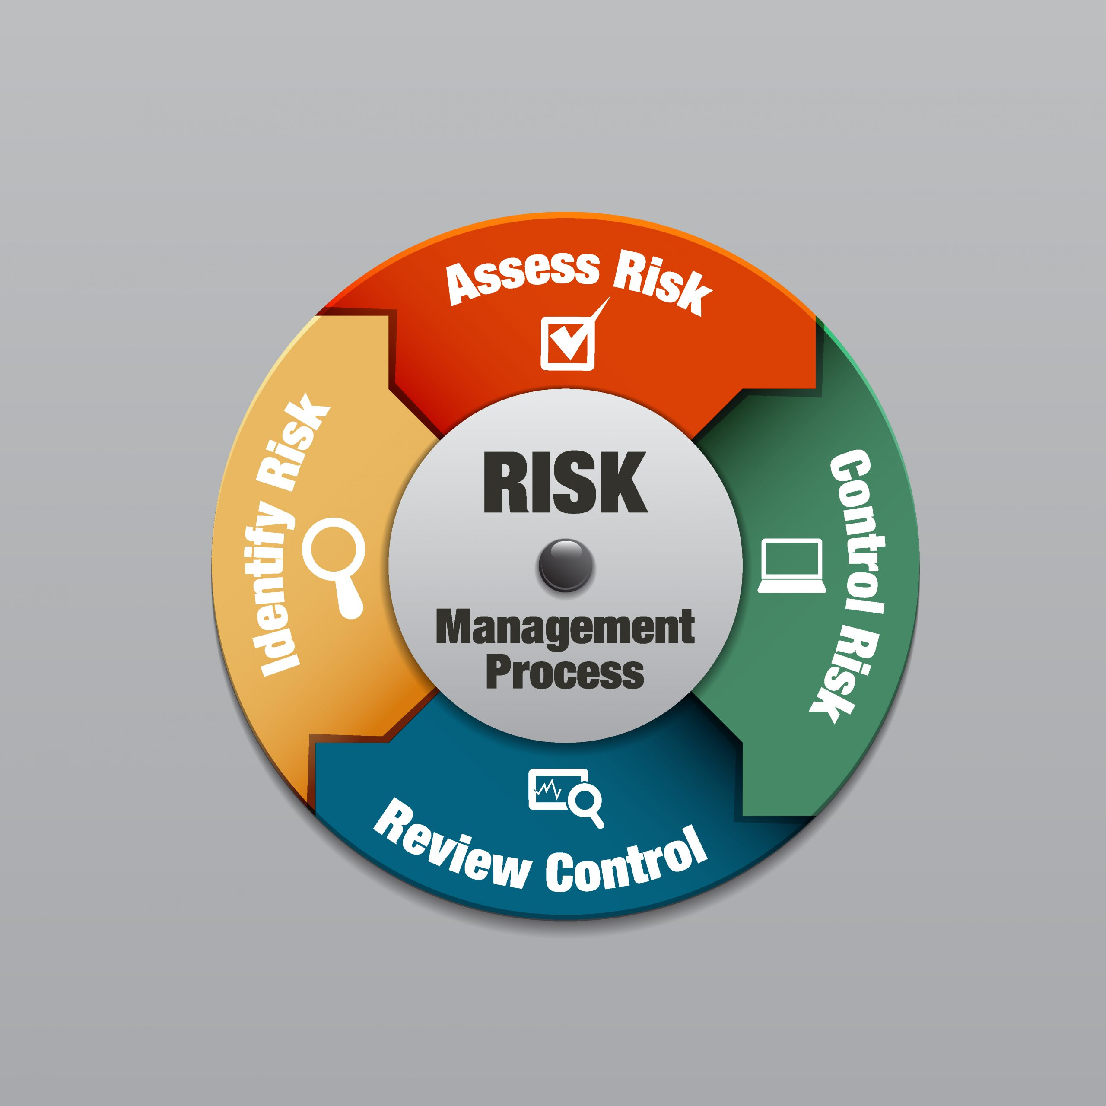
How do we manage risk?
Risk Benefit Analysis
What are the risks?
What is the educational benefit?
https://www.theirmindia.org/blog/wp-content/uploads/2022/07/shutterstock_172516121-scaled.jpg
Notes:
Assess- how risky is it? Is there an educational benefit to it? What is the risk to benefit balance? This is where knowing your resources and your

Slide 4
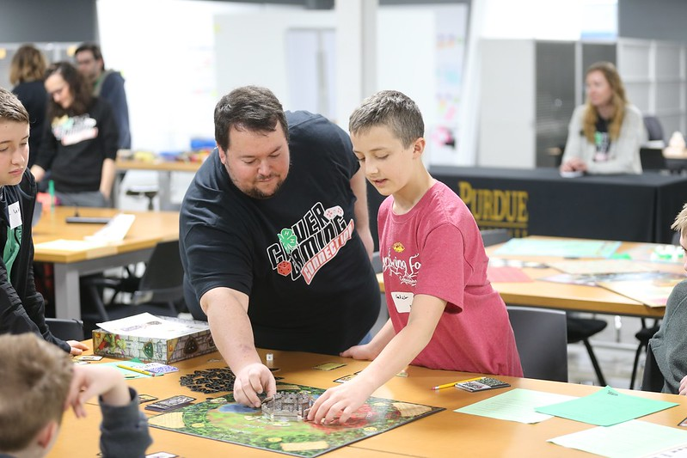
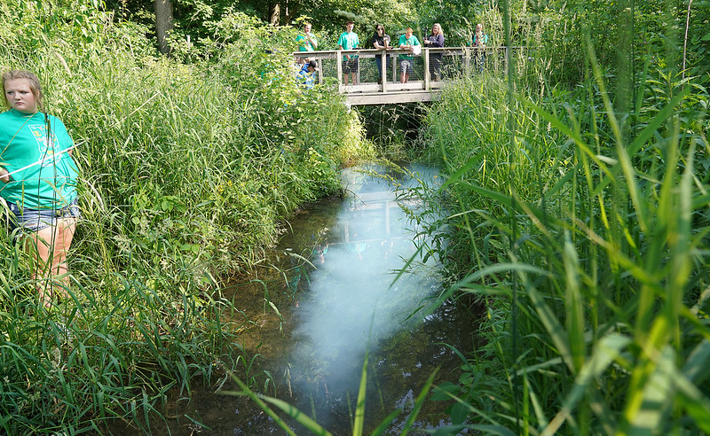
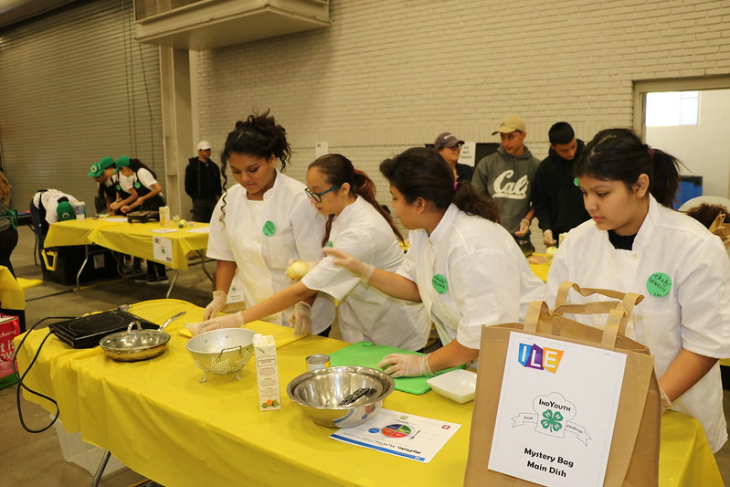
Identifying and Assessing Risks
Notes:
Activity 1:
The most important step is to recognize the risks around you or those that could happen, and this is important!
It is key that you don’t ignore them, and to have the mindset “It will never happen to me”, “I’ve done this for years and that has never happened here”, or “That’s not my problem, so the others can handle it” are phrases you never want to say or think! If you don’t get ahead of risks, it can create a mess very quickly for you and the program as a whole!
Once identified, you need to prioritize the risks: by frequency or potential occurrence, severity or risk of harm and to whom it could potentially affect, and the available timeframe to develop a plan of action. Rank each risk.
High
Medium
Low
Discuss the educational benefit to this program. Consider if this is a program replicated elsewhere in the community, the potential audience impact if this program was not offered and what the youth get out of participating in it.
Remember it is better to be preventative instead of being corrective.

Slide 5
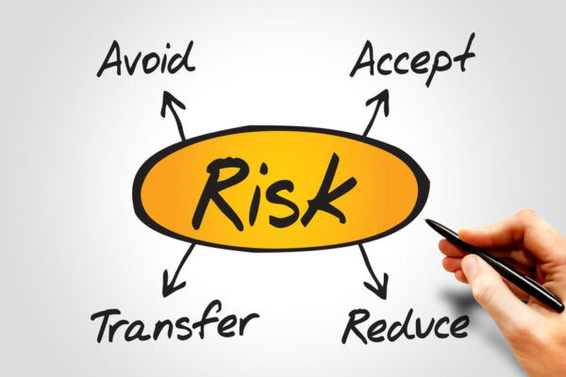
Controlling Risk and Reviewing Control
Notes:
Matrix activity or discussion
Reduce: To lessen in extent, amount, number, degree, or price.
This involves minimizing the potential for risk through by gaining
control of variables in an activity or event. An example is to modify
the program or facility, such as adding a fence to separate the
public from animals in a show ring.
• Transfer: Shifting all or part of a risk to another party. Insurance is
the most common method of risk transfer, but there are other
means. Examples are to charter a bus instead of using personal
vehicles or hold a meeting in a public place instead of your home.
• Avoid: Taking steps to remove a hazard, engage in an alternative
activity, or otherwise end a specific exposure. Examples are to
replace one activity with another or discontinue a high risk event.
• Assume: To take upon oneself or undertake. An example is to
decide all necessary precautions have been taken and go ahead
with conducting the event.

Slide 6
What is your role in Risk Management?
4-H Volunteers
Create a Safe Environment for Youth
Supervision
Programming
Environment
Follow Expectations, Policies and Procedures
Notes:
What is your role in risk management?- Jamie
Volunteers are essential to creating a safe environment for youth, by building on the foundation of 4-H expectations, policies and procedures and focusing on areas of risk management in "their world" including supervision, programming and the environment they create for 4-H participants.
It is also essential to realize the scope and reality of our 4-H authority.
4-H Volunteers serve at the discretion and under the supervision of the county 4-H Extension Educator. They are screened and appointed to specific volunteer roles by the county 4-H Extension Educator to support 4-H program needs. 4-H volunteers annually agree to respect, adhere to, and enforce the rules, policies, and guidelines established by Purdue Extension and accept the supervision and support from the county 4-H Extension Educator.
County 4-H educators are the "keepers of the clover" and are appointed to serve as the 4-H authority by the State 4-H Program, Purdue Extension and Purdue University.
Delegating
Cannot delegate to non-volunteers
Only approved volunteers can supervise and work directly with youth at 4-H activities

Slide 7
What is your role in Risk Management?
Follow Expectations, Policies and Procedures
Know your resources:
4-H Policies and Procedures
State Project (rules)
County Handbook (rules)
Volunteers are provided liability and legal protections by working within the 4-H expectations, rules and policies.
Notes:
Share copies of ABE and Volunteer Role Descriptions and have participants review what responsibilities/expectations we have for risk management
Follow all 4-H guidelines and policies of the Purdue University Extension, State 4-H Program, and County 4-H Program.
Communicate with assigned supervisor regularly. Report any concerns to assigned supervisor in a timely fashion.
Provide supervision to meet leadership and supervision expectations at all times and venues.
Create a safe and inclusive environment for all participants at all times.
Adhere, communicate and enforce rules, policies and expectations with all youth and adults.
Work and communicate with other 4-H adults as appropriate.
Indiana tort claims act protection and connection with duties (gross negligence and malice?)
Adult behavior expectations

Slide 8
What is your role in Risk Management?
4-H Volunteers
Supervision
Programming
Environment
2 Approved 4-H Volunteers
Depends on age, typically 8:1 youth to adult ratio
Active Supervision
Age appropriate and hands on
Follow project safety rules
Check about insurance
Prepare for accidents
Check the scene for physical hazards
Set up with safety in mind
Communicate expectations to all
Watch for changes in the environment and follow Emergency Procedures if necessary
Notes:
What is your role in risk management?- Jamie
Responsibilities and expectations
Supervision
Adequate # adult supervision and appropriate amount of hands on assistance for the activity and age of participants
Active supervision, line of sight and supervision ratio
Programming
Appropriate activities for the age of participants (ex. Shooting sports and ATV only for youth in grade 3 and up, not for minis), making it hands on can help eliminate misbehavior
Appropriate materials and space for the activity
Follow project safety rules- discuss where to find these on the web or elsewhere (ex. Everyone riding a horse in a 4-H horse show must wear a helment, that is a project safet rule)
Check about insurance- group insurance covers all 4-H members and volunteers for regular county programming (club meetings, project workshops, etc., but special activity insurance can be purchased for special events such as out of county field trips, overnight events, workshops/events open to non-4-H youth)
Prepare for accidents-
have copies of incident reports on hand at all times,
have a first aid kit with you,
having people trained in first aid and cpr is a bonus, but not a requirement (everyone can provide first aid and cpr and are protected under good samaritan law as long as you are "doing no harm")
Know your reporting expectations and procedures
Accident/Incident reporting- provide care (call EMS if needed), notify educator, after participant is safe, complete incident report (online or form RM27), respond to educator communications about the situation in a timely manner
Child abuse and neglect reporting- 911 if it is happening, call DCS, notify educator and complete incident report, don't need proof, if you witness, are told or observe. Mandated by law to report.
Behavioral concerns- Use Youth Behavioral Expectations and positive bhavioral management techniques (proximity, redirection, private/public conversations, parental notification/participation), notify educator
Volunteer concerns- Use constructive conflict conversation techniques, notify educator
Environment
Space for the activity is free of barriers and potential harm
Use common sense when setting up the activity to avoids pinch points and assure adequate supervision during the whole activity
Communicate expectations to participants, parents, adults that are observing, etc. Be clear, positive and consistent. Stop activity if safety concern develops.
Watch for changes in the enrivornment (including weather). When in doubt, err on the side of caution. If there is a tornado warning during a fair event, take precaution. No ones life is worth finishing a show when the show can finish after the weather emergency has passed.
creating a sense of belonging and welcome (emotional safety)

Slide 9
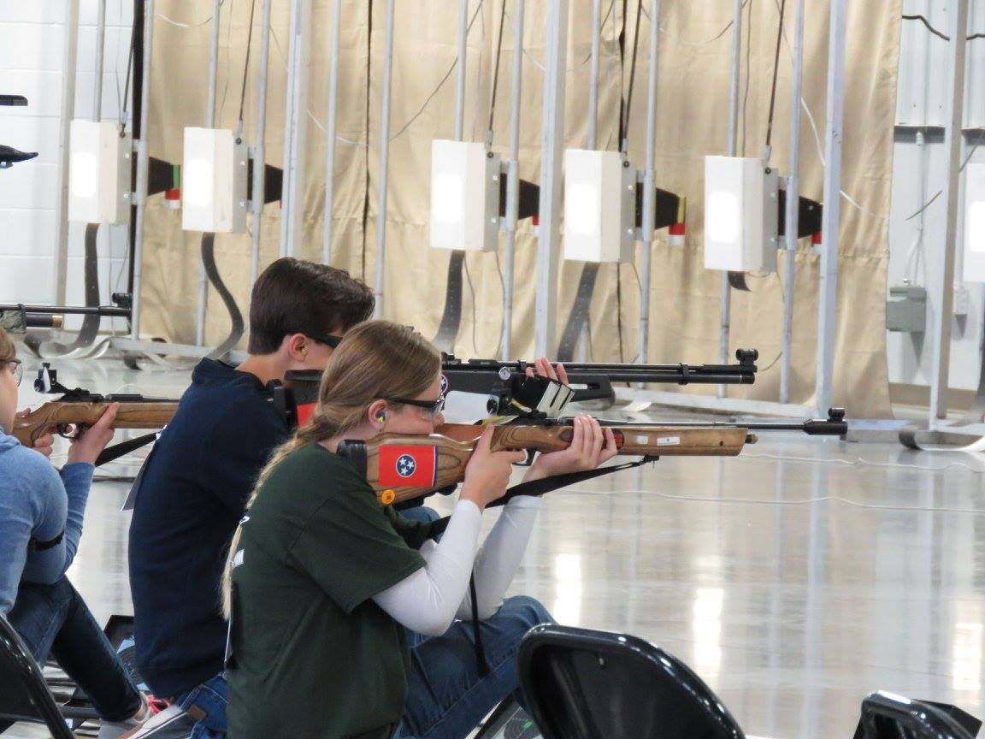
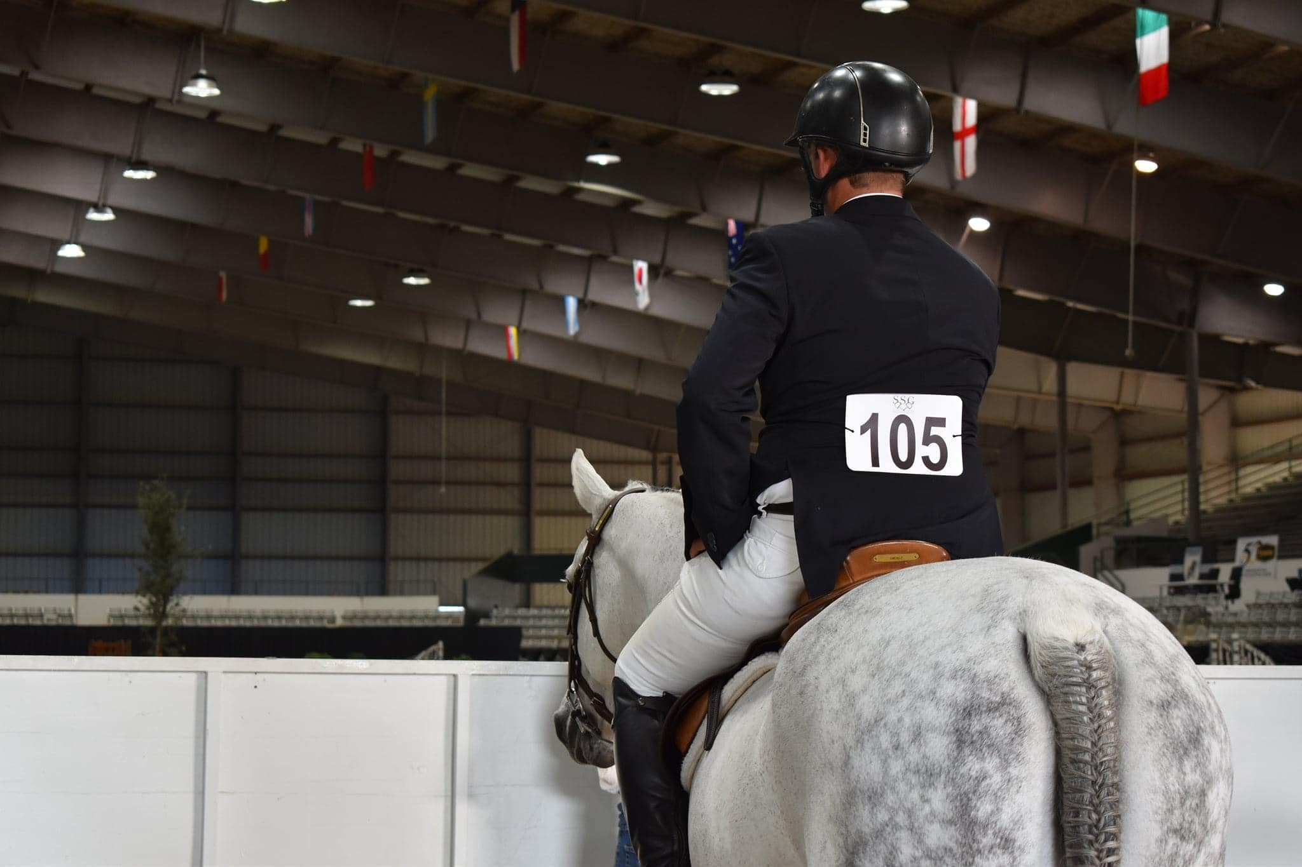
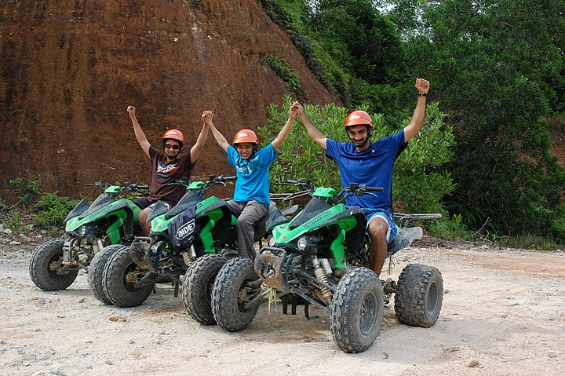
What is your role in Risk Management?
Create a Safe Environment for Youth
Notes:
Activity 2:
Split up into at least three groups and assign one of the projects represented on the slide to a group to discuss how they would create a safe environment for youth based on what was discussed in the last two slides:
Shooting Sports
ATV
Horse and Pony

Slide 10
Risk Management Best Practices
Be proactive and prepared.
Involve others in all stages as appropriate.
Maintain open lines of communications with your 4-H Educator at all times.
Communicate expectations in advance with everyone.
Be consistent with communication, expectations, enforcement of rules and actions.
Make decisions in the best interest of all and in alignment with 4-H Policies and Procedures.
Trust your gut!
Notes:
Be proactive and prepared.
First aid kit
Proper supervision
Proper paperwork and registration completed.
Adequate supplies
Involve others in all stages as appropriate.
YOUTH!
Volunteers
Parents
4-H Educator!
Maintain open lines of communications with your 4-H Educator at all times.
Communicate expectations in advance with everyone.
YBE
ABE
Activity expectations
Be consistent with communication, expectations, enforcement of rules and actions.
Make decisions in the best interest of all and in alignment with 4-H Policies and Procedures.
Trust your gut!

Slide 11
Scenario Work
Let's practice what we have learned!
Work with your group to discuss the scenario provided
Talk through the questions associated with the scenario and use information from today's session to address the risk management concerns.
Be prepared to highlight your situation and share out at least two things you would do in to make a safe environment for participants.

Slide 12
Managing Risk May Cause Conflict
Managing conflict can help mitigate risk.
Use:
Tips for dealing with difficult people.
Conciliatory Gestures
Tips to getting conversations back on a trave toward a solution.
Constructive Responses
4-H Personnel Resources
Image by Risely (2024)
Notes:
Listen to them (Some people just want heard)
Be honest and transparent
Share any information which can quell the issue
Address any elephants in the room.. Those issues not fun but must be dealt with and by showing a willingness to address them can help those on the attack to come to the table instead of walk away….
Don’t be afraid to walk away if the attacks become personal or if the group is closed to listening. Walking away and regrouping is ok and it will allow you to ask for help or advice on how to best move forward without putting yourself in a bad position….
Don’t be afraid to say: “When you calm down and we can have a civil conversation, we can talk (Or Call Back) then.”
Policies to guide
scenarios

Slide 13
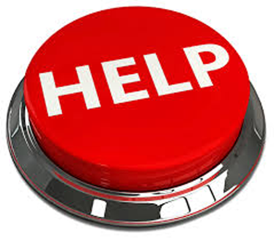
I's OK to ask for help!
Remember that our Extension Specialist, Assistant Program Leaders Program Area Mentors and other educators are here to help also! Click on the website link to find the person you need or an educators contact in a county too!
As a volunteer your first contact needs to be your local educator! They will help provide the resources you need along with helping contact who you need to contact on campus.
If your educator isn’t available, you can go to the Extension page with contact information for all leaders and specialist in Extension
https://extension.purdue.edu/about/administration.html
The key contact for volunteers for 4-H is Jamie Morris
Email: morri688@purdue.edu
Notes:
Educator
Modify for volunteers to direct them to educators

