Slide 1
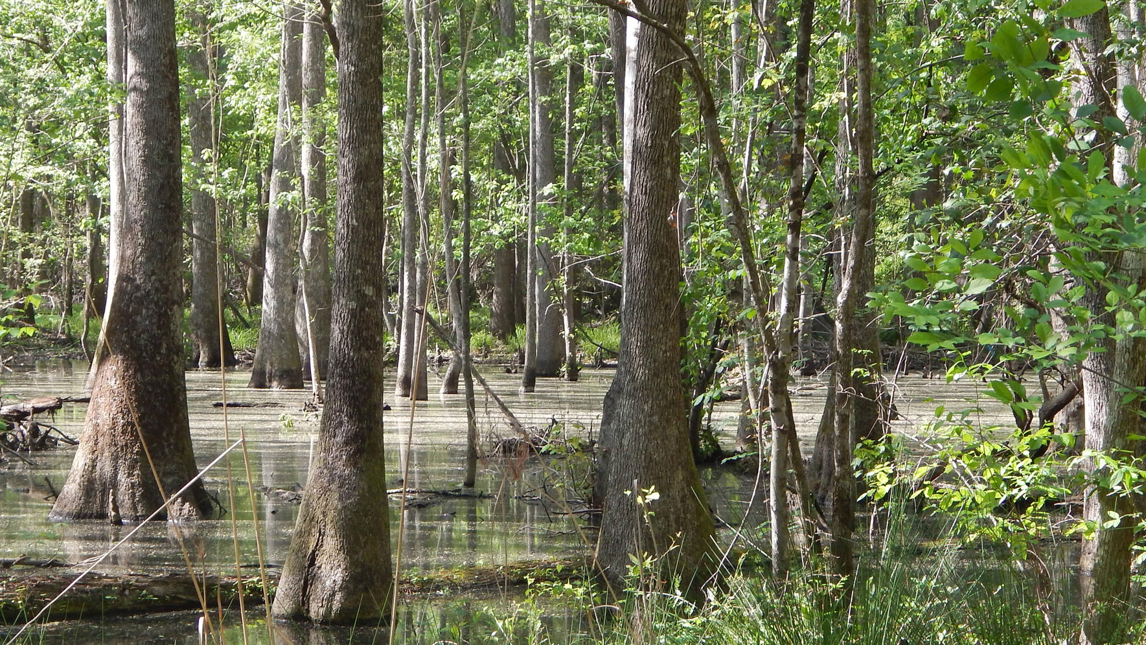
Legal Definitions of Wetlands
Dani Lay
Adapted from ABE 42600

Slide 2
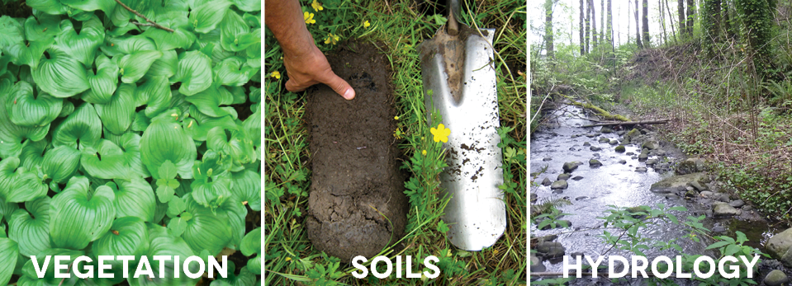
Jurisdictional Definition
Three characteristics to determine if an area is a wetland:
1. Hydrophytic vegetation
2. Hydric soils
3. Hydrology
Wetlands are defined by Section 404 permit of the Clean Water Act (CWA) along with the 1987 Corp of Engineers Wetland Delineation Manual and Regional Supplements
Section 404 permit is needed to place, dredge, or fill materials in “Waters of the United States” (WOTUS)

Slide 3
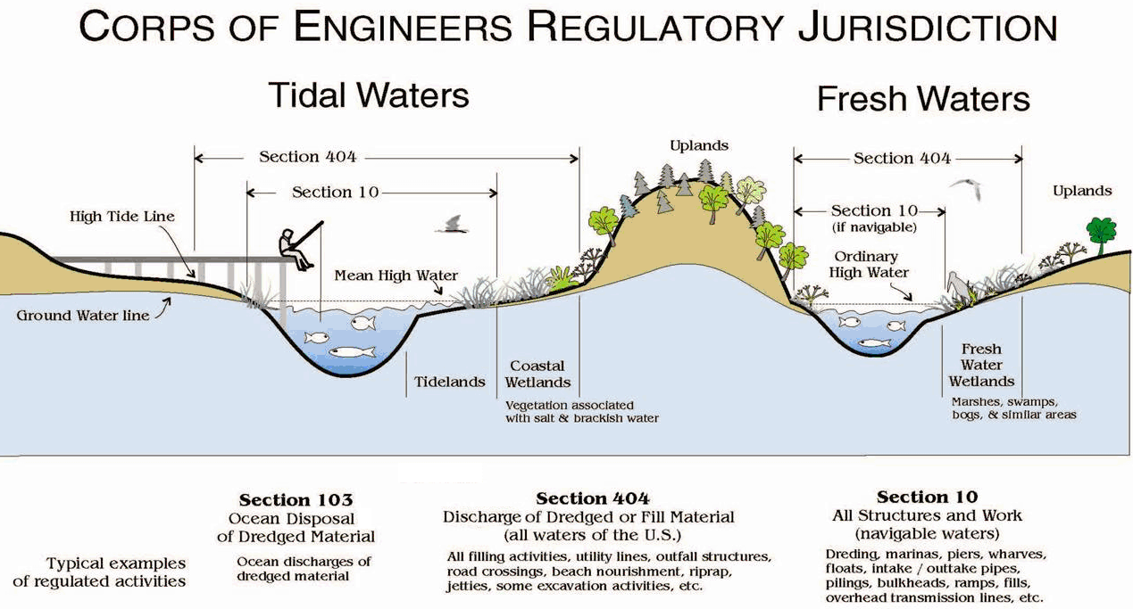
WOTUS?
WOTUS: connectivity to navigable waters and their ability to protect quality of nearby surface waters
Navigable waters: “those waters that are subject to the ebb and flow of the tide and/or are presently used, or have been used in the past, or may be susceptible for use to transport interstate or foreign commerce. A determination of navigability, once made, applies laterally over the entire surface of the waterbody, and is not extinguished by later actions or events which impede or destroy navigable capacity.”
CWA left out conversion for agriculture and silviculture
Food Securities Act of 1985 closed the loophole by linking wetland drainage to farm subsidies (i.e., Swampbuster provision)
Federal protection of pocosins, bogs, prairie potholes, and Carolina Bays was often questioned due to the lack of surface connectivity to navigable surface waters
Clean Water Act

Slide 4
Significant Nexus
Rapanos versus United States yielded a plurality opinion
Justice Scalia: WOTUS “only if it abuts a tributary with a continuous surface water connection to a traditionally navigable water” [navigable in fact]
Justice Kennedy: WOTUS “affect the physical, biological, and chemical integrity of downstream navigable water” [significant nexus]
Significant nexus opinion led to the 2015 Clean Water Rule (CWR): case-by-case protection to wetlands that lack surface water connection to navigable waters

Slide 5
Significant Nexus Determination
RPWs: Relatively permanent waters
TNWs: Traditional navigable waters

Slide 6
Significant Nexus Determination
Wetlands performing functions that society values…
AND where there is evidence for real potential to affect the physical, chemical, or biological integrity of traditional navigable waters
AND when the evidence is more than speculative or insubstantial

Slide 7
Significant Nexus Determination
Wetlands performing functions that society values…
AND where there is evidence for real potential to affect the physical, chemical, or biological integrity of traditional navigable waters
AND when the evidence is more than speculative or insubstantial

Slide 8
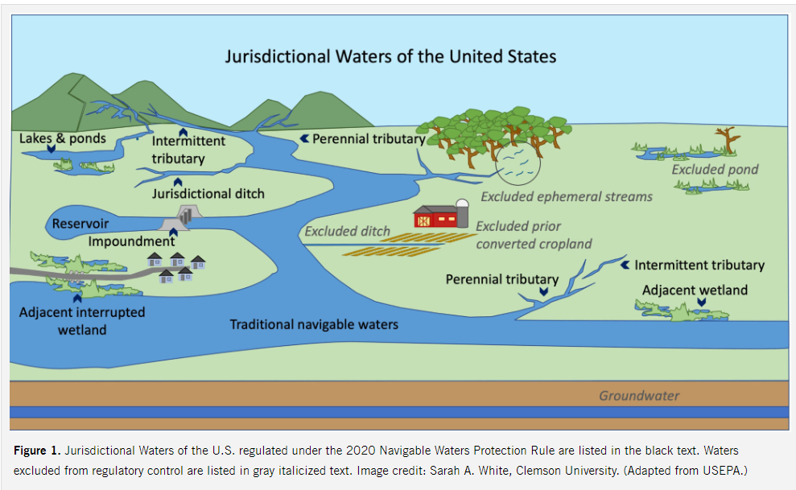
Significant Nexus to Navigable In-Fact
Clean Water Rule repealed and replaced with the Navigable Waters Protection Rule (NWPR) in 2020
NWPR put “navigable in-fact” opinion into practice
Wetlands that do not abut a tributary with continuous or intermittent flow fall outside CWA protection
~50% of wetlands would lose CWA protections with NWPR

Slide 9
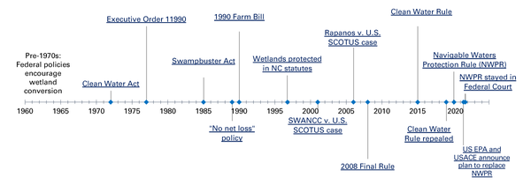

Slide 10
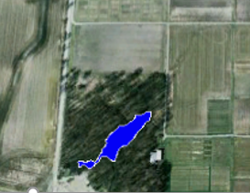
U.S. Army Corps of Engineers (USACE) Jurisdictional Wetland Hydrology Definition
Focus: dry edge of a wetland to determine wetland extent
Wetland hydrology = inundated or saturated for a sufficient time during the growing season in most years to result in development of hydric soils and dominance by hydrophytic vegetation
Presence of water has overriding influence on characteristics of vegetation and soil
12-18 inches from surface, depending on soil type

Slide 11
What is not a wetland?
Too dry: Intermittently inundated or saturated for <5% of growing season [soil temperature is >41 °F, approximately the number of frost-free days] (USACE)
Influence of vegetation: 12-18 inches within soil surface
2.5 m depth splits lacustrine and riverine deepwater habitats from wetlands (USFWS National Wetlands Inventory)
5% ranges from 7-18 days depending on region, problematic in some coastal regions
14 days is recommended by National Academy of Sciences

Slide 12
Wetland Hydrology Indicators
Most reliable evidence: gauging station or groundwater monitoring
Primary indicators: stand-alone evidence of current or recent hydrologic event
Secondary indicators: provide evidence of wetland hydrology when supported by one or more primary or secondary indicators
Groups of Evidence
Observation of surface water or saturated soils
Evidence of recent inundation
Evidence of current or recent soil saturation
Evidence from other site conditions or data

Slide 13
Groups A & B
Be aware of recent or unusually high precipitation or drought
Group A: Water table/saturation within 12-18 inches of the soil surface, depending on soil type
FAC-neutral test: >50% of remaining dominant species are FACW and/or OBL; no FAC dominants

Slide 14
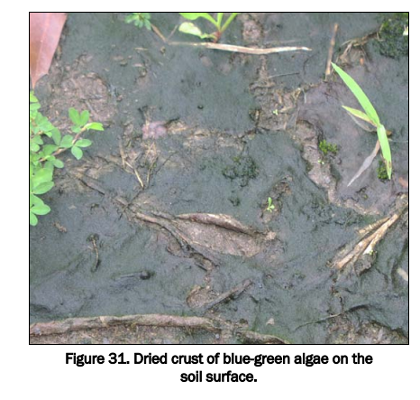
Example Indicators

Slide 15
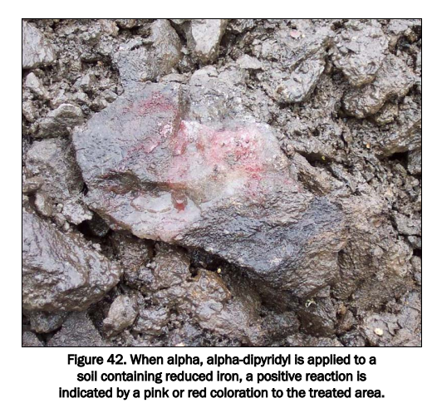
Example Indicators

Slide 16
Groups C & D
Overlap with hydric soil indicators and vegetation indicators
FAC-neutral test: >50% of remaining dominant species are FACW and/or OBL; no FAC dominants

Slide 17
Example Indicators

Slide 18
Difficult delineations
Agricultural lands due to lack of native wetland vegetation
Midwest wetlands may lack hydrologic indicators
Multi-year droughts in a changing climate may mean that a wetland is not saturated or inundated in a given year
Particularly toward end of growing season

Slide 19
More ecological view of wetland hydrology
Wetland hydroperiod: seasonal pattern of the water level in a wetland
Helps characterize type of wetland
Integrates inflows and outflows
Water levels generally fluctuate
Seasonally
Daily or semi-daily
Unpredictably

Slide 20
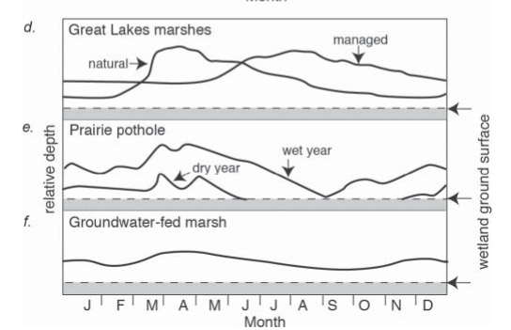
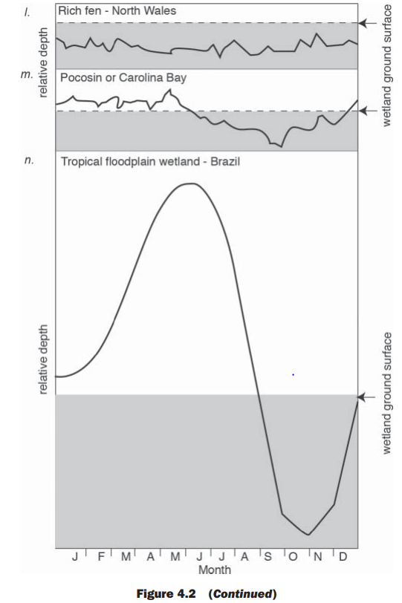
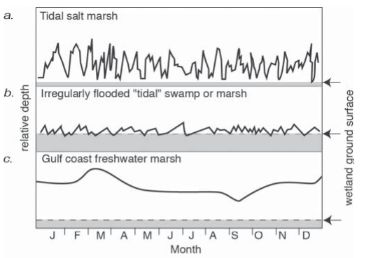

Slide 21
USACE Hydrogeomorphic Classification of Wetlands
Class | Landscape Position | Dominant Water Source | Dominant Hydrodynamics
Riverine | Adjacent to river/stream | Overbank flow from channel | Unidirectional and horizontal
Depressional | Depressions | Interflow/ groundwater; precipitation | Vertical
Slope | Forced to surface via impermeable layer, sharp slope break, concave land surface | Groundwater | Unidirectional and horizontal
Mineral soil flats | Flat areas | Precipitation | Vertical
Organic soil flats | Flat areas | Precipitation | Vertical
Estuarine fringe | Along an estuary | Overbank from estuary | Bidirectional and horizontal
Lacustrine fringe | Along a lake | Overbank from lake | Bidirectional and horizontal
Where is the wetland in the landscape?
Where does water come from? Where does water go?
What direction does water flow?

Slide 22
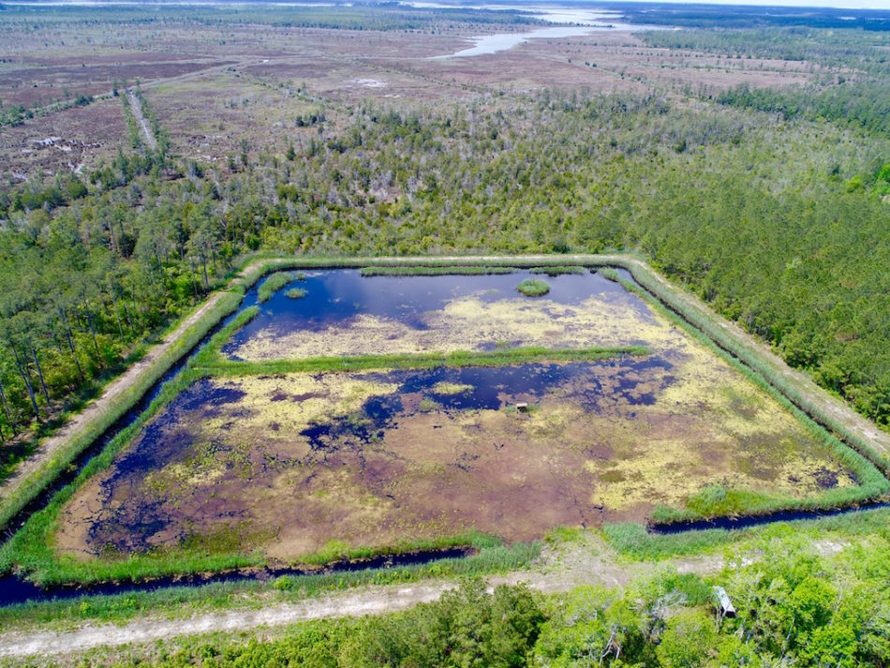
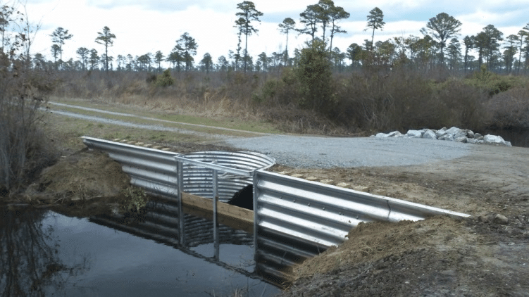
Managed Wetland Hydrology
Wetlands for waterfowl
Storage for irrigation
Changing hydroperiod for wetland restorations or natural wetlands
Example Implementation:
Water control structures
Pumping/other diversions
Engineered bypasses for high flow
Levees, embankments, ditches, etc
Notes:
Waterfowl impoundment near Pamlico County, NC
Water control structure in the Great Dismal Swamp

