Slide 1
Green Infrastructure Design Scenarios

Slide 2
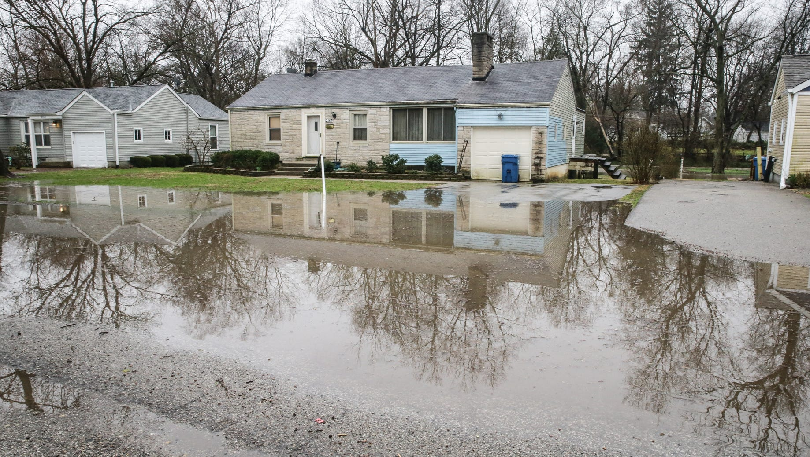
Location: Indianapolis, IN
Image Source: Indy Star
Notes:
GI/LID practice: bioretention cell/rain garden

Slide 3
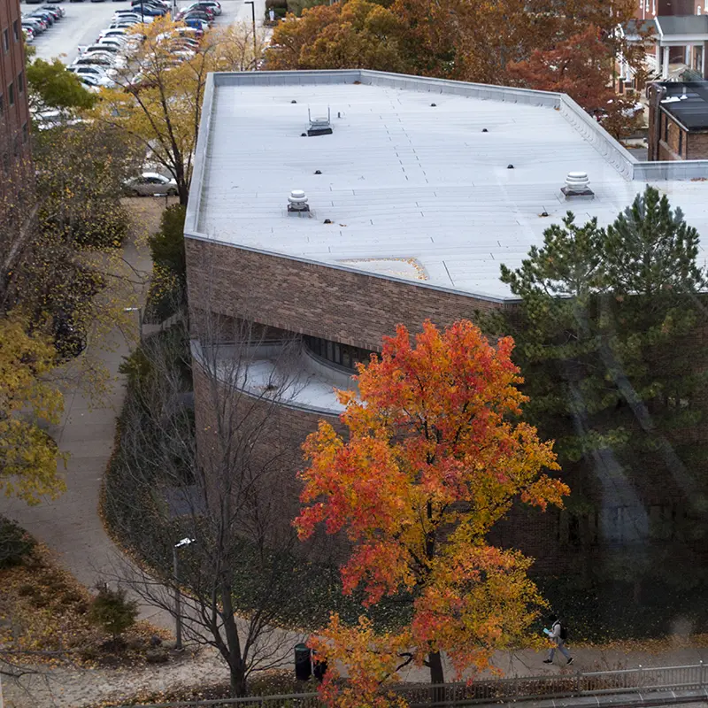
Location: West Lafayette, IN
Image Source: Purdue Daniels School of Business
Notes:
GI/LID practice: green roof

Slide 4
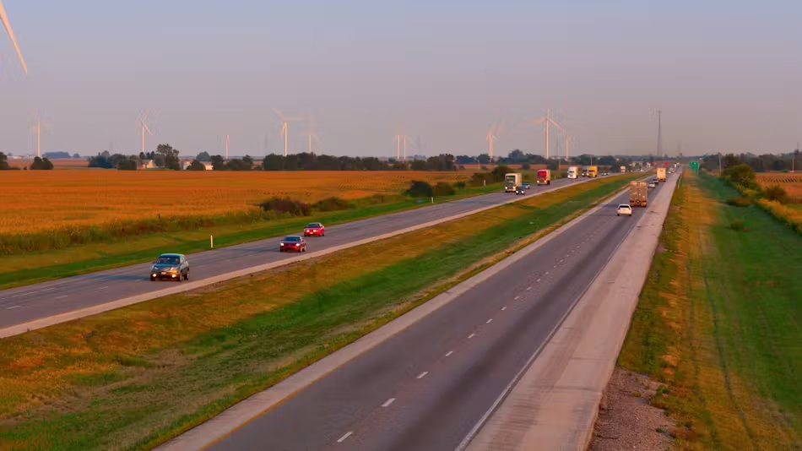
Image Source: Roads & Bridges
Notes:
GI/LID practice: bioswales

Slide 5
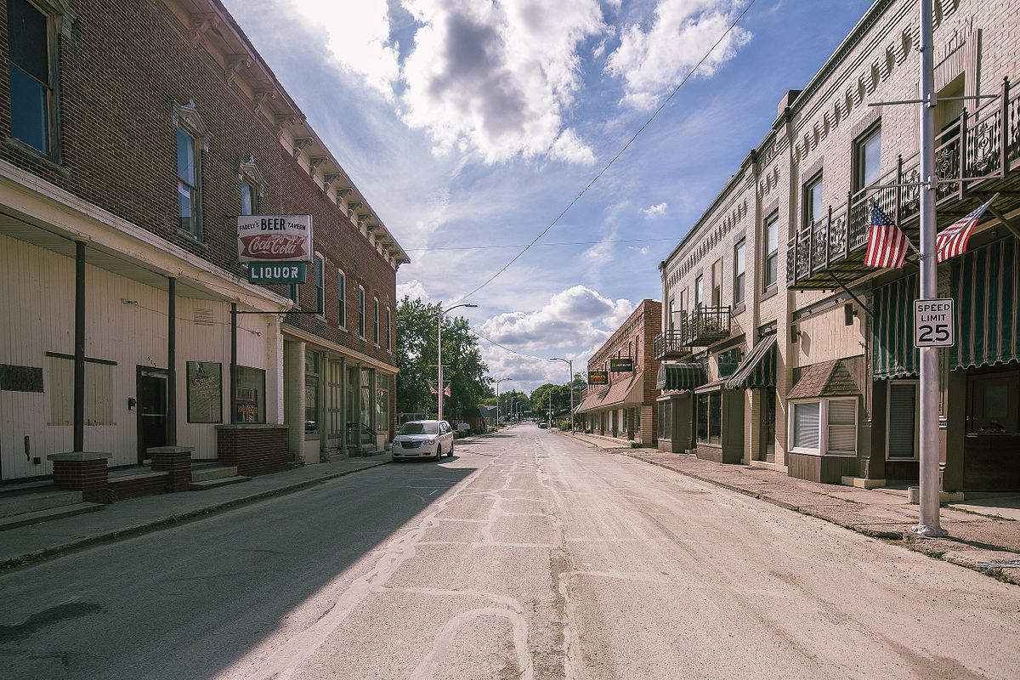
Location: Middletwon, IN
Image Source: Wikipedia
Notes:
GI/LID practice: planter boxes and/or green streets/alleys

Slide 6
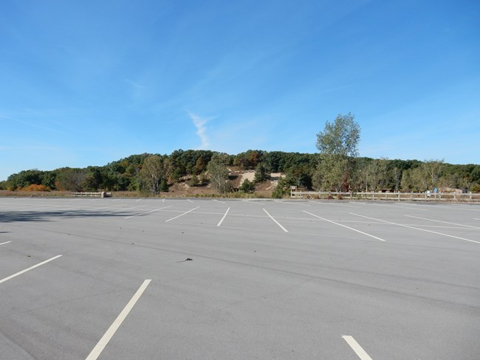
Location: Porter, IN
Image Source: National Park Service
Notes:
GI/LID practice: permeable pavement and/or green parking

Slide 7
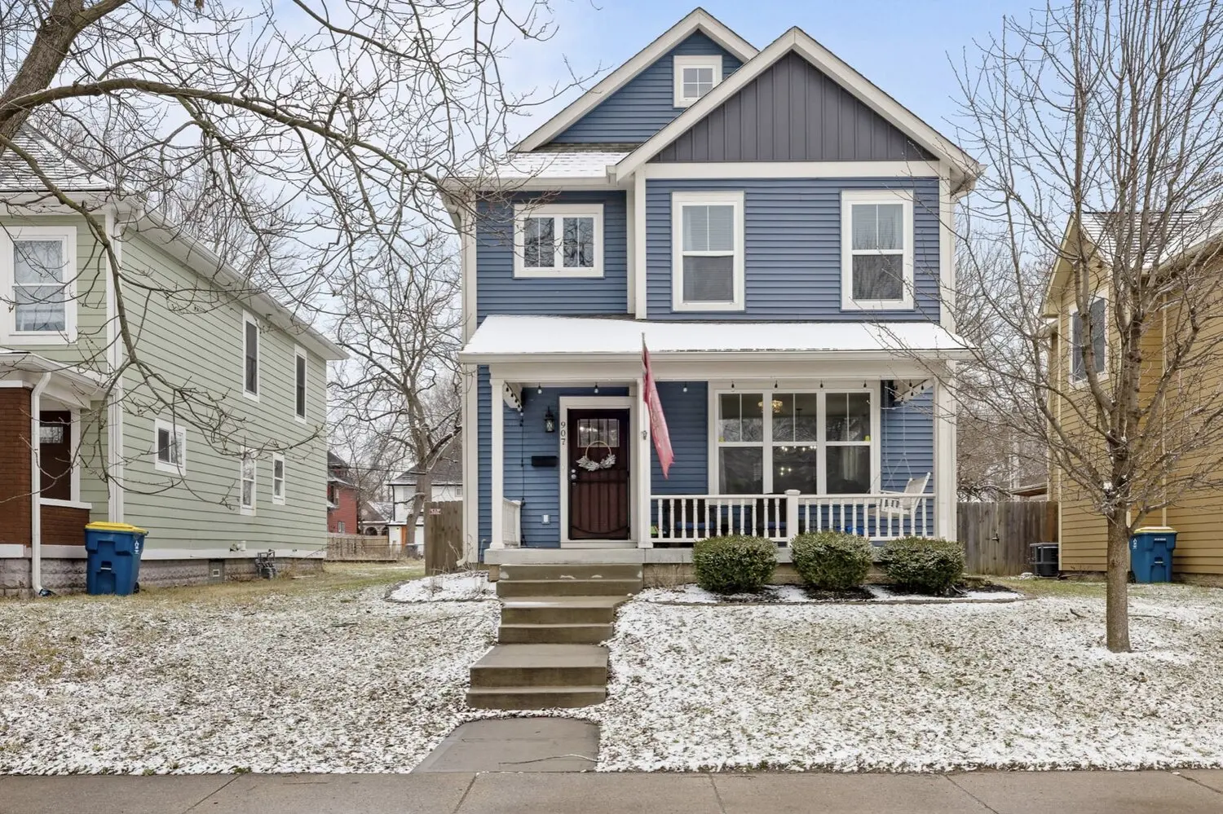
Location: Indianaplis, IN
Image Source: New York Times
Notes:
GI/LID practice: rainwater harvesting

Slide 8
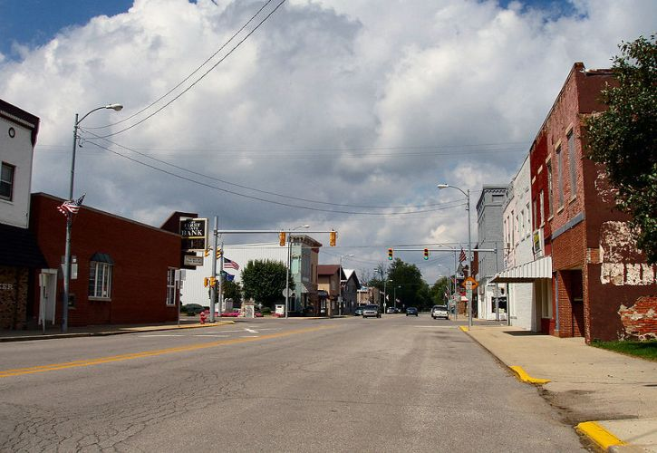
Location: Bourbon, IN
Image Source: Wikimedia
Notes:
GI/LID practice: planter boxes and/or green streets and alleys

