Slide 1
Indiana 4-H
Rachel Haselby
Extension Specialist – CS Youth Development

Slide 2
Indiana 4-H
Introductions
Rachel Haselby – Computer Science Specialist – Indiana 4-H Youth Development
rhaselby@purdue.edu

Slide 3
Indiana 4-H
What is 4-H Youth Development
4-H started over 100 years ago
Today is the largest youth development organization in the country
We help youth learn to be leaders
Hands on experiences
Leadership opportunities
Community clubs
After school
School enrichment
Camps/workshops
Special interest programs

Slide 4
Indiana 4-H
Thrive Model
In 4-H we understand that it takes time to develop youth into successful adults
We use the Developmental Context to help them grow
Sparks
Belonging
Relationships
Engagement

Slide 5
Indiana 4-H
Computer Science
What is computer science to you?
Frankly the science of computers suffers from an image problem.
When you hear the word “computer science” you tend to think of a geek hacking in a darkened basement. In reality, it touches almost all areas of life, including our youth and our farms.
By definition, it is the study of computers and computational systems. In 4-H, than means it is a very diverse subject. Today I’m going to show you one of my favorite tools, the Micro:Bit.

Slide 6
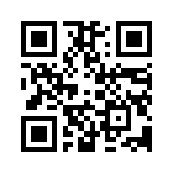
Indiana 4-H
Micro:Bit
https://www.elecfreaks.com/micro-bit-smart-science-iot-kit.html
https://stemeducationworks.com/product/microbit-smart-science-iot-kit/
Same thing – you may also be able to piece it together

Slide 7
Indiana 4-H
What’s important
Don’t be afraid

Slide 8
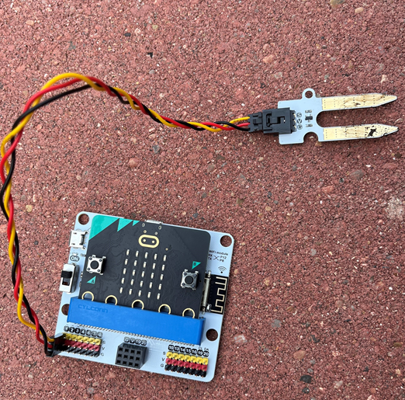
Indiana 4-H
Set Up Your Micro:Bit and Sensor
This tiny little processor is deceptive. We are using an external soil moisture sensor on it, but it has several sensors built in, so you can very creative with it’s uses. In fact, we’ll add in a couple of those sensors in the code. Because connecting to it with an external sensor can sometimes be tricky I’m going to use an “Octopus”, which will make connecting easier.
Slide the Micro:Bit into the Octopus
Attach the sensor – make sure the colors on the wire match the colors on the Octopus.

Slide 9
Ndiana 4-H
Connect the Micro:Bit
Plug the Micro:Bit into the computer
Open https://makecode.microbit.org
Choose New Project and name it
Connect the Micro:Bit by clicking on the three dots next to Download and following instructions.
Now we need gather the data. What should that look like? We are going to use the octopus to connect, simply because it’s easier. It actually comes with prewritten code that will allow us to connect to the sensor we need. First, we need to import the code through an extension. To do this, choose Extension, then double click on Environment-and-Science-IoT.

Slide 10
Indiana 4-H
Think Through the Problem/Computational Thinking
First, lets think about the problem. We need to see how moist the soil is.
Soil moisture sensors test humidity levels, so we need to create a variable, or a placeholder, where the humidity level can be put.
Then we need to look at that number. One of the nice things about the Micro:bit is that it has a display, so we can easily tell it to show the variable.
These different sections are arranged around data and called objects. Modern coding languages such as Python or Java are called object-oriented languages.

Slide 11
Indiana 4-H
Computational Thinking
Lets think about the first part of the code. How would you tell the computer to create a variable?
Yes, you’d simply write: soil_humidity = 0
(You need to give it a starting value. Your sensor will soon replace it, but it needs something there to start.)
soil_humidity = 0

Slide 12
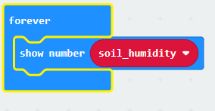
Indiana 4-H
Computational Thinking
Now we have to tell the program to read the sensor and put that data into the variable.
To do that Replace that zero next to soil_humidity with value of soil moisture at pin 1.
soil_humidity = Environment.read_soil_humidity(AnalogPin.P1)
def on_forever():
basic.show_number(soil_humidity)
basic.forever(on_forever)

Slide 13
Indiana 4-H
Add More, Make it Better – Computational Thinking Expanded
Yes, it is working, but we can make it better
What steps would you take to add a % sign?
What about if you want to add reactions based on certain parameters? These are called conditionals.

Slide 14
Indiana 4-H
What a Conditional Looks Like
def on_button_pressed_a():
for index in range(4):
if soil_humidity < 20:
music.play(music.string_playable("C - C - C - C - ", 120),
music.PlaybackMode.UNTIL_DONE)
basic.show_icon(IconNames.SAD)
elif soil_humidity <= 40:
basic.show_icon(IconNames.HAPPY)
else:
music._play_default_background(music.built_in_playable_melody(Melodies.FUNERAL),
music.PlaybackMode.IN_BACKGROUND)
basic.show_icon(IconNames.GHOST)
input.on_button_pressed(Button.A, on_button_pressed_a)

Slide 15
Questions?

Slide 16
Rachel Haselby – CS Specialist - rhaselby@purdue.edu

