Slide 1
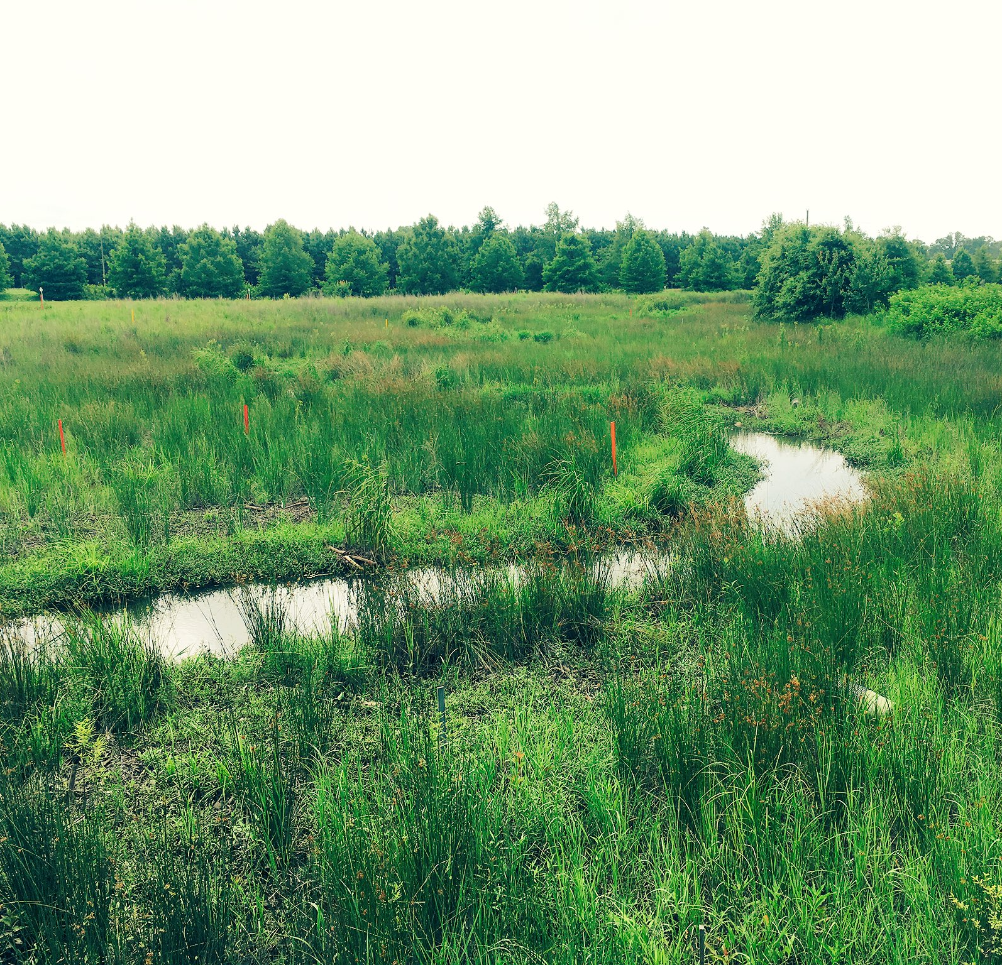
Stream Restoration Examples

Slide 2
Streambank Stabilization: Bioengineering Solutions

Slide 3
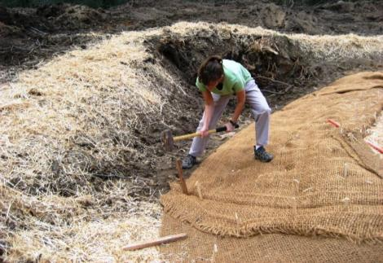
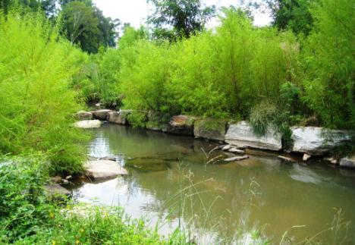
Successful Streambank Stabilization
Low streambanks
Shallow slope
Dense vegetation
Temporary biodegradable matting
Bioengineering in high-stress areas
Proper channel morphology

Slide 4
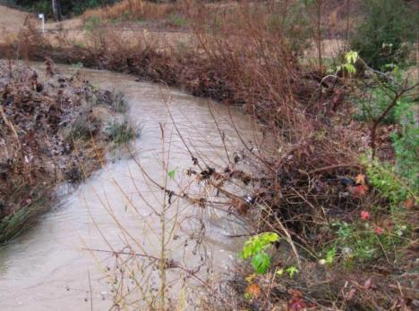
Streambank Bioengineering
Integrating living woody and herbaceous materials to increase strength and structure of the soil (i.e., increase critical shear)

Slide 5
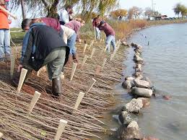
Brush mattress & live stakes

Slide 6
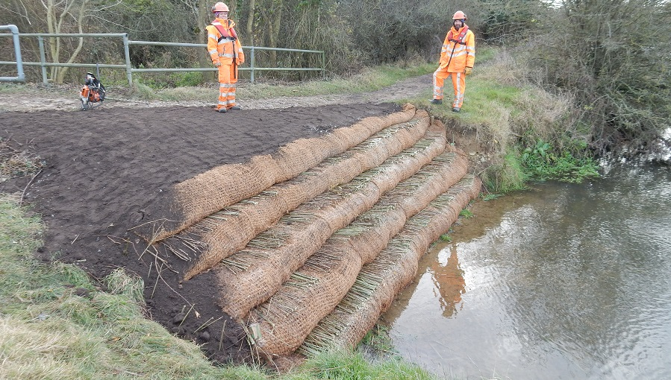
Vegetated Soil Lift

Slide 7
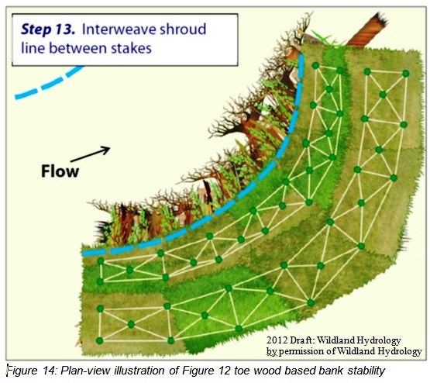
Root wads & wood vanes

Slide 8
Root wads & wood vanes

Slide 9
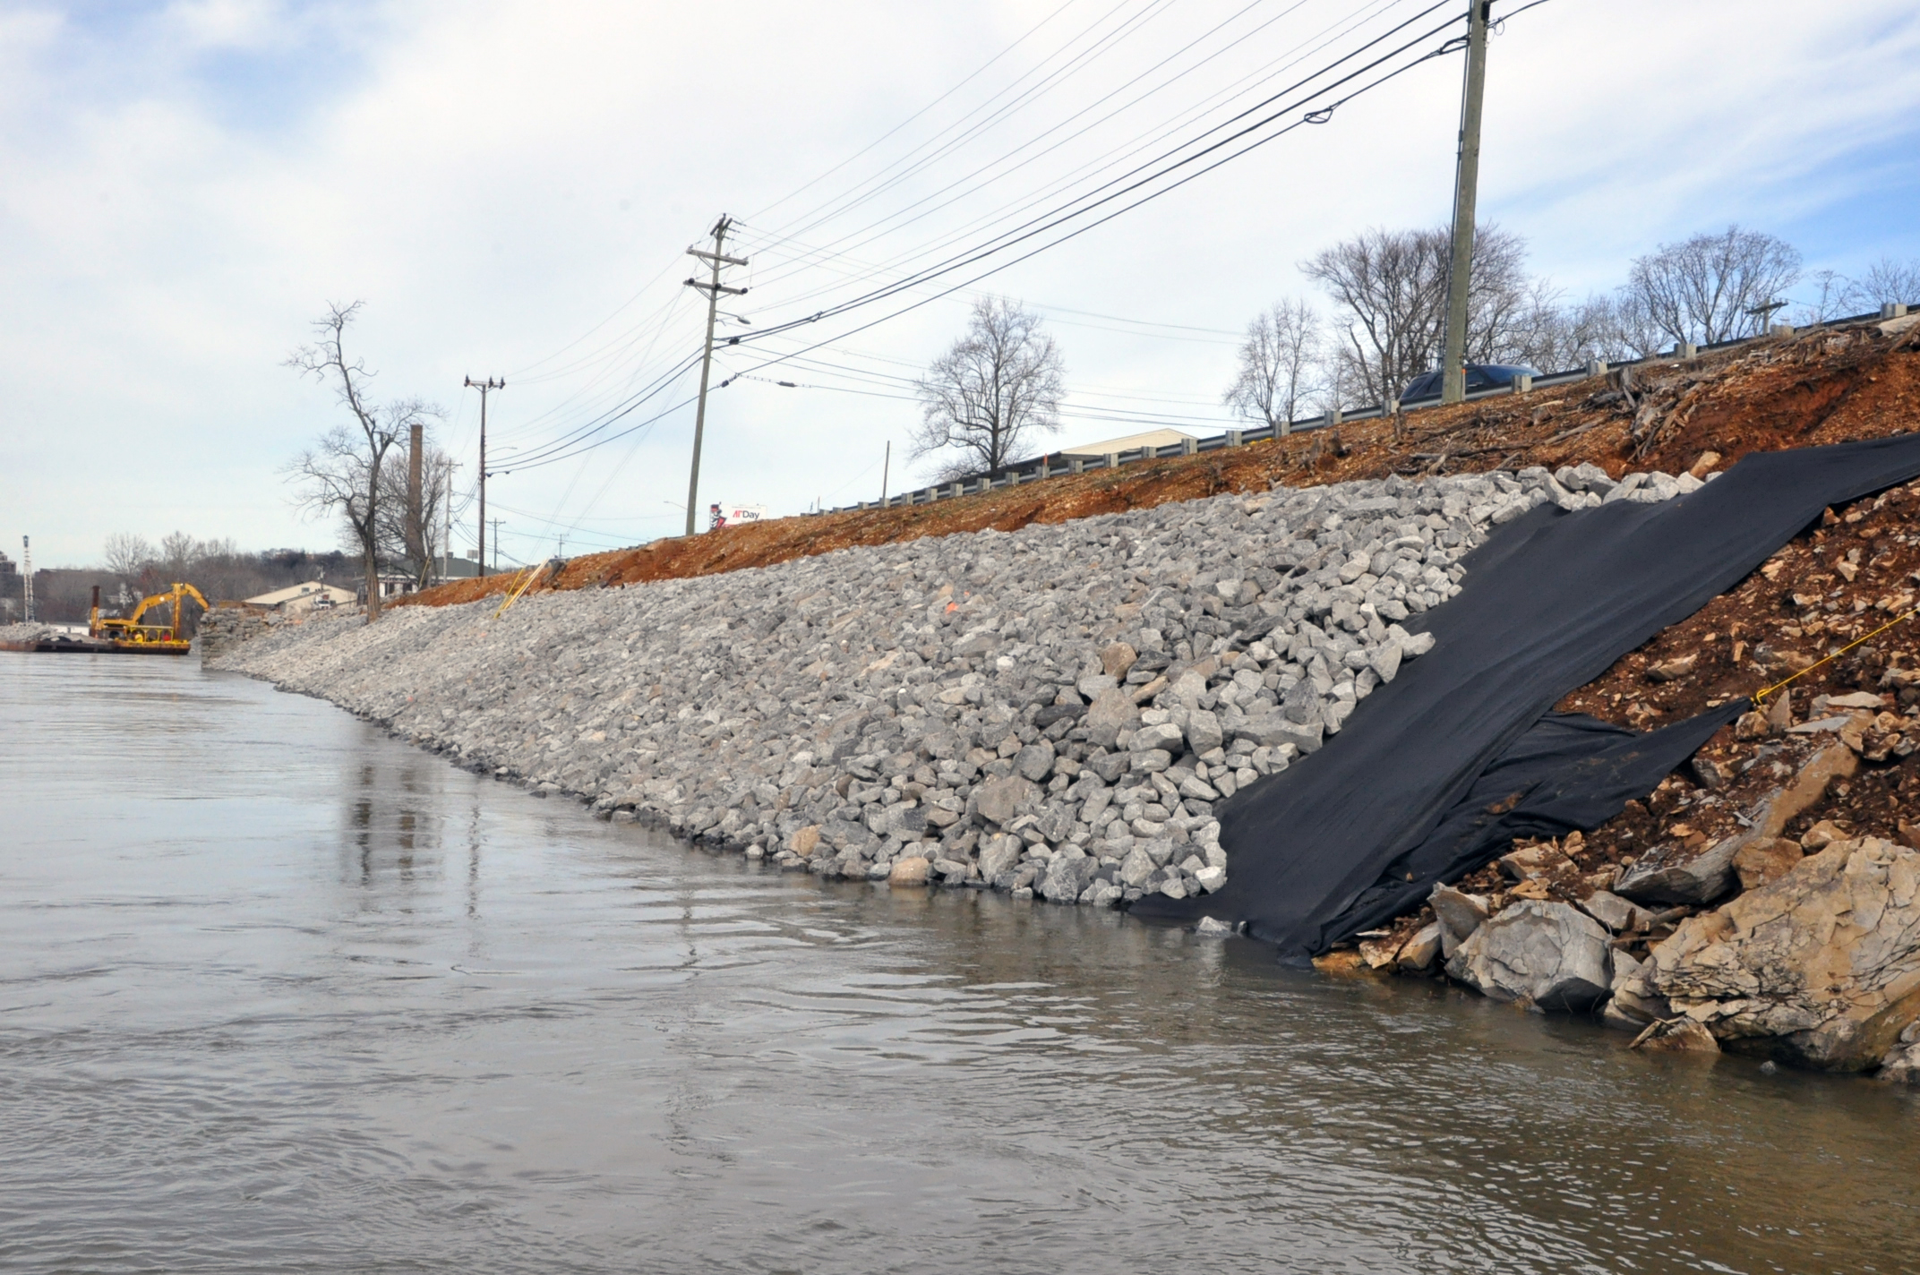
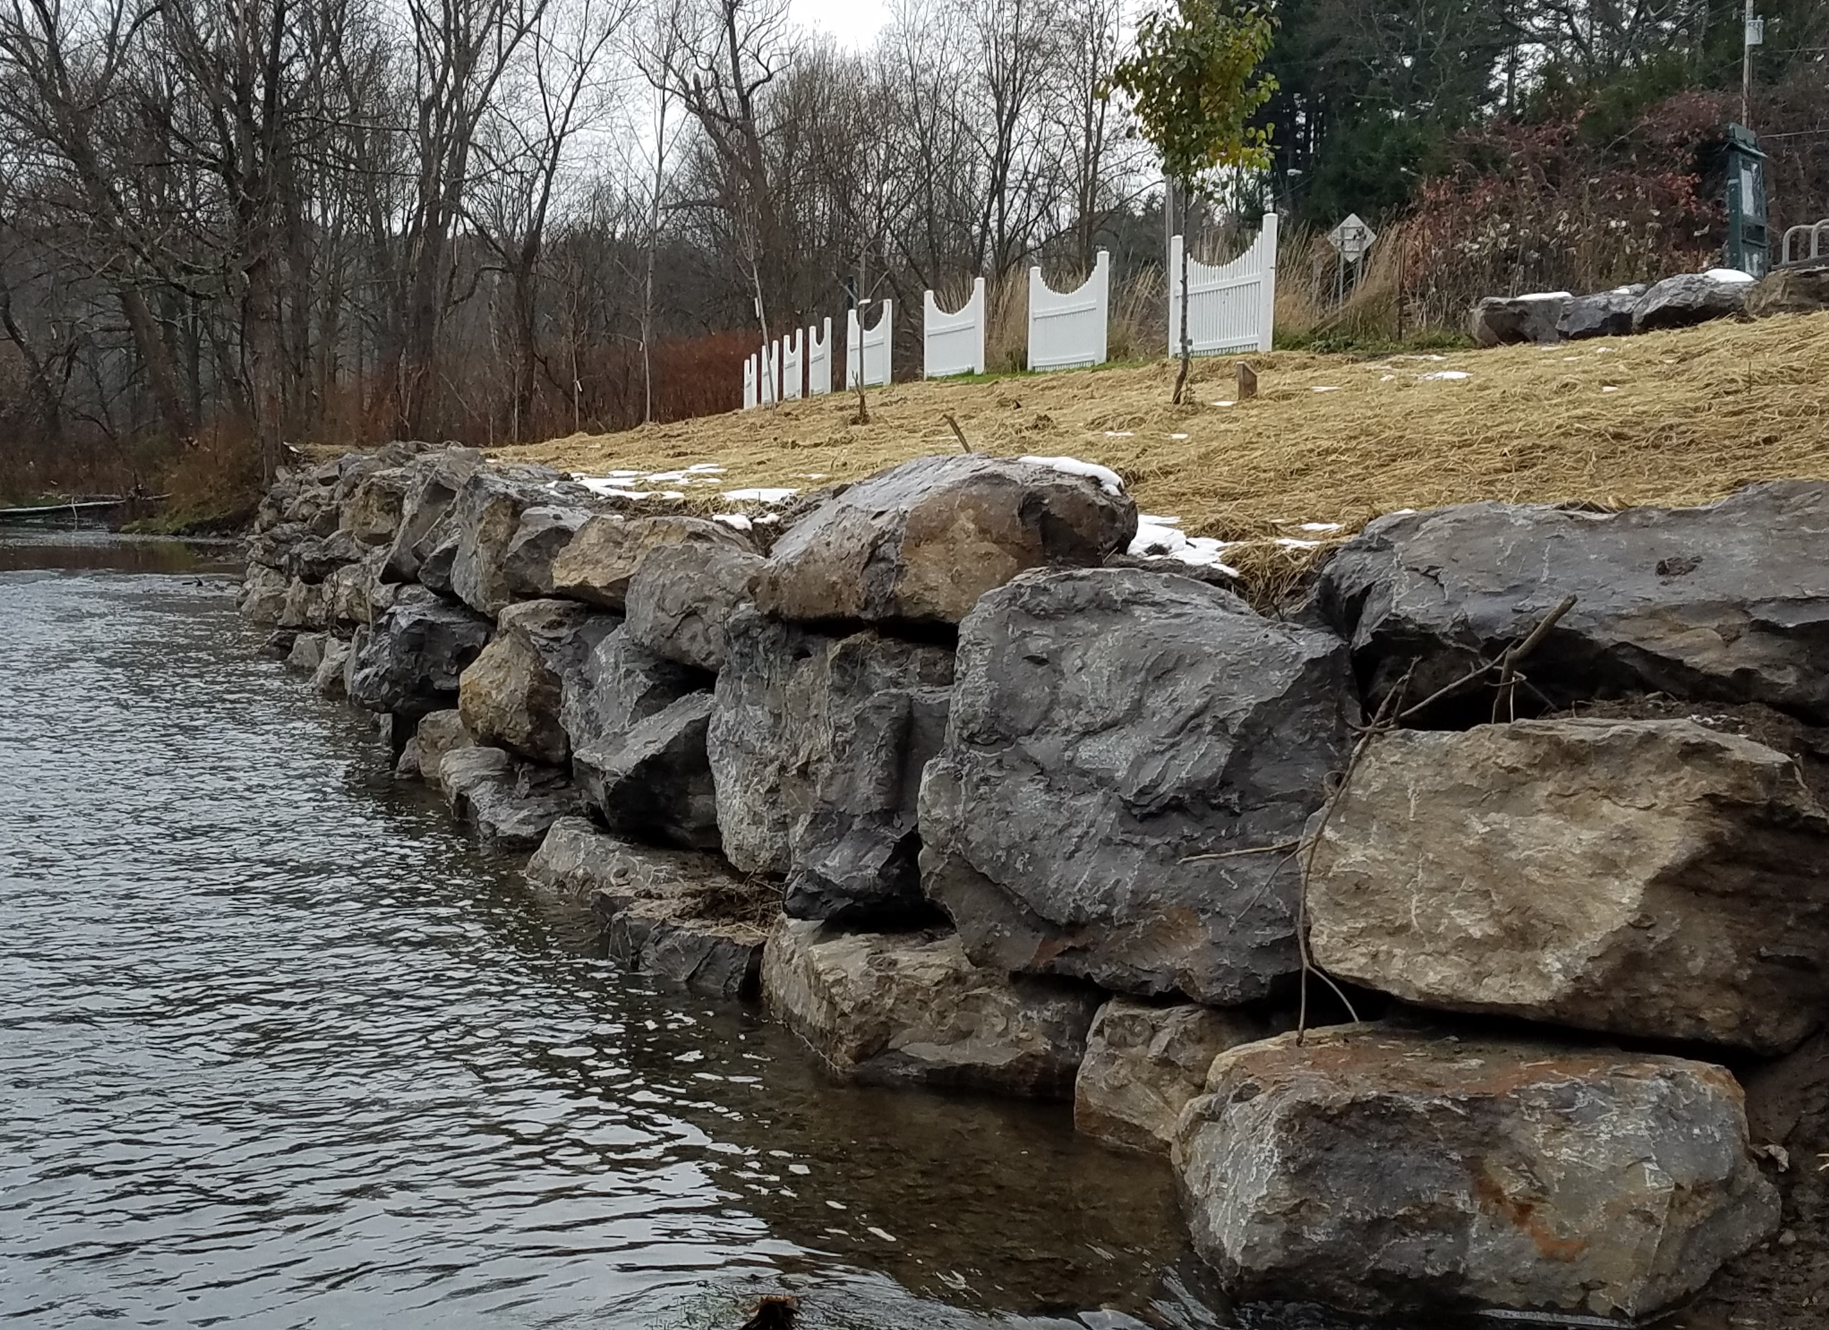
Stream Bank Stabilization: Hard Engineering

Slide 10
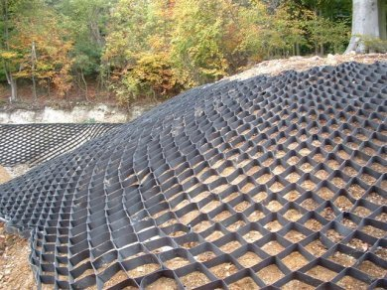
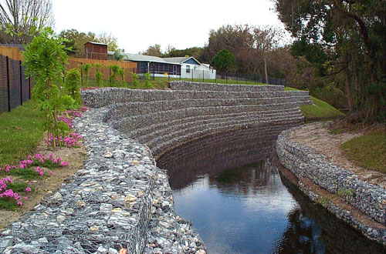
Stream Bank Stabilization: Hard Engineering
Geocells
Gabbions

Slide 11
Riparian Buffer Restoration

Slide 12
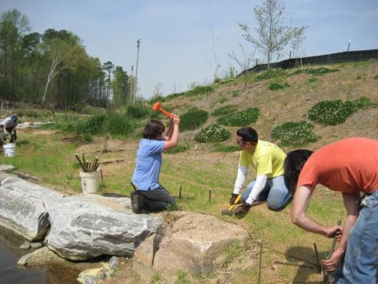
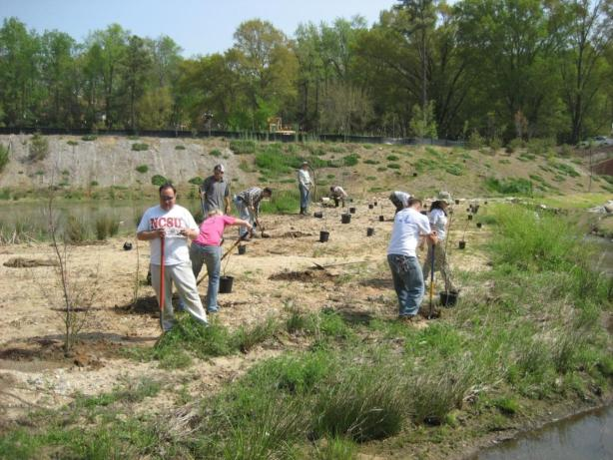
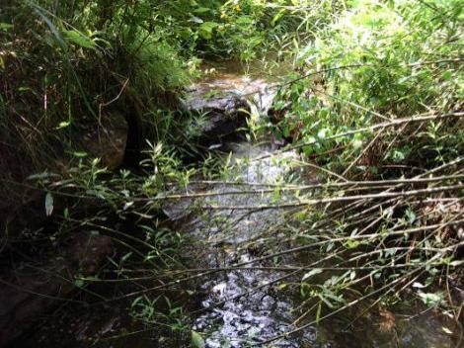
Riparian Buffers
Temporary ground cover
Permanent grasses
Wetland plants
Shrubs and trees

Slide 13
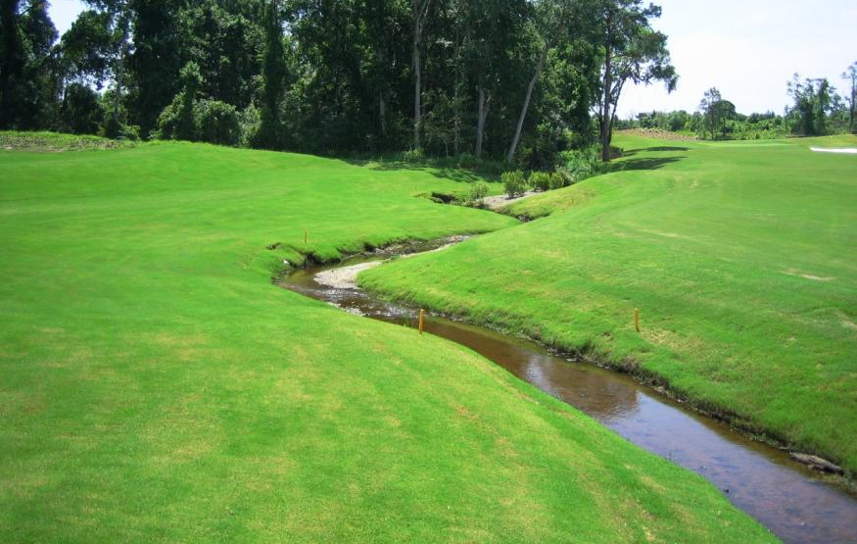
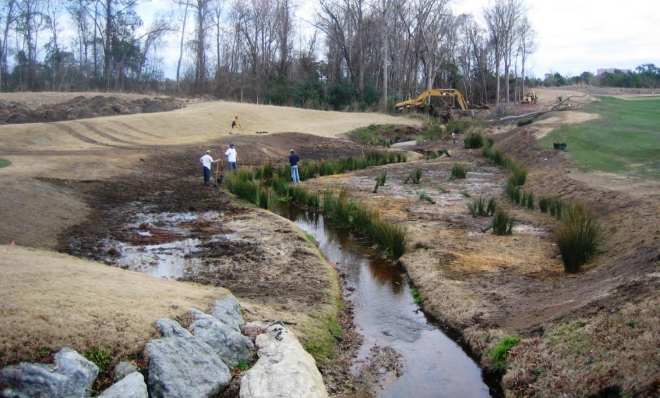
Myrtle Beach, SC
2005

Slide 14
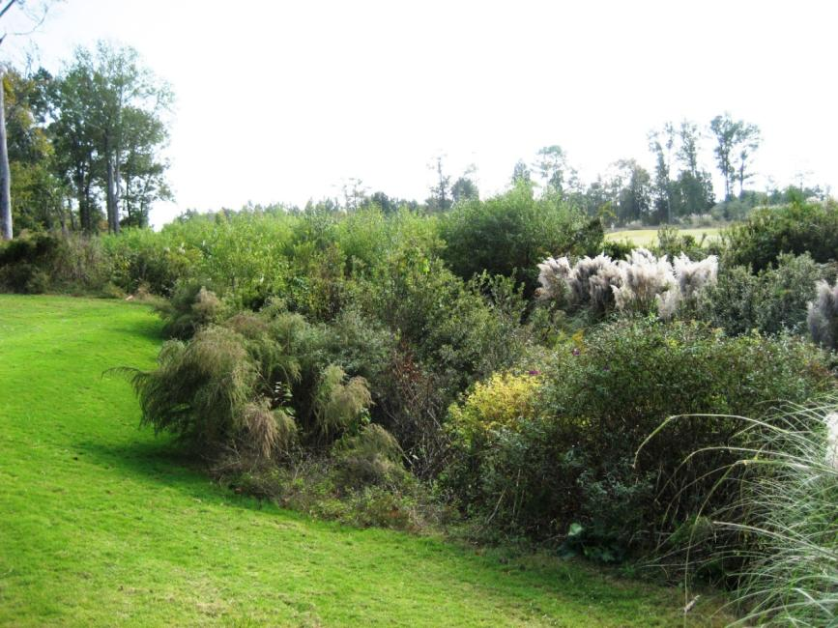
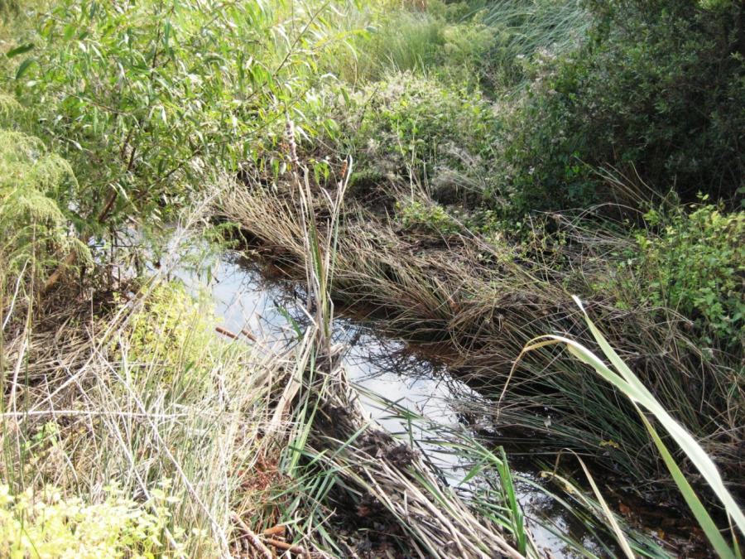
2007

Slide 15
In-Stream Structures

Slide 16
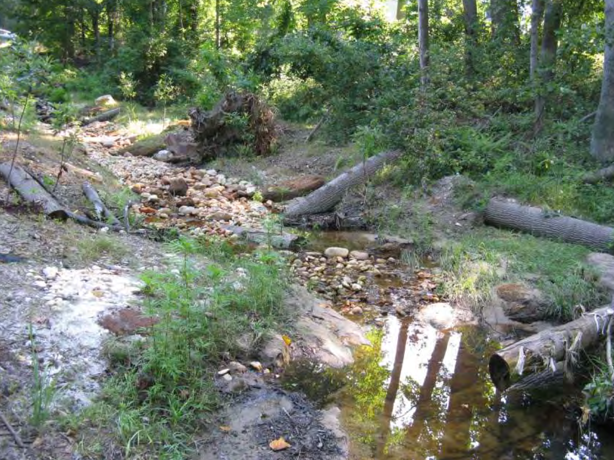
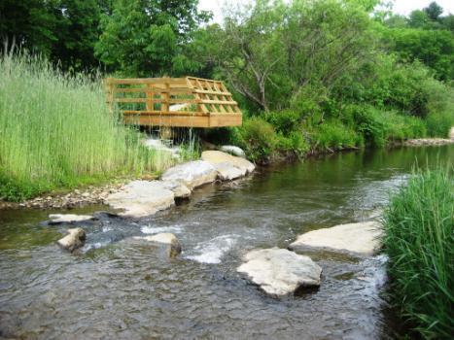
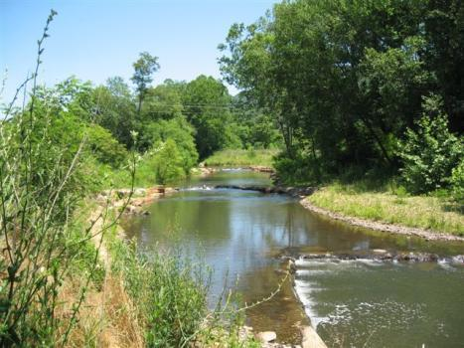
In-stream Structures
Grade control
Streambank protection
Habitat enhancement
Newland N Toe R Asheville Swannanoa R

Slide 17
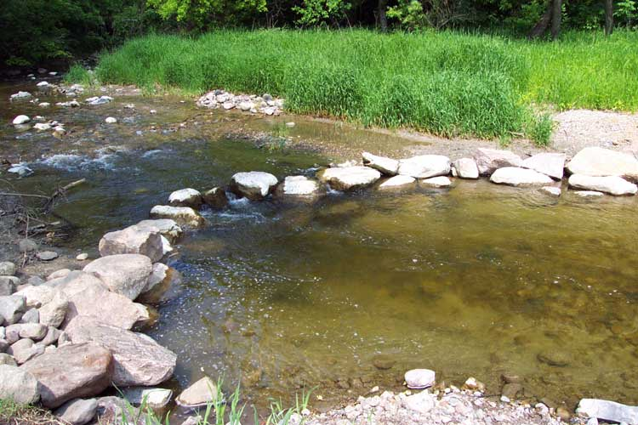
Cross-vane boulder structures
Fabric sheet

Slide 18
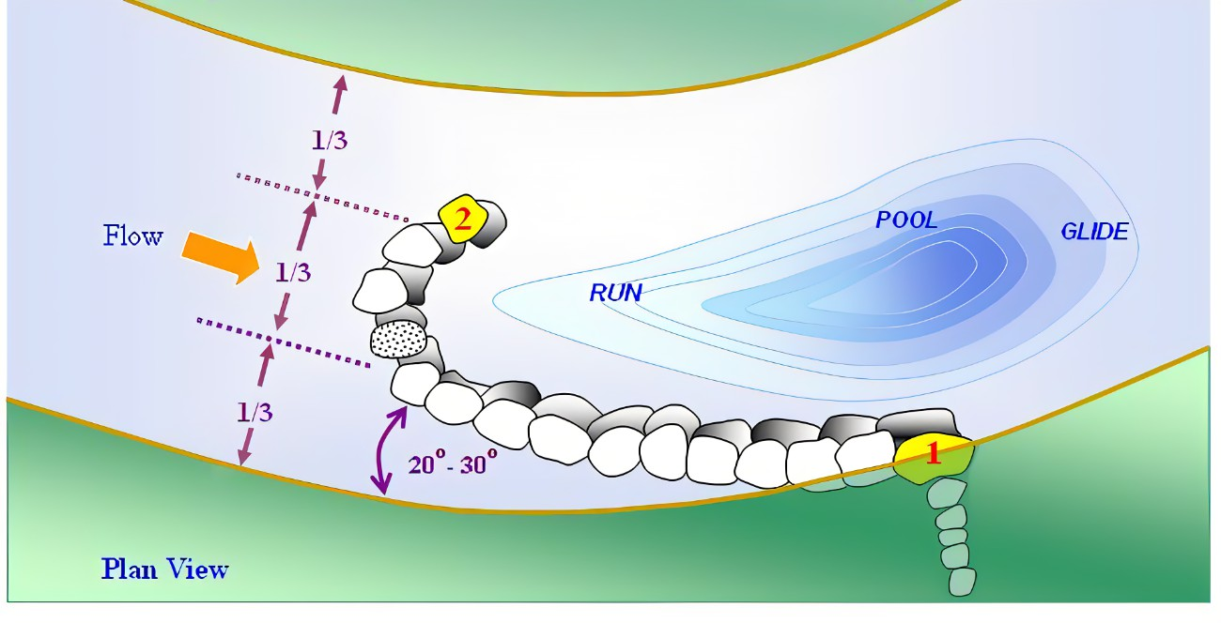
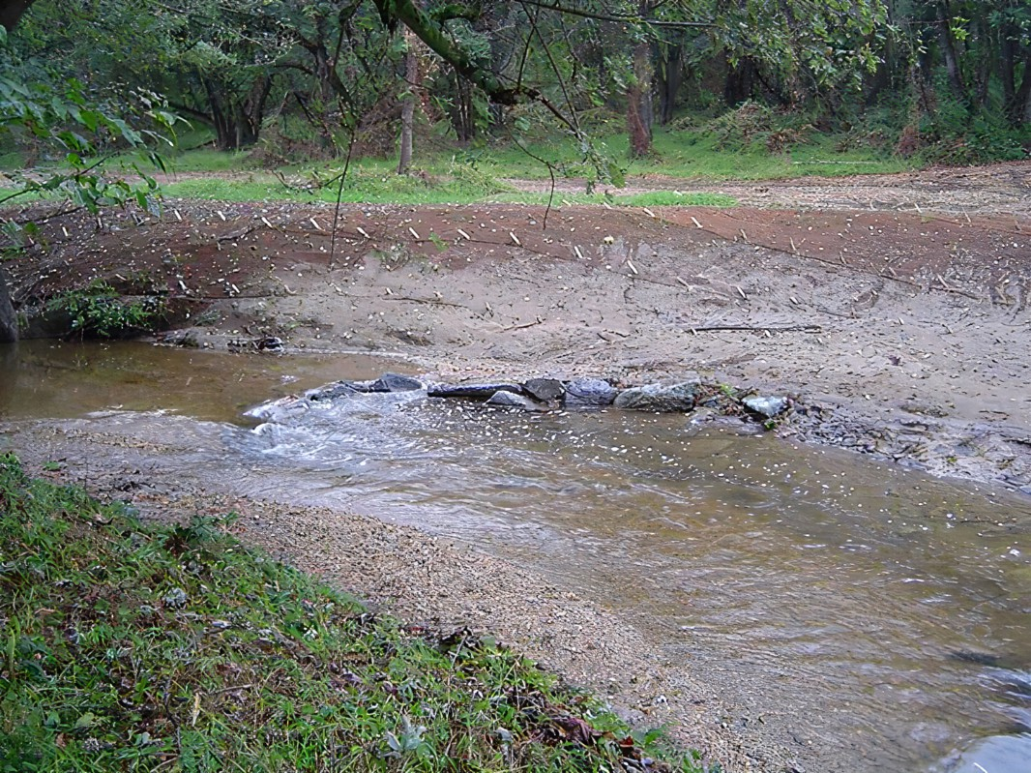
J-hook

Slide 19
W-weir

