Slide 1
4-H/FFA Crops Career Development Event 2011-2015
Weed Plant Identification
Photos Courtesy of Purdue Agronomy and Google Images

Slide 2
Garlic Mustard
Beginning 2012 Season
Triangular, heart-shaped leaves with coarsely toothed margins
Only 2nd year plants will be used (1st year are rosettes)

Slide 3
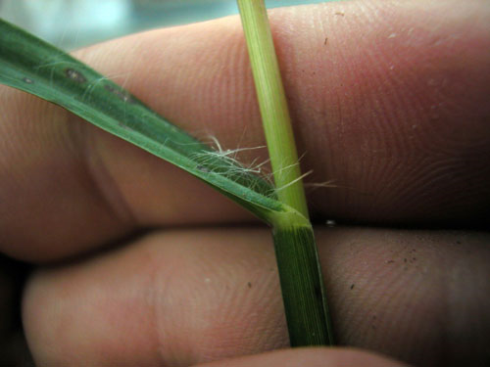
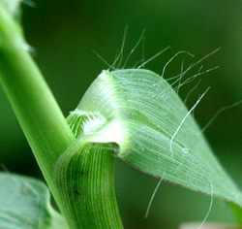
Yellow Foxtail
Beginning 2012 Season
Large seed head like giant foxtail
Sparse, long hairs located on upper leaf surface

Slide 4
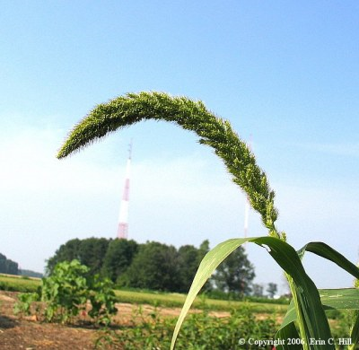
Giant foxtail
Numerous short hairs on the upper surface of the leaves and sheath
Seed head is much larger than related species

Slide 5
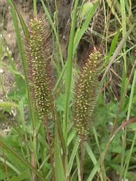
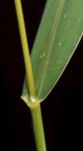
Green foxtail
Rough blades that lack hairs
Sheaths have hairy margins
Seed head is smaller and greener

Slide 6
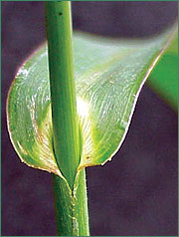
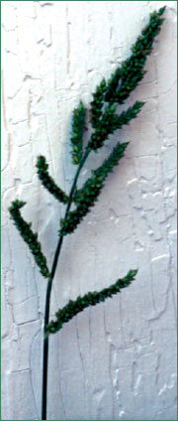
Barnyardgrass
Ligules and auricles are absent
No hairs present on leaf surface
Mid-vein is distinct
Dense spikelets

Slide 7
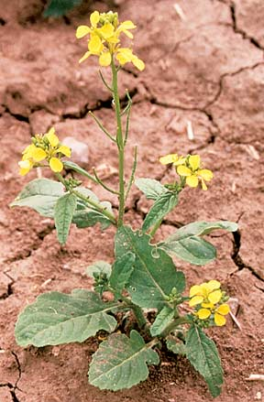
Wild Mustard
Leaves are alternate and roughly hairy
Leaf is widest at the apex and tapers off near the base
Siliques have long pedicels and have angular beak at the tip
Seeds can be seen through siliques
Silique
pedicel

Slide 8
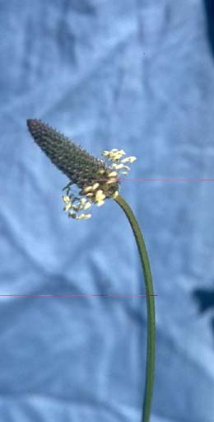
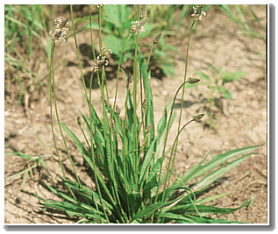
Buckhorn plantain
Leaves are a basal rosette
3-5 prominent parallel veins on blade
Seed head is leafless and cone-like

Slide 9
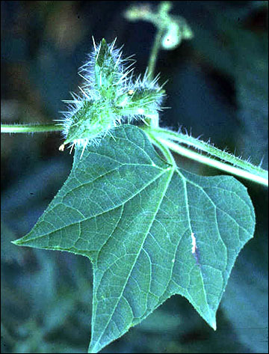
Burcucumber
Stems are sticky, hairy
Climbs with tendrils
Alternate leaves with shallow, angular lobes

Slide 10
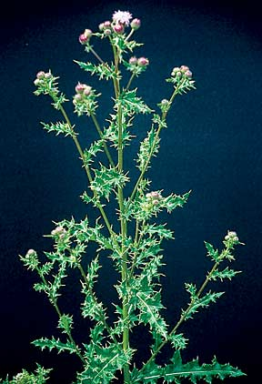
Canada thistle
Leaves are spiny
Leaves alternate and have crinkled edges that are irregularly lobed

Slide 11
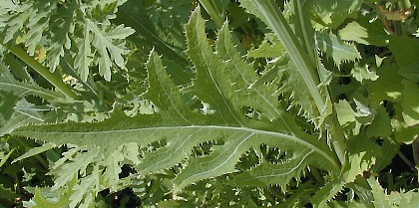
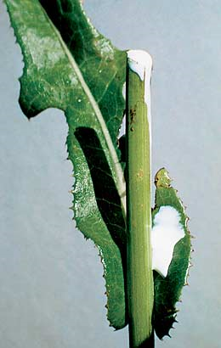
Perennial sowthistle
Bluish green stems that branch only near the inflorescence
Leaves are alternate with prickly-toothed margins
Margins are deeply triangularly lobed

Slide 12
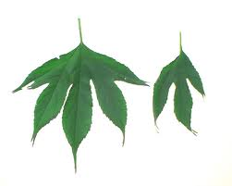
Giant ragweed
Leaves can have anywhere from 3-5 lobes
Both stems and leaves are roughly hairy
Lower leaves are more deeply lobed

Slide 13
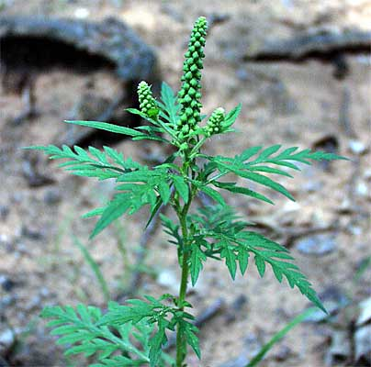
Common ragweed
Leaves are alternate with lower leaves sometimes being opposite
Lobed segments

Slide 14
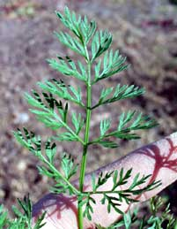
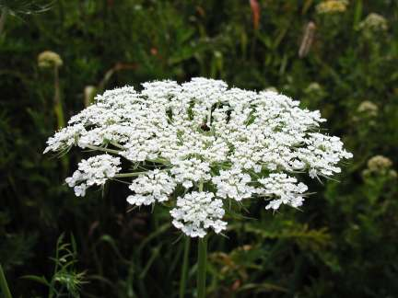
Wild carrot (Queen Anne’s Lace)
White flowers in compound head
Leaves alternate
Leaves are finely pinnately divided, making them fern-like

Slide 15
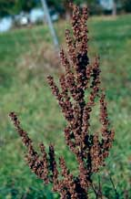
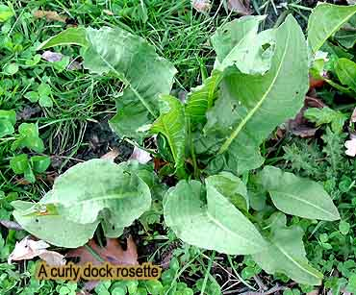
Curly dock
stem are smooth and erect
Leaves have wavy margins
Flower head is narrowly spaced between branches

Slide 16
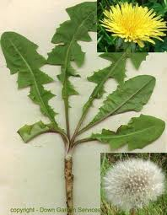
Dandelion
yellow ray flowers
deeply lobed leaves
points on leaves point towards the base

Slide 17
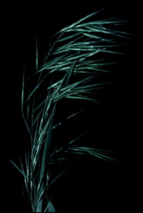
Downy brome
panicle is soft and drooping
Blades are hairy and sharply pointed

Slide 18
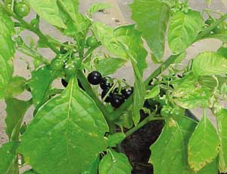
Eastern black nightshade
Branching stems that are angular
Leaves alternate with irregular toothed margins

Slide 19
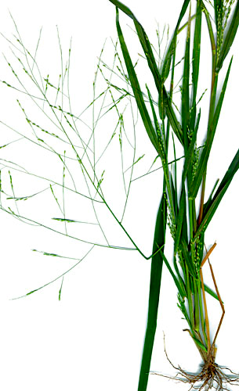
Fall panicum
Stem often has a waxy appearance with ligule as hair fringe
Swollen nodes give zig zag appearance
Midvein is light green to white
Seed head is large, freely branched, spreading panicle

Slide 20
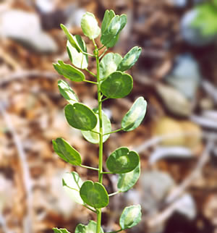
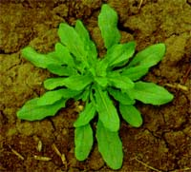
Field pennycress
Basal leaves have toothed margins
Flowering stems do not branch with oblong upper leaves
Upper leaves have auricles
Fruit is flat and circular and winged around margins with a notch

Slide 21
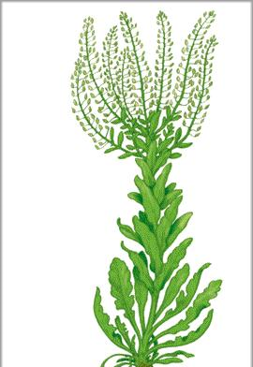
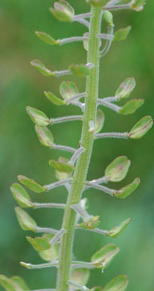
Field pepperweed
Leaves are rounded at the ends and tamper to the base
Upper leaves are more arrowhead shaped and clasp at the base
Leave margins can be entirely or partially toothed
Fruit is ovate with wing like structures ( much smaller than pennycress)
Fruit collectively gives a bottle brush appearance

Slide 22
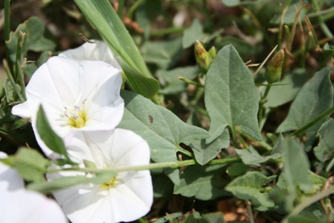
Field bindweed
Vines
Alternate leaves with lobes pointing away for the petiole at the base
petiole

Slide 23
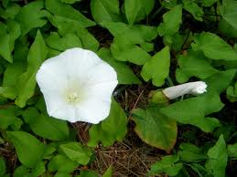
Hedge bindweed
Vines
Square lobes at bottom of leaf
leaves have five points
Lobes points away from the petiole at the base

Slide 24
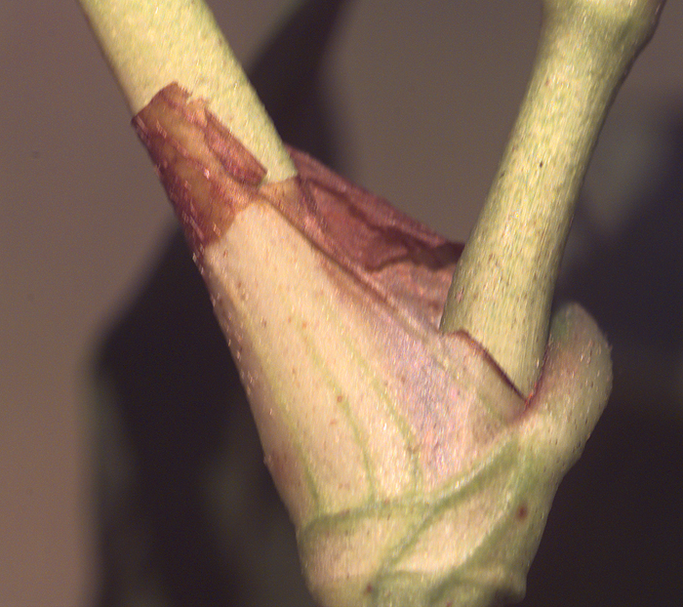
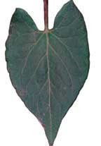
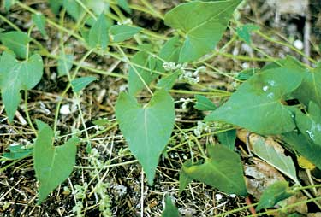
Wild buckwheat
Vines
Leaves are alternate and are triangular to heart shaped
Base lobes point toward petiole
Ocrea encircles the stem at the base of the petiole
Ocrea

Slide 25
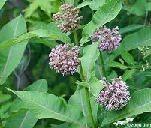
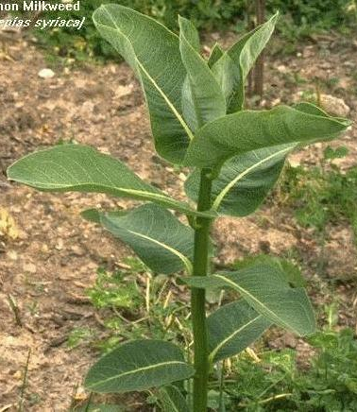
Common milkweed
Unbranched, erect stems covered in hairs
Stems contain milky sap and become red later in the season
Leaves are oblong and opposite and contain a prominent, white midvein

Slide 26
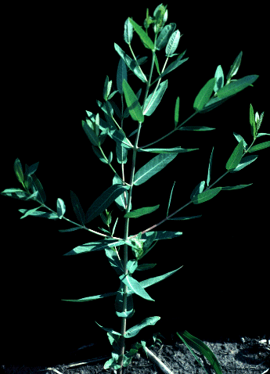
Hemp dogbane
Opposite leaves
Branched near top of plant
Stem appears to be woody

Slide 27
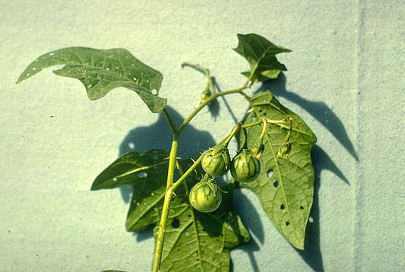
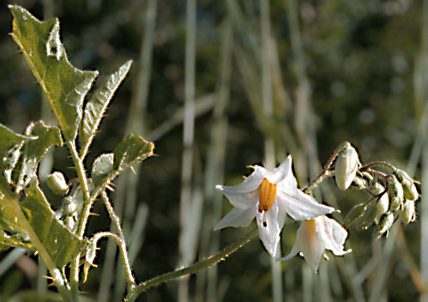
Horsenettle
Stems have sharp, stout, yellowish or white prickles

Slide 28
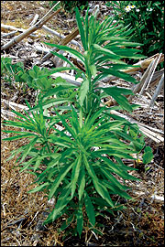
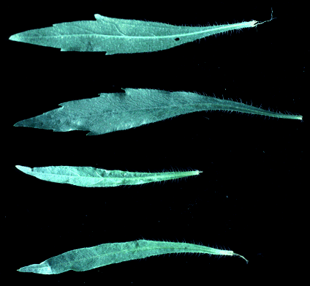
Horseweed
Leaves are hairy and alternate
Tall, erect central stem
Leaf margins are toothed

Slide 29
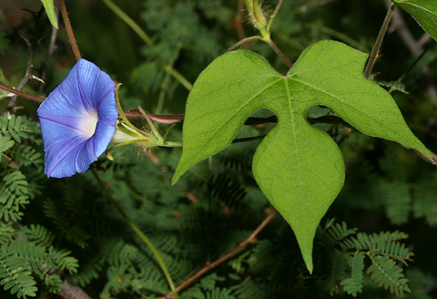
Ivyleaf morningglory
Vines
Leaves are alternate and have 3 deep lobes
1st true leaf may be heart shaped
Hairs on leaves and stems

Slide 30
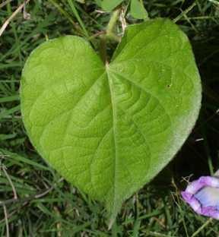
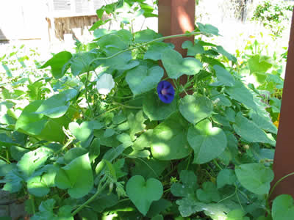
Tall morningglory
Vines
Leaves are alternate and heart shaped
Leaves covered densely with hairs lying on the surface

Slide 31
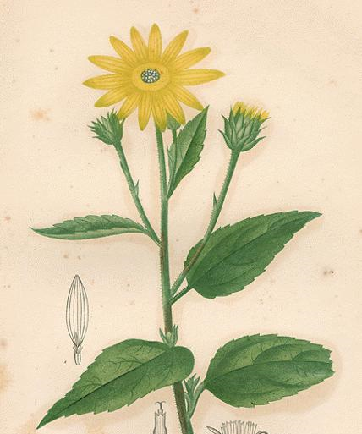
Jerusalem artichoke
Coarse, stout stem with hairs
Simple leaves with narrow tip
Toothed margins with rough leaf surface
Lower leaves are opposite, upper leaves are alternate

Slide 32
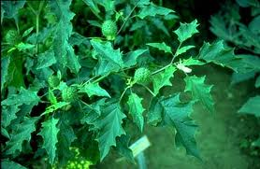
Jimsonweed
Smooth stems that are green or purple in color
Leaves are fairly large and alternate
Leaf margins are coarsely and unevenly toothed, resembles oak leaves

Slide 33
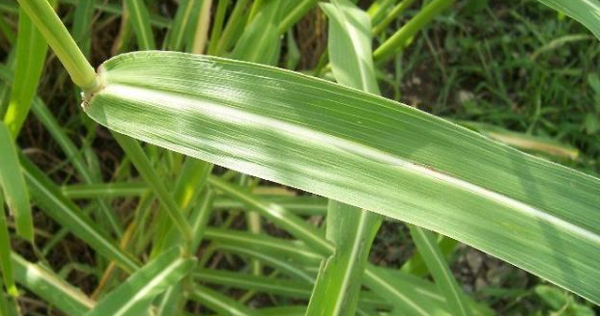
Johnsongrass
Membranous ligule, may be jagged across top
Blades may have some hairs near ligule
Blades are flat with thick prominent white midvein
Large, open coarse panicle with spikelets in pairs

Slide 34
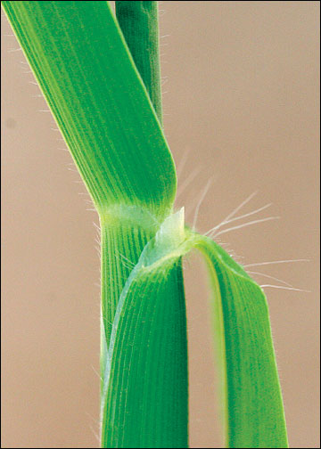
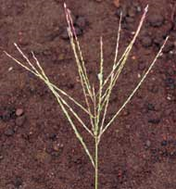
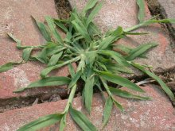
Large crabgrass
Hairs present on blade
Elongated stems
Sheaths

Slide 35
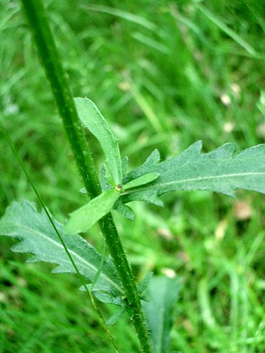
Oxeye daisy
Basal rosette
Stems are smooth and hairless, usually unbranched
Leaves are hairless with teeth or round lobes on the margins and become smaller up the stem
White ray flowers

Slide 36
Pennsylvania smartweed
Swollen and jointed at the nodes
Ocrea present at base of petiole
Leaves are alternate
Center of leaves may have a purplish blotch
Ocrea

Slide 37
Quackgrass
Auricles are narrow and clasp the stem
Ligule is membranous and short
Sheaths are rounded and smooth, some hairs near base of plant
Seed head is long spike arranged in 2 rows
Awns can be present

Slide 38
Redroot pigweed
Upper portion of plant is branched and hairy
Leaves alternate and ovate with wavy margins and hair along veins
Veins on lower surface are white

Slide 39
Shepherdspurse
Basal rosette with leaves deeply toothed or lobed
Flowering stems are usually leafless and covered in gray hairs

Slide 40
Trumpetcreeper
Woody vine
Leaves are alternate and pinnately compound
7-11 leaflets that are coarsely toothed

Slide 41
Velvetleaf
Erect stems covered with short velvety hairs
Leaves are heart shaped with toothed margins and soft hairs
Leaves and stems emit an unpleasant odor when crushed

Slide 42
Wild garlic
Leaves are linear
Flowering stems are solid and unbranched

Slide 43
Common lambsquarters
leaves have white grainy underneath
stem has prominent venations
sometimes has a purplish cast

Slide 44
Common cocklebur
rough, sandpapery leaves
stems are hairy with black spots
leaves are alternate with long petioles
occasionally have 3-5 shallow lobes and often heart-shaped at the base

Slide 45
Yellow nutsedge
triangular stem
flowers yellow bushy

