Slide 1
4-H/FFA Crops Career Development Event 2011-2015
Weed Seed Identification
Photos Courtesy of Purdue Agronomy

Slide 2
Johnsongrass
2 knobbed rachilla
Long, oval, and dark reddish brown color
7

Slide 3
Perennial sowthistle
Rough, dark brownish red
Oblong shape with deep ridges

Slide 4
Dandelion
Reddish brown color
Tiny ribs and spines on seed
Usually has a prominent white tip

Slide 5
Canada thistle
Smooth and brown
Long ridge around the blossom end

Slide 6
Wild garlic
Like tiny garlic or onion bulblets

Slide 7
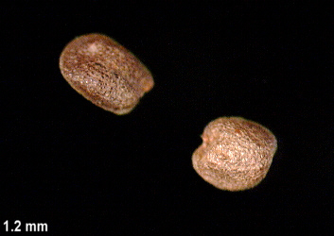
Bitter wintercress
Dull, tannish to light brown
Rough seed coat

Slide 8
Buckhorn plantain
Medium brown color
Long, oval shape
Hilum has one light colored spot
Middle is dug out to look like a canoe

Slide 9
Curly dock
Shiny, triangular seed
Reddish brown color

Slide 10
Eastern black nightshade
Flattened yellow to dark brown
Dull and pitted
Smaller than horsenettle
Usually has a dirty appearance

Slide 11
Horsenettle
Oval, flattened
Usually yellow
Resembles hot pepper seeds at Pizza hut

Slide 12
Shepherdspurse
Tiny orange-brown
Slender long
Straight crease in seed
Dark tip

Slide 13
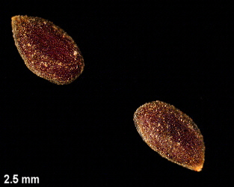
Field pepperweed
small, dark brown
rough seed coat
generally pointed at one end and may be indented on one side

Slide 14
Oxeye daisy
Carrot or comma shape
Tiny ridges or stripes on seed

Slide 15
Field pennycress
Flat, black seed with “thumbprint”
Teardrop shaped

Slide 16
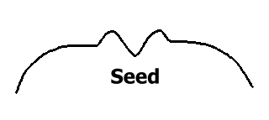
Wild mustard
Black-reddish color
Round seed with 2 hills and 1 valley in the seed

Slide 17
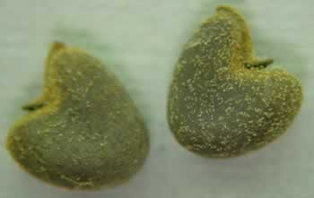
Velvetleaf
Gray and notched on one side
Rough appearance

Slide 18
Common ragweed
Like giant ragweed, but smaller

Slide 19
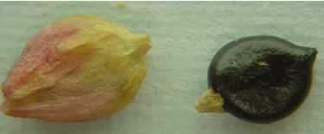
Pennsylvania smartweed
Tear drop shapre both in and out of hull
Seed is shiny black, almost flat
Looks like ace of spades

Slide 20
Morningglory
Dark seed
Watermelon slice shape (wedge)
Larger and smoother than bindweed

Slide 21
Bindweed
Dull gray with rough surface
Triangular
1 end looks bunched, like it has been “binded”

Slide 22
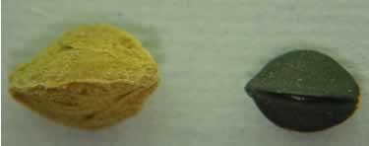
Wild buckwheat
Seeds are triangular somewhat shiny black
Usually covered fully or partial with rough hull
Larger than curly dock

Slide 23
Redroot pigweed
Lens shaped
Glossy black, looks oily
Extremely small

Slide 24
Green foxtail
Oval shape with a green hue
Smaller than giant foxtail
Palea covers more than ½ the seed

Slide 25
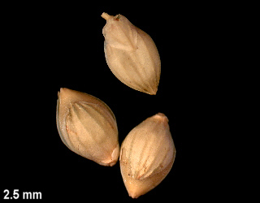
Giant foxtail
light green to yellow
Larger than green foxtail
Palea and lemma are attached to the seed

Slide 26
Wild carrot
Oval shape
Tiny spines and feathery on outside edges

Slide 27
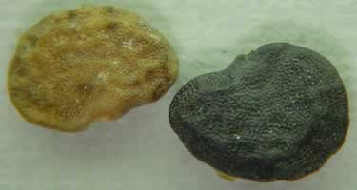
Jimsonweed
Pitted surface
Dark brown to black with kidney like shape
Seeds slightly wrinkled and somewhat flat

Slide 28
Giant ragweed
Large, woody hull
Blunt ridges with several short, thick spines

Slide 29
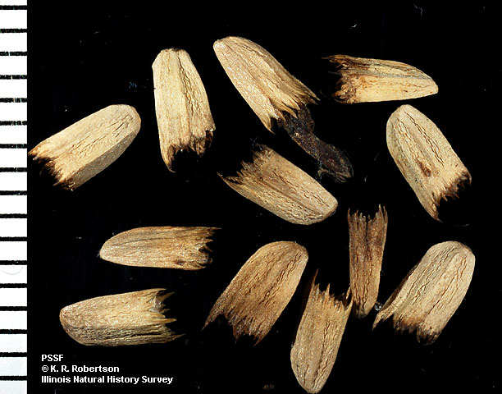
Horseweed
Extremely small seed, sometimes with pappus
Sample usually looks messy and includes plant matter

Slide 30
Quackgrass
Sucker mouth on rachilla
Teeth on edges of palea

Slide 31
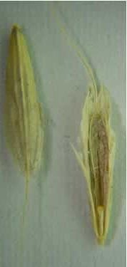
Downy brome
Long and slender
Very long awn
One vein on glume
hairy at ends

Slide 32
Common lambsquarters
In papery casing looks star shaped
Dull to shiny black, circular

Slide 33
Barnyardgrass
Naked seed is glossy straw color
Humped shape awns with spiny hairs on palea

Slide 34
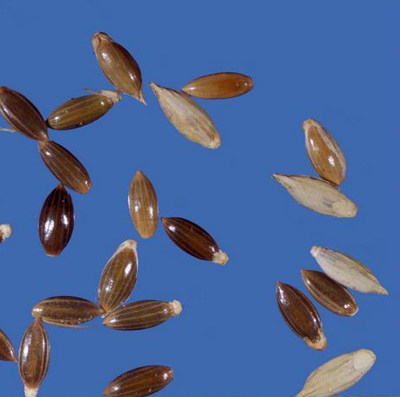
Fall panicum
Small straw colored seeds
Oval shape

Slide 35
Large crabgrass
Flat on one side with about 3 veins
Rounded to oval
Other side is striped and hairy
May have purple tint

Slide 36
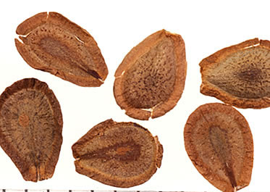
Common milkweed
Papery like seed
Tear drop shape and light brown

Slide 37
Cocklebur
Bur
Elliptic to egg-shaped
Covered with hooked prickles
Two beaks project from tip of the bur

Slide 38
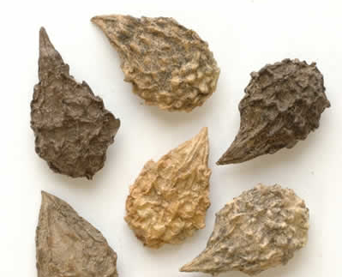
Burcucumber
Tear drop shape with rough hull
Dime-sized

Slide 39
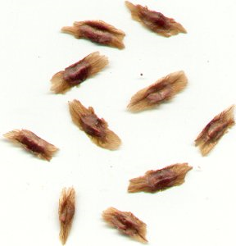
Trumpetcreeper
Light to dark brown
Papery appearance

