Slide 1
4-H Trips and Scholarships
Taking what you’ve learned
and turning it into $$$
Taken from 2021 scholarship workshop-Updated November 2023

Slide 2
What have you gained so far from being a member in 4-H?

Slide 3
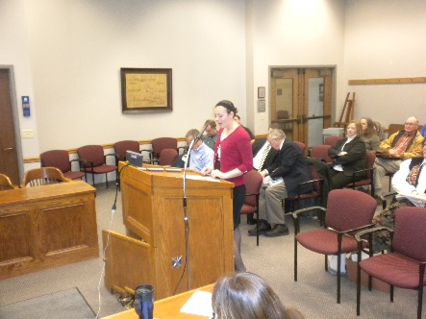
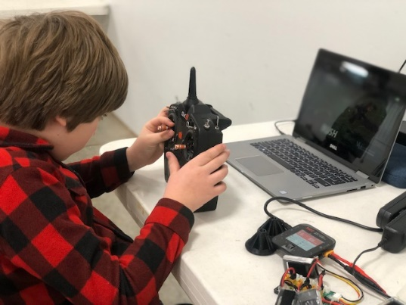
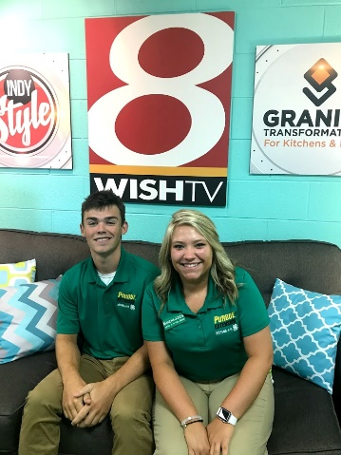
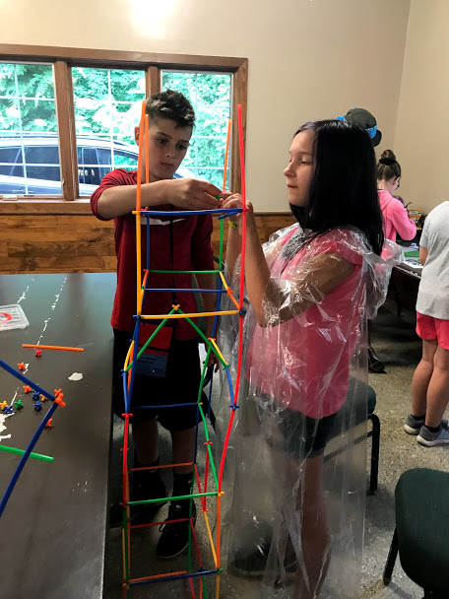
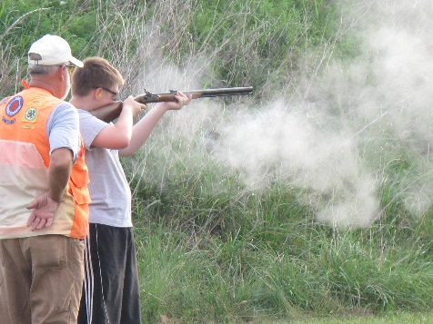
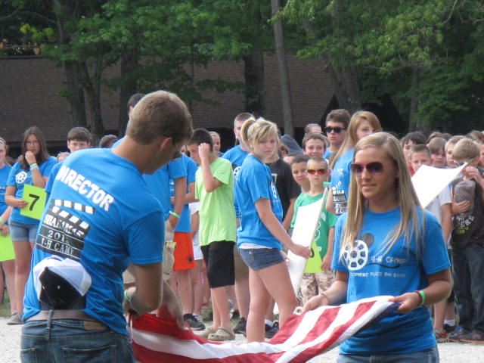
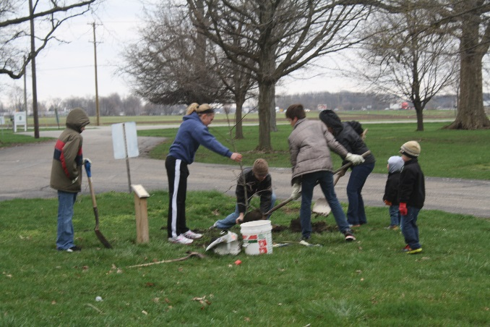
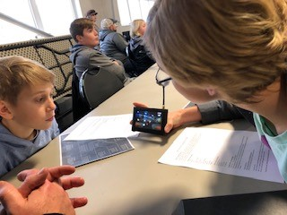
4-H Members
Learn
Life Skills

Slide 4
Life Skills Learned Through Different Activities
Tip: Use your Achievement Book or record sheets for examples.
Activity | Type of Skill(s)
Club Committee Office Service Project | Teamwork Leadership Community Service / Citizenship
Project Animal Arts & Crafts | Responsibility, Time Management Creativity, Planning
Contest - Demo, Share-the-Fun - Judging Teams | Communication Decision-Making
Junior Leaders | Leadership, Teaching, Organization

Slide 5
How can you gain more life skills?
By going on
4-H Trips & Conferences!

Slide 6
4-H Trips
Types of Trips
  Trips that are just for Boone County 4-H members.
  Trips that are just for Indiana 4-H Members.
  Trips that 4-H members from across the nation go to.
How do you get to go on these trips?
  Apply using the Boone County 4-H Trip Applications
How much does it cost?
  Trip expenses differ based on the trip. Some are free, but most are at a reduced cost to Boone County 4-H members because of Boone County 4-H Boosters Club.

Slide 7
4-H Trips
More details on each of these trips can be found on our website. https://extension.purdue.edu/Boone
  Select 4-H Youth Development (side bar - middle of page)
  Scroll down on the page to 4-H Trips & Scholarships
Videos from 4-H trips are also online so you can have a better picture of what the trip is like.

Slide 8
4-H Trips - Boone County Applications
Simple online application (survey)
Summer application due February 15th
Fall applications due September 1st
Simple click the boxes for the trips you want to go on that year.
Committee looks at record grades and placings for projects, leadership roles, community service, & other trips attended from your permanent record.

Slide 9
4-H Trips - State 4-H Applications
For some trips you must turn in a Boone County Trip Application and a State 4-H Application
  4-H Band
  4-H Chorus
  National 4-H Dairy Conference- essay
  National 4-H Congress
  National 4-H Conference

Slide 10

2024 County, State and National 4-H Trips & Events

Slide 11
Trips on Fall Application

Slide 12
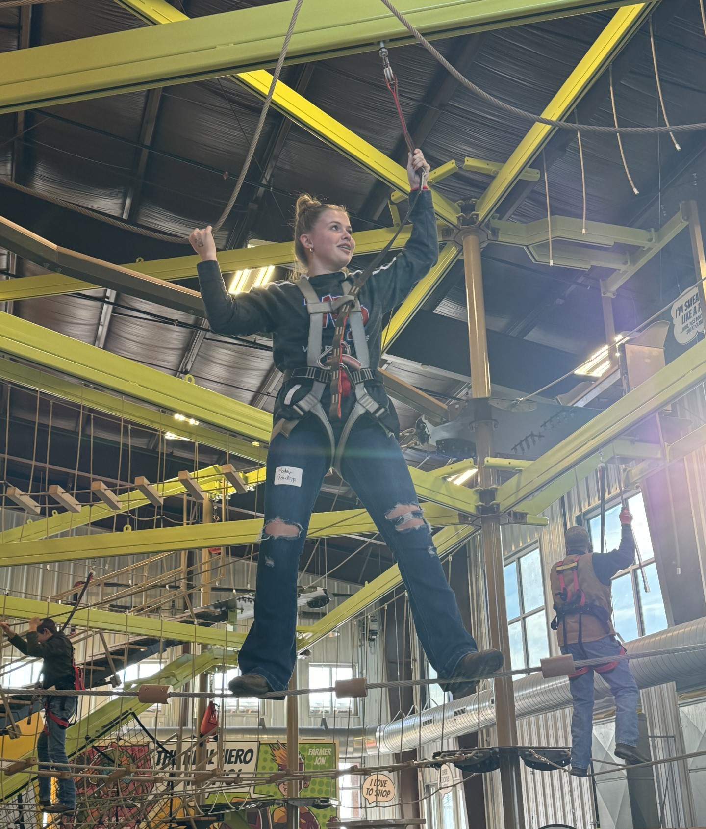
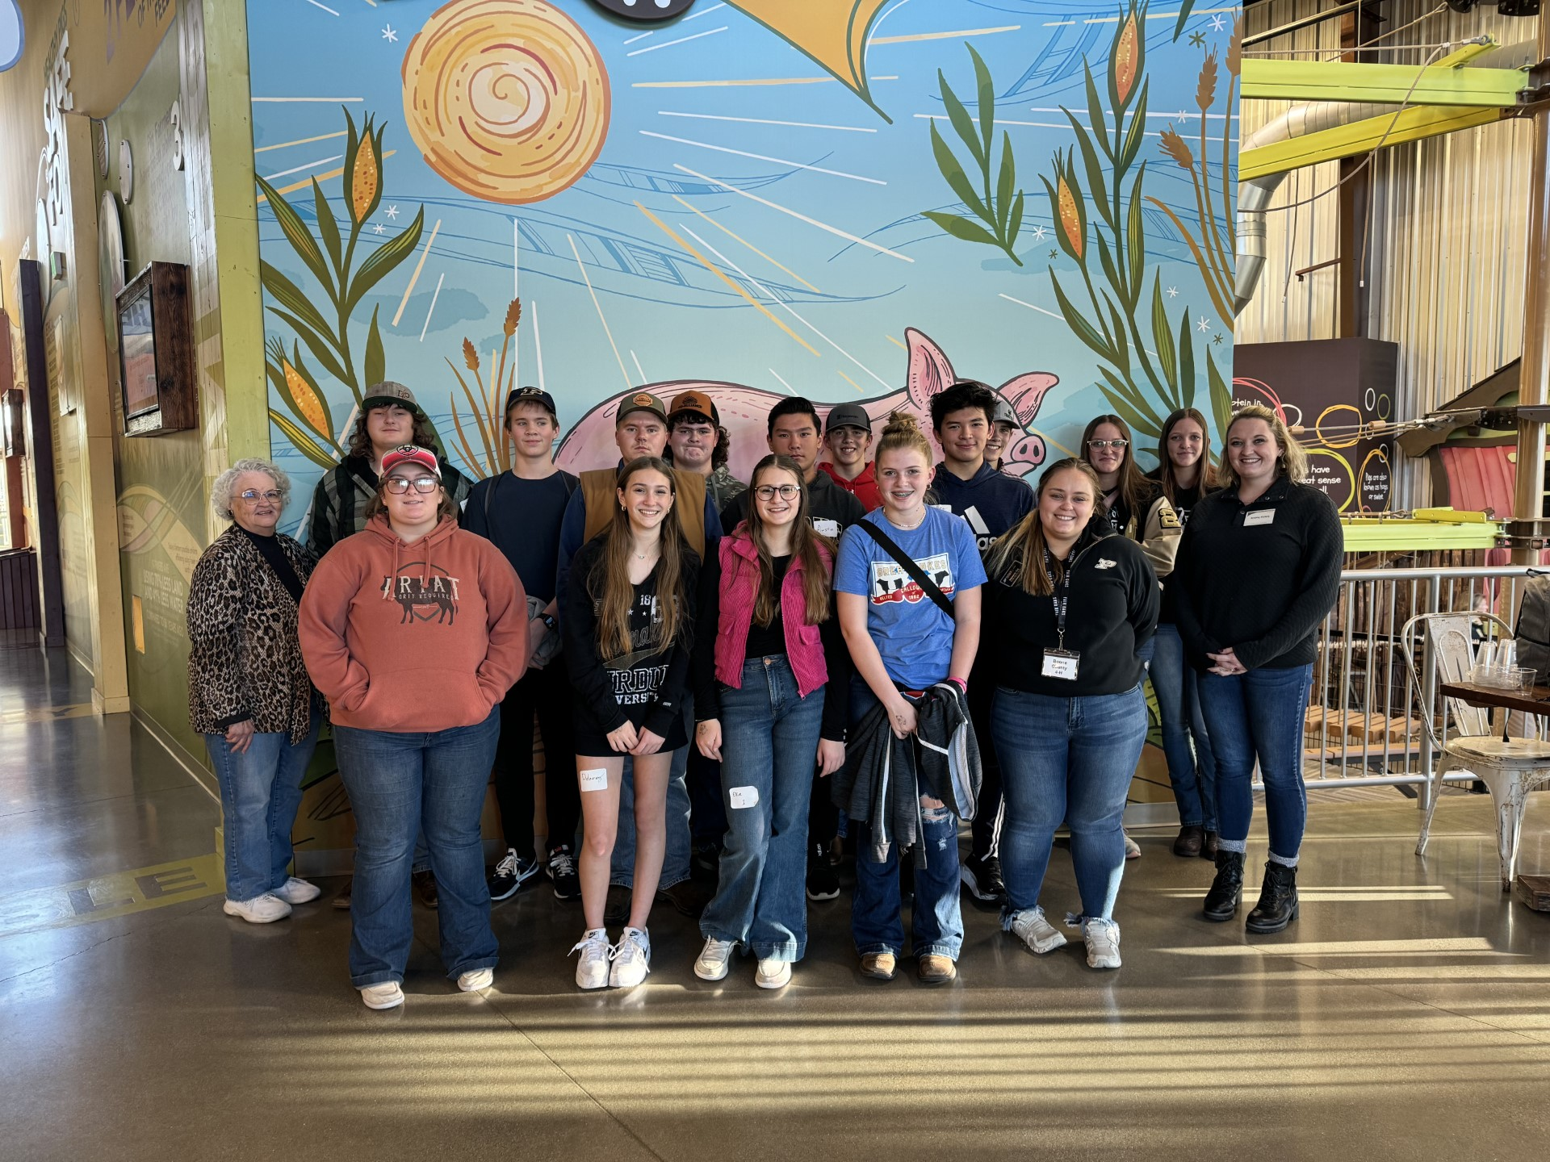
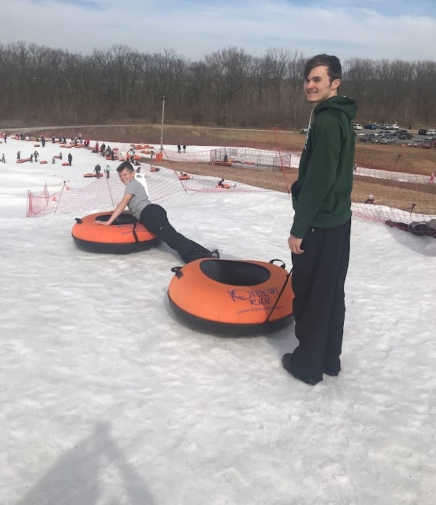
Boone County 4-H Achievement Trip
FALL APPLICATION
Current Grades 7-12
35 Youth from Boone County attend a one-day educational, hands-on trip in Indiana.
Each year is a different location and you can reapply each year!
Completely free…funded by Boone County 4-H Booster Club
Usually on a weekend in October or November

Slide 13
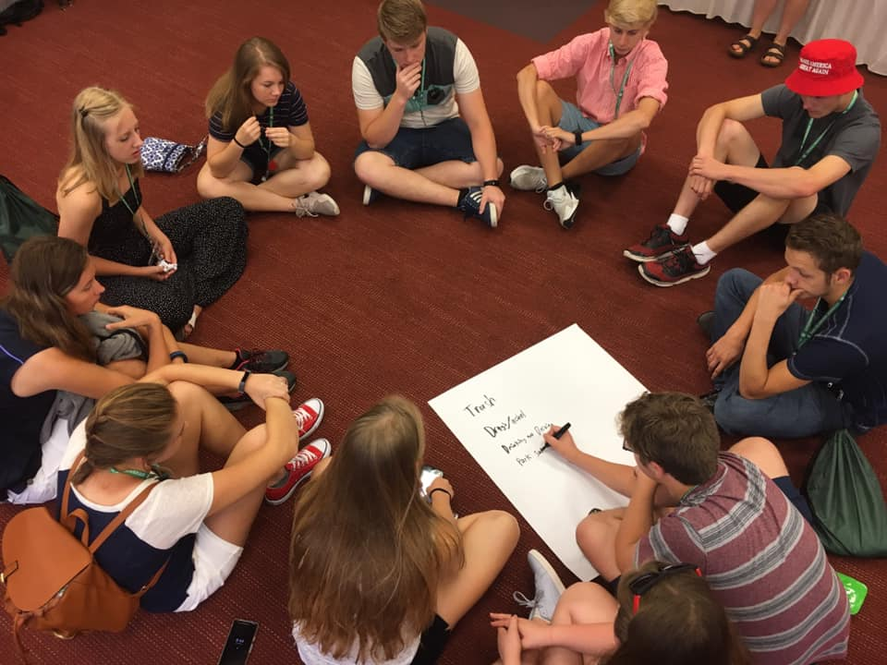
Citizenship Washington Focus
July 1-7, 2023
Conference teaches personal and team leadership as well as citizenship skills
Conducted in Washington, DC metro area
Visit legislators on Capitol Hill
Sightseeing in Washington, DC
Must be at least 15 years old
$1,600 (generally fully funded by Boone County 4-H Booster Club)
FALL APPLICATION

Slide 14
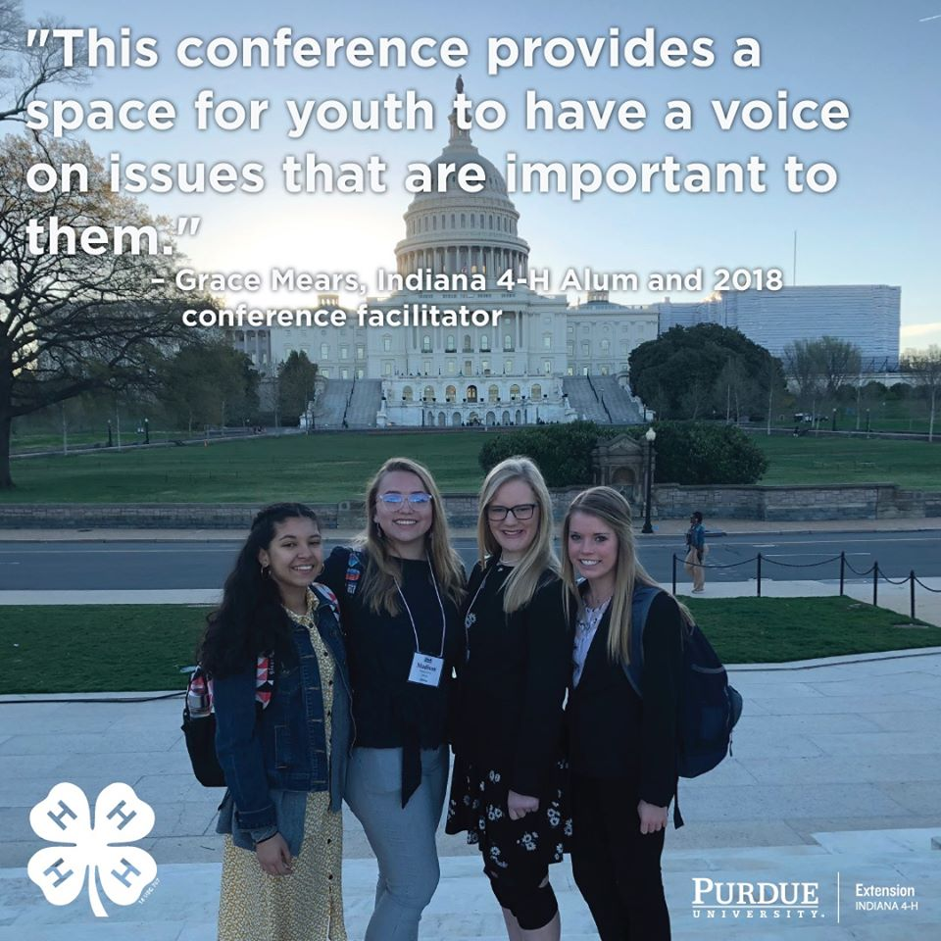
National 4-H Conference
Grades 9 - 12
Delegates selected from application and interview process by IN 4-H
Leadership conference that teaches personal leadership and citizenship skills
April 19-24, 2024, at National 4-H Conference Center near Washington, DC
$600 (estimate – will be partially to fully funded by Boone County 4-H Booster Club)
FALL APPLICATION

Slide 15
Trips on Summer Application

Slide 16
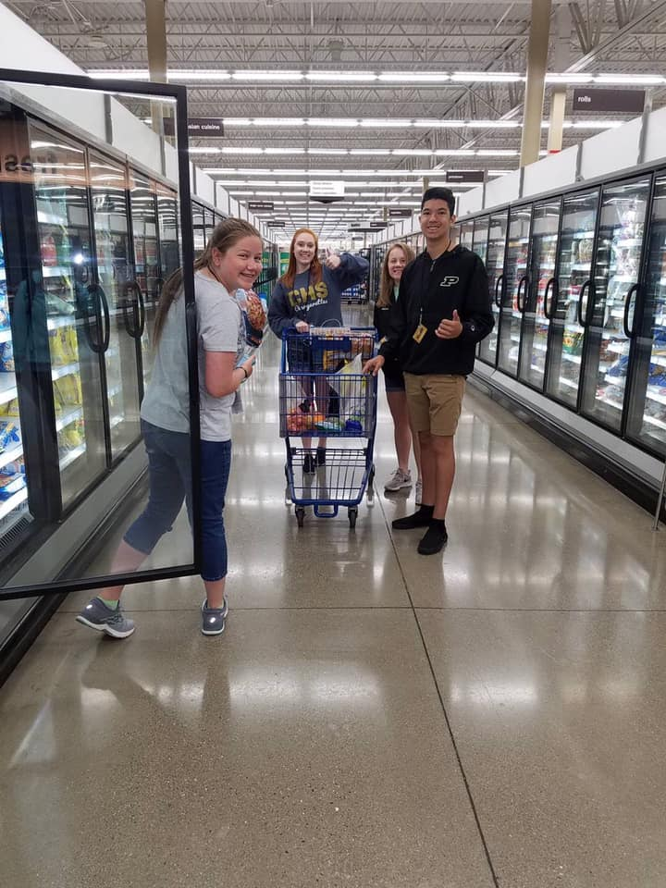

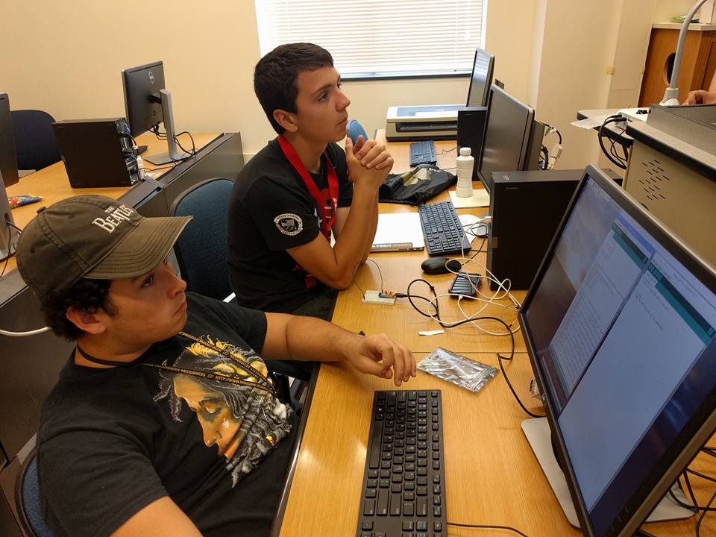
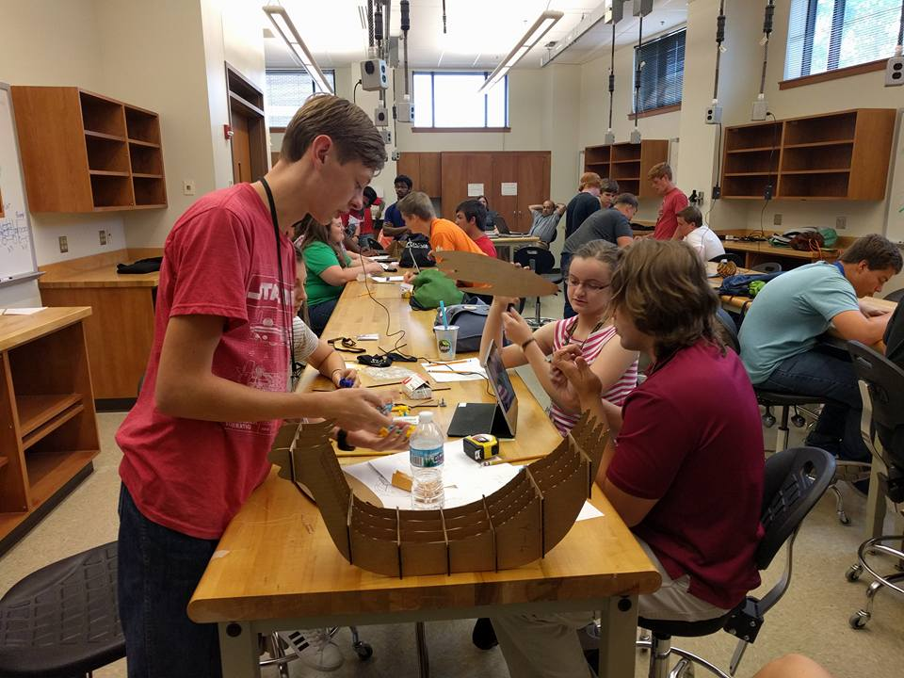
4-H Academy @ Purdue
Grades 9-12
June 12-14, 2024
Opportunity for youth to live on a Big Ten Campus
Hands-on educational workshops designed to teach technical and workforce preparation skills
Cost and deadline to register
List of workshops on next slide
$200 (generally fully funded by Boone County 4-H Booster Club)
https://www.youtube.com/watch?v=9HGP2FlY-Yk&list=PLtXSf1tu3Jd94YLXWTqsLwn1FogVoEPrB&index=84

Slide 17
4-H Academy @ Purdue OPTIONS
▪ Animal Bio-Science
▪ Animal Health
▪ Food Animal
▪ Horse and Companion
Animal
▪ Civic Engagement:
Community Change Starts
with Me
▪ Exploring Health Careers
▪ Intro to EMS
▪ Food Science/Nutrition
Science
▪ Natural Resources
▪ Plant Science
▪ Show Me the Money
▪ Spread the News
▪ Computer
▪ Engineering
▪ Science of Flight

Slide 18
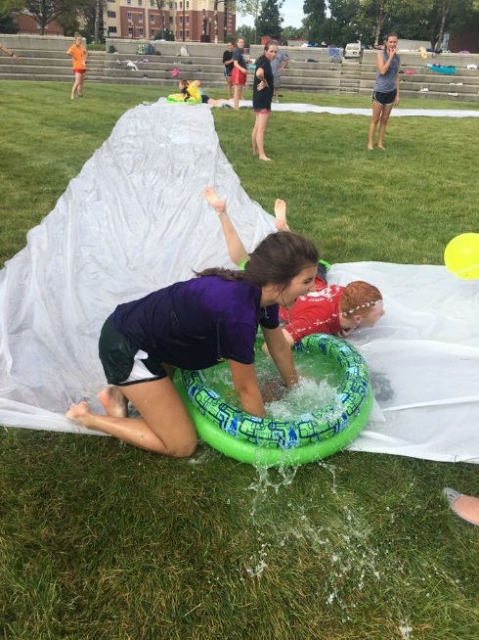
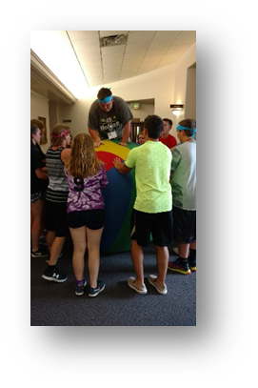
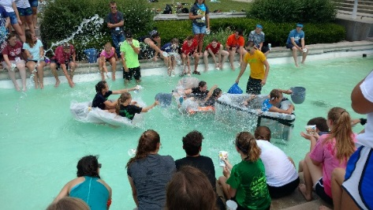
State 4-H Junior Leader Conference
June, 2024
DePauw University
Grades 9-12
Do not have to be in Jr. Leaders
Leadership development focusing on personal and team leadership
$200 (estimate – will be partially to fully funded by Boone County 4-H Booster Club)
https://www.youtube.com/watch?v=WZMw2mtQHds&list=PLtXSf1tu3Jd94YLXWTqsLwn1FogVoEPrB&index=82

Slide 19
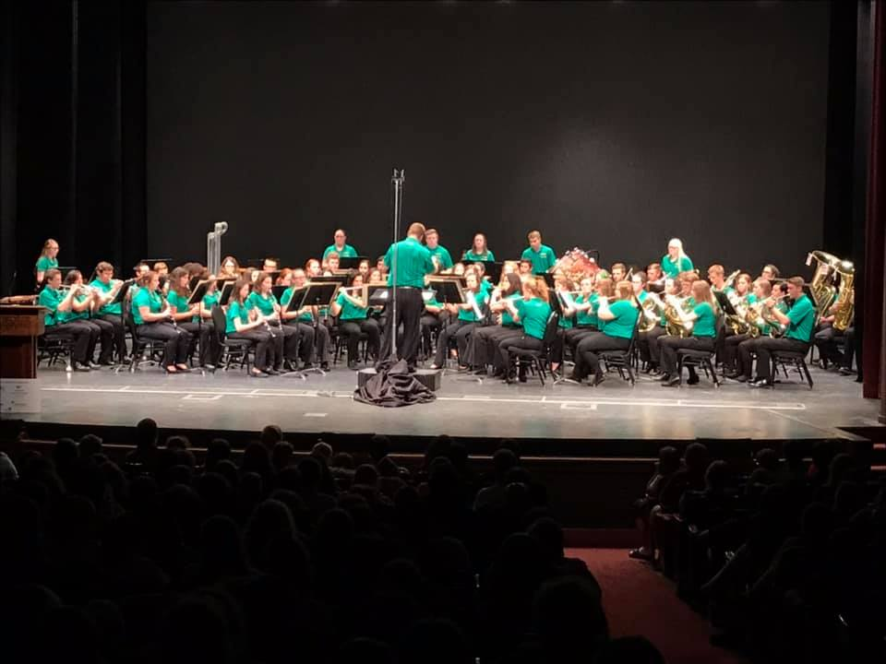
4-H Band
Grades 9-12
Do not have to be a 4-H member
Intensive instructional workshop
Perform at 4-H Round-Up
June 22-24, 2024
$200 (estimate – will be partially to fully funded by Boone County 4-H Booster Club)

Slide 20

4-H Chorus
Grades 9-12
Do not have to be a 4-H member
Must have recommendation letter from Choir Director
Intensive instructional workshop
Perform at 4-H Round-Up
June 22-24, 2024
$200 (estimate – will be partially to fully funded by Boone County 4-H Booster Club)

Slide 21
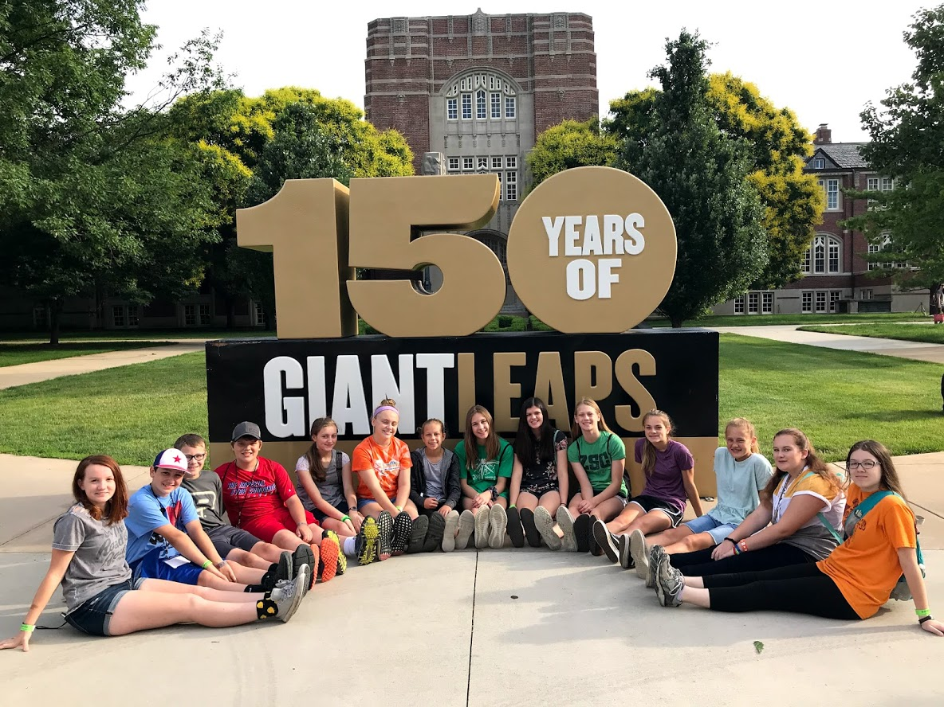
4-H Round-Up
Grades 7-9
Approximately 500 youth and adult participants
Introductory leadership development
Career awareness
Experience living in residence halls and navigating a Big Ten campus
June 24-26, 2024
$200 (estimate – will be partially to fully funded by Boone County 4-H Booster Club)
https://www.youtube.com/watch?v=p82f6ISNec0&list=PLtXSf1tu3Jd94YLXWTqsLwn1FogVoEPrB&index=83

Slide 22
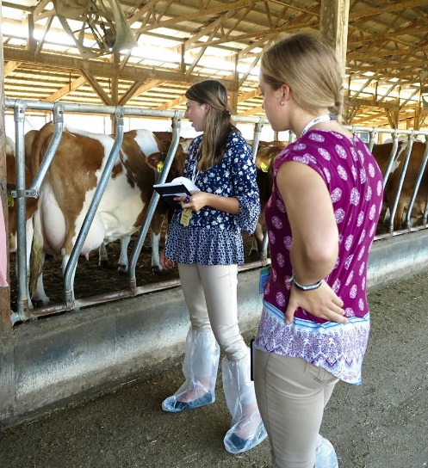
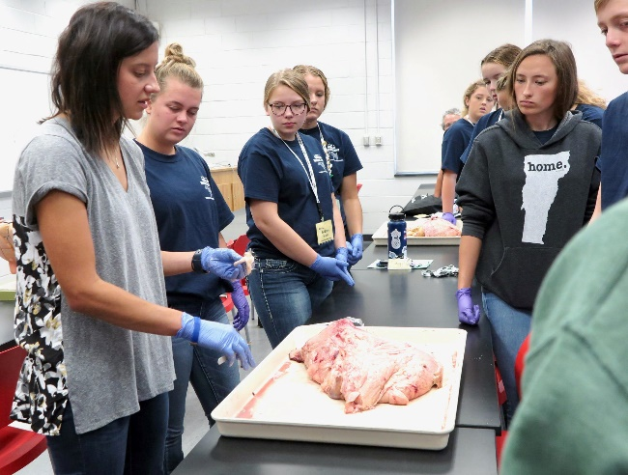
National 4-H Dairy Conference
Grades 9-12
October 2024
On University of Wisconsin-Madison campus
Educational sessions on dairy production and related careers
$600 (estimate – will be partially to fully funded by Boone County 4-H Booster Club)

Slide 23
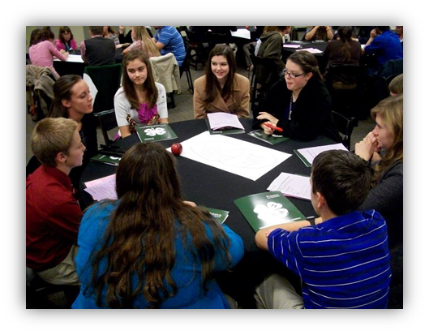
Indiana 4-H Leadership Summit (Youth and Adults)
Grades 8-12 and Adult Volunteers
Saturday, October 21, 2023 (Unsure if happening in 2024)
Leadership development sessions that can be replicated at club meetings
Recognize Accomplishment Scholarship winners
Event sponsored by Indiana 4-H Foundation
$50 (estimate – will be partially to fully funded by Boone County 4-H Booster Club)

Slide 24
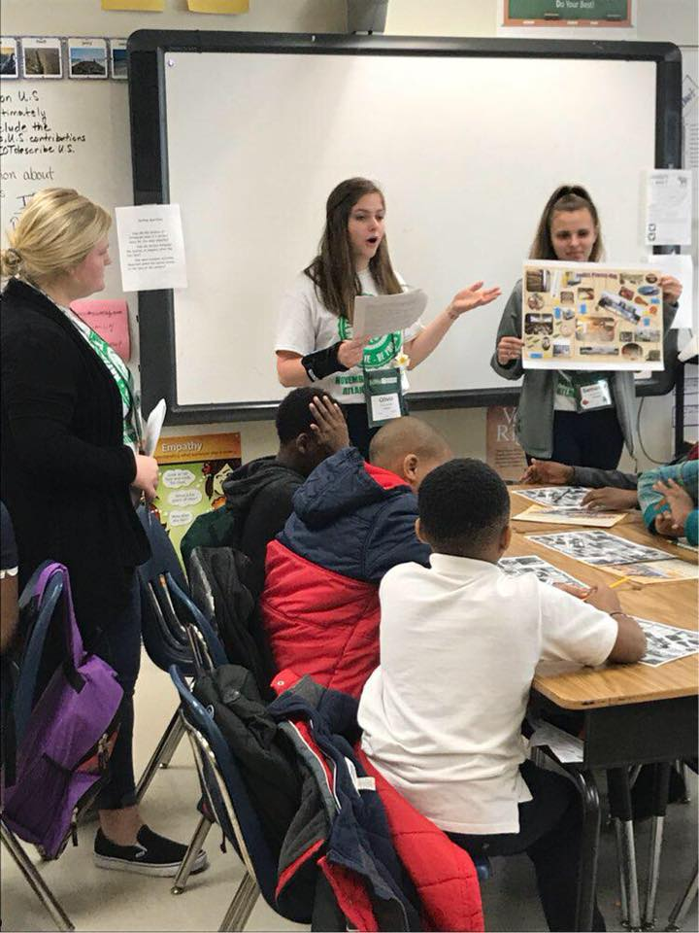
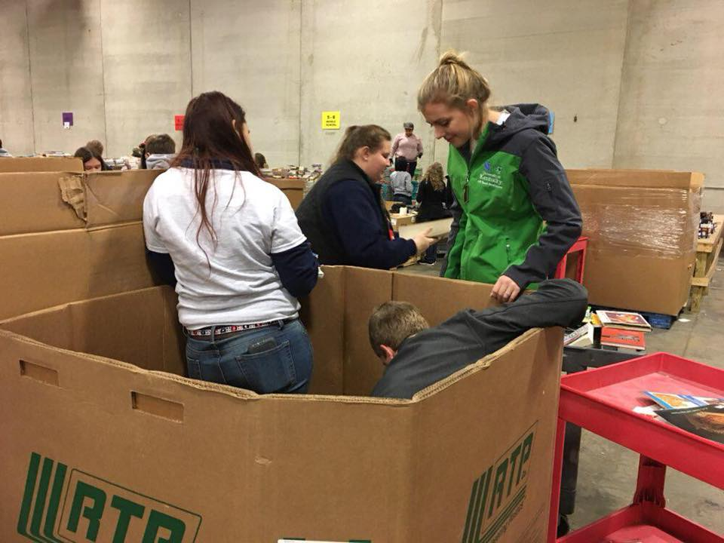
National 4-H Congress
November 2024 in Atlanta, Georgia
Delegates are selected through an application and interview process through Indiana 4-H
Indiana 4-H application deadline is May 1
Premier leadership development conference
$600 (estimate – will be partially to fully funded)

Slide 25
Boone County
4-H Scholarships

Slide 26
Boone County 4-H Scholarships
12 scholarships
1 Application Form (no matter how many you apply for.)
2 References - sealed (It is preferred that one of the references be from someone related to the Boone County 4-H program who has seen your efforts in 4-H.) References should talk about life skills you possess and examples of how they have seen you demonstrate those skills.
Transcript required
Link to application: http://extension.purdue.edu/boone - application that is very similar to the Indiana 4-H Foundation Senior Scholarship.
We need you to put everything in a big envelope or folder when you turn your scholarship packet into the office.
Due to Purdue Extension Office by January 25th

Slide 27
Boone County 4-H Scholarships
Tips to writing an application that will impress…
Write in your essay what you did in the projects that you are applying for. This way the committee knows what you learned in each of those projects.
Make sure you do all the steps (including a signature from you and your parent)
Have 1 reference that can talk about the growth they have seen in you since you started 4-H.

Slide 28
Boone County 4-H Scholarships
Categories:
4-H Booster Club
4-H Horse and Pony
4-H Junior Leaders
4-H Llama/Alpaca
Beef Producers Pork Producers
Darrell A. Portell Memorial
Bill Canada Memorial
Mark Cunningham Memorial – 4 year College –renewable
Mark Cunningham Memorial – 2 year Jr. College/Continuing Edu. -renewable Joe Garst Memorial – renewable Wes Beck Memorial

Slide 29
The Most important Tip I can give you…
When filling out applications for scholarships remember it is ALWAYS about what you have LEARNED,
NOT what you have EARNED during your time in 4-H!!

Slide 30

Indiana 4-H
Scholarships

Slide 31
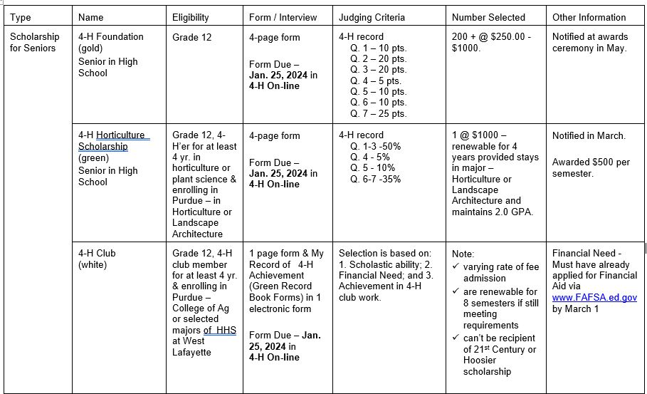

Slide 32
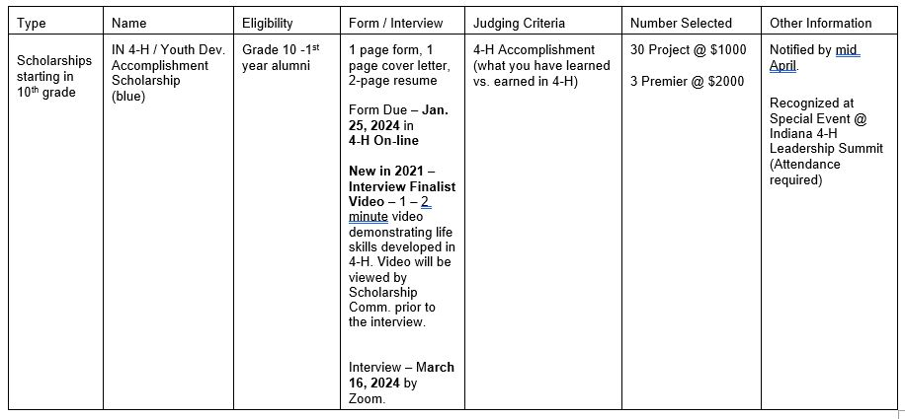

Slide 33
4-H Foundation Scholarship
Fill out State 4-H Foundation Scholarship Demographic Application Form and answer 7 questions.
3 page (max) to answer questions.
Largely based on 4-H participation and small amount on other work and activities.
Seniors only or final year of 4-H eligibility
Award range $250.00-$1,000.00
Applicant notified in March, claim form mailed in December, payment to college/university on behalf of 4-H member

Slide 34
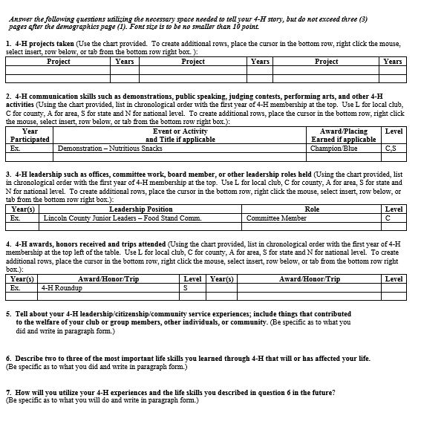
Score
100 points
Questions | Pts.
1 | 10
2 | 20
3 | 20
4 | 5
5 | 10
6 | 10
7 | 25

Slide 35
4-H Club Scholarship
Applicants: Any young person in Indiana who is a High School senior or who is currently enrolled in a post-secondary institution and will be transferring to Purdue University in the fall semester (2024).
Must be enrolled any major course of study in the College of Agriculture or one of these Academic Units in the College of Health and Human Sciences. (Development and Family Science, Family and Consumer Sciences Education, Financial Counseling and Planning, Nutrition Science, Retail Management, or Hospitality and Tourism Management)
Must have your FAFSA application on file.
Has maintained 4-H club membership and has been a member in good standing for at least four years
Fill out the 4-H Club Scholarship form
Attach “My Record of Achievement”
40 total scholarships available, may be renewed up to 4 years

Slide 36
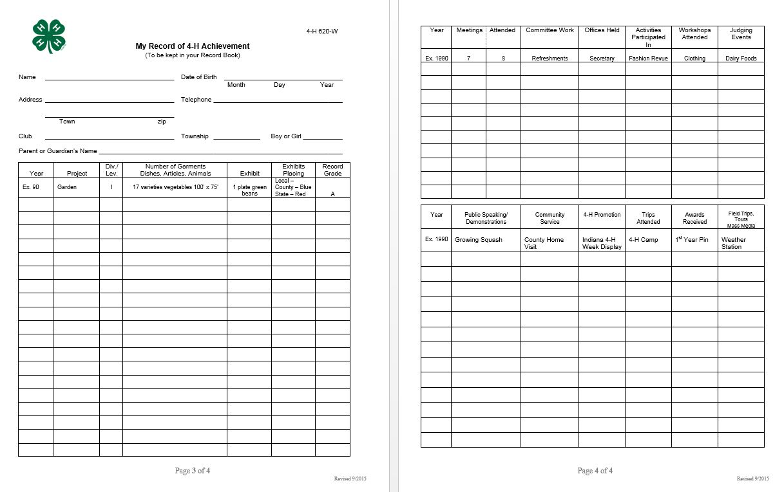
4-H Club Scholarship

Slide 37
Laurenz Greene Memorial
Excellence in 4-H Horticulture Scholarship
$1,000 award per year, renewable for 4 years.
One scholarship awarded per year
Apply senior year of high school
Applicant must be planning to pursue a Purdue University Department of Horticulture and Landscape Architecture undergraduate degree in one of the following program areas; Horticulture, Turf Management and Science, Sustainable Food and Farming Systems or Landscape Architecture.
Applicant must have studied at least four years horticulture and/or plant science related subject matter/project through Indiana 4-H Youth Development.
Scholarship is automatically renewed up to 4 years provided the student continues majoring in one of the eligible Purdue University Department of Horticulture and Landscape Architecture majors and maintains a minimum 2.0 GPA.
Based largely on 4-H record with a small amount on other work and activities. (Use State 4-H Scholarship/Trip Application Form with judging criteria as follows: questions 1-3 worth 50%, question 4 worth 5%, question 5 worth 10%, and question 6-7 worth 35%.)
The winner will be notified by March 1st.

Slide 38
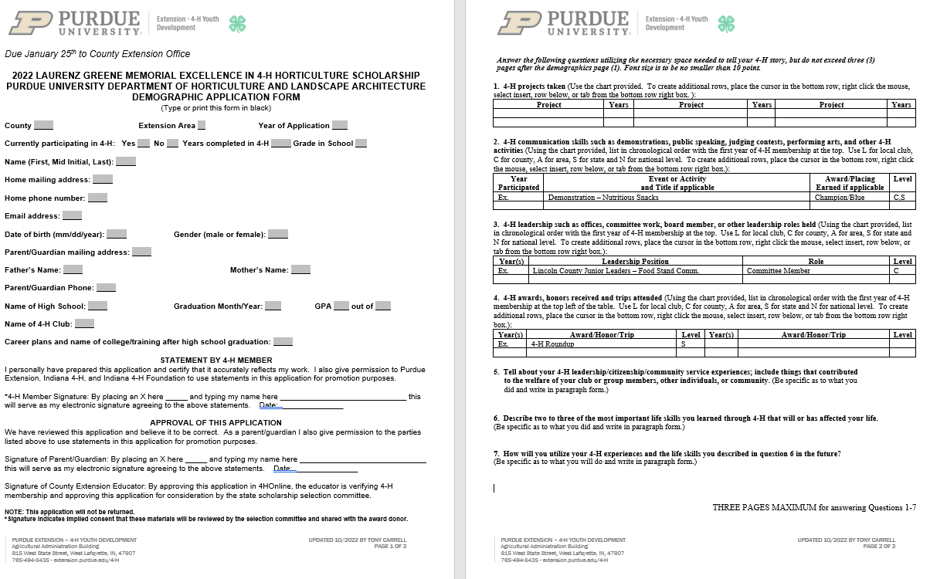
Laurenz Greene Memorial
Excellence in 4-H Horticulture Scholarship

Slide 39
Accomplishment Resume
Scholarship
Remember that TIP I gave you earlier!!!
1 page Cover Page
2 page Life Skill Resume
State 4-H Foundation Accomplishment Scholarship Demographic Application Form
You may enter a maximum of 3 categories . Each entry must speak to the specific category entered, thus one application cannot be used 3 times.

Slide 40
4-H Accomplishment Scholarship
Eligibility grade 10 through one year post 4-H
Application consists of two page life skills resume and one page cover letter
  Cover letter introduces applicant to reader and highlights life skills developed
  Life skills resume demonstrates 3-5 life skills developed as a result of participation in 4-H project/subject matter, events, and activities
Applicant may submit one application in up to three categories per year
Applicant may reapply in subsequent years if not awarded
Once applicant is awarded a category scholarship, may only apply in premier categories if eligible
Minimum of 30 Category awards $1,000.00, three Premier Category $2,000.00
Finalists interviewed in March, notified in April, awardees honored at Indiana 4-H Leadership Summit scholarship luncheon, claim form mailed in December, payment to college/university on behalf of 4-H member.

Slide 41
Categories
Seven categories related to educational mission focus areas plus three premier categories:
  Animal Science- Meat and Milk Production Category
  Animal Science- Companion and Small Animal Production Category
  Citizenship
  Communications
  Engineering and Technological Science
  Healthy Living, Food, and Nutrition Science
  Leadership Development
  Plant and Environmental Science
  Premier Achievement
  Premier Citizenship
  Premier Leadership

Slide 42
Categories with examples of projects/activities
Animal Science- Meat and Milk Production Category | Animal Science- Companion and Small Animal Production Category
Ag Day Animal Science Workshops Aquatic Science Beef Dairy Dairy Foods CDE Dairy Judging CDE Demonstrations Food Science Workshop Goat Junior Pork Day Junior Pork Quality Assurance Plus Livestock Judging CDE Livestock Skillathon CDE Meat Judging CDE National 4-H Dairy Conference National 4-H Science Experiment Poultry Rabbit Sheep Swine Veterinary Science | Ag Day Animal Science Workshops Aquatic Science Cat Critter Companions Demonstrations Dog Food Science Workshop Goat Hippology CDE Horse Horse Judging CDE Illustrated Talk Informative 4-H Presentation Llama and Alpaca National 4-H Science Experiment Pet Poultry Public Speaking Rabbit Veterinary Science

Slide 43
Categories with examples of projects/activities
Citizenship
Genealogy Personality Jr. Leaders Community Service projects in 4-H Officer of your club or Jr. Leaders Citizenship Washington Focus Presentations- Demonstrations / Illustrated Talk / Informative Presentation / Professional Persuasive Presentation / Public Speaking Community Service Indiana 4-H Youth and Adult Congress Indiana State Fair Youth Leadership Conference International Programs National 4-H Conference National 4-H Congress, Operation: Military Kids, Start Local…Go Global! Workshop State 4-H Junior Leader Conference State Fair Achievement Trip

Slide 44
Categories with examples of projects/activities
Communications | Engineering and Technological Science | Healthy Living, Food, and Nutrition Science
Computers Demonstrations at Club meetings Presentation about 4-H to a group 4-H Animal Ambassador 4-H Band 4-H Chorus 4-H Performing Arts Citizenship Washington Focus Communication Presentations – Demonstrations / Illustrated Talk / Informative Presentation / Professional Persuasive Presentation / Public Speaking Indiana 4-H Youth and Adult Congress Indiana State Fair Youth Leadership Conference National 4-H Conference National 4-H Congress Officer Training State Fair Achievement Trip State Junior Leader Conference | Small Engines Remote Control Aviation Aerospace Model Tractor Pull Computers Electric Lawn and Garden Tractor Tractor Maintenance Model Building Woodworking Robotics Aerospace Workshop Computer Science Workshop Presentations – Demonstrations / Illustrated Talk / Informative Presentation / Professional Persuasive Presentation / Public Speaking Electric Workshop Engineering Workshop, National 4-H Science Experiment Robotics Workshop | Foods Food Preparation Microwave Cooking Health Personality Child Development ATV Safety Bicycle Outdoor Chef 4-H Round-Up Captain Cash Presentations – Demonstrations / Illustrated Talk / Informative Presentation / Professional Persuasive Presentation / Public Speaking Food Science and Nutrition Workshop Healthy Living Workshop Show Me the Money Workshop

Slide 45
Categories with examples of projects/activities
Leadership Development | Plant and Environmental Science
Building Leadership Skills Club Officer Jr. Leader Officer Livestock Leadership Committee member Mentor to younger 4-H member Camp Counselor 4-H Ambassador Citizenship Washington Focus Indiana 4-H Youth and Adult Congress Indiana State Fair Youth Leadership Conference National 4-H Conference National 4-H Congress Officer Training State Fair Achievement Trip State Fair Exhibit Hall Worker State Junior Leader Conference | Garden Soil and Water Science Weather and Climate Science Crops Forestry Floriculture Geology Wildlife Beekeeping Entomology Shooting Sports Presentations – Demonstrations / Illustrated Talk / Informative Presentation / Professional Persuasive Presentation / Public Speaking Crops CDE, Entomology CDE, Forestry CDE, Horticulture CDE, National 4-H Science Experiment PINE Workshop, Plant Science Renewable Energy Workshop Soil Judging CDE Wildlife Habitat CDE

Slide 46
Categories with examples of projects/activities
Premier Achievement | Premier Citizenship | Premier Leadership
Looking for a wide range of 4-H Involvement Can include: Projects Trips Leadership Officer Positions Committees Citizenship Community Service Communication Presentations – Demonstrations / Illustrated Talk / Informative Presentation / Professional Persuasive Presentation / Public Speaking Career Development Events (CDE) Camp Counselor | Looking for a wide range of 4-H Citizenship Club leadership Club community service projects Jr. Leaders Jr. Leader Officer Jr. Leader community service projects Leadership of community service projects Leadership Citizenship Washington Focus Indiana 4-H Youth and Adult Congress Indiana State Fair Youth Leadership Conference International Programs National 4-H Conference National 4-H Congress Operation: Military Kids Start Local…Go Global! Workshop State 4-H Junior Leader Conference State Fair Achievement Trip | Looking for a wide range of 4-H Leadership Not just attending meetings, but leading or planning Camp Counselor Jr. Director at camp Mentor other 4-H members 4-H Livestock Ambassador Indiana State Fair Youth Leadership Group Advisor or Delegate Coordinators State 4-H Jr. Leader Council Area 6 Jr. Leader event planning committee Taught lessons from Indiana 4-H Congress Taught educational program in club meeting Stated a new activity in your club or Jr. Leaders State Fair Exhibit Hall Worker

Slide 47
The Resume…
I suggest writing the resume first.

Slide 48
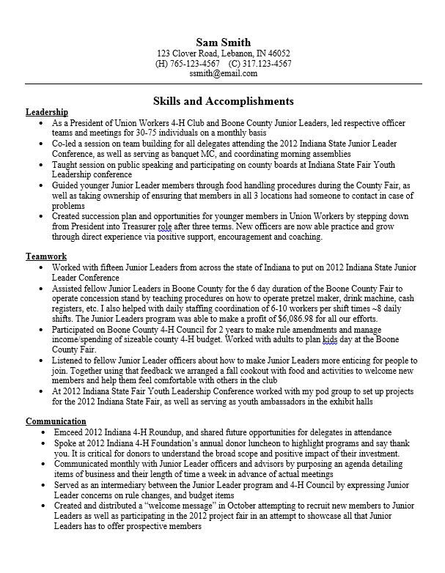
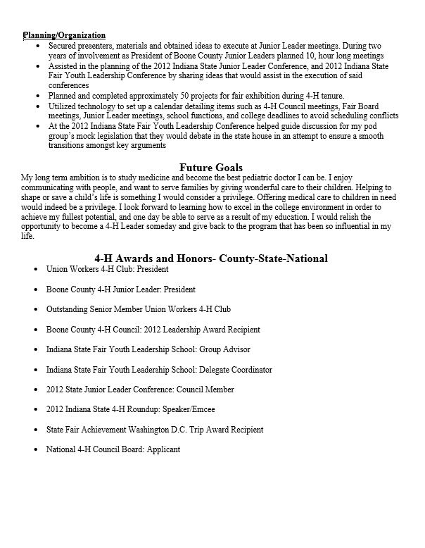

Slide 49
Life Skills – Select 5
Accepting Differences**
Character **
Citizenship
Communication **
Community Service Volunteering **
Concern For Others **
Conflict Resolution **
Contributions To Group Effort **
Cooperation **
Coping
Creative Thinking
Critical Thinking **
Decision Making **
Disease Prevention **
Empathy **
Goal Setting **
Healthy Lifestyle Choices
Honesty
Interpretation
Keeping Records**
Leadership **
Listening
Managing Feelings **
Managing Resources
Managing Stress
Marketable Skills **
Mastering Technology
Mathematics
Motivating Self
Negotiating
Nurturing Relationships **
Organizational
Personal Safety **
Planning
Planning & Organizing **
Problem Solving **
Reasoning
Record Keeping **
Resiliency **
Responsible Citizenship **
Responsibility
Self-Discipline **
Self-Esteem **
Self-Motivation **
Self-Responsibility **
Service Learning **
Sharing **
Social Skills **
Speaking
Stress Management **
Teaching
Teamwork **
Technology
Thinking Critically
Time Management
Wise Use Of Resources **
Writing

Slide 50
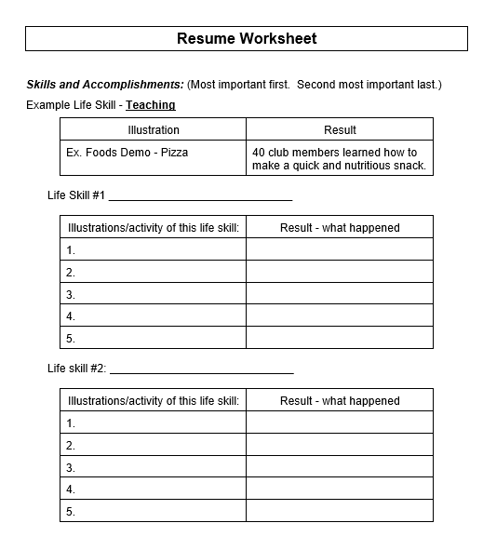
Resume Worksheet

Slide 51
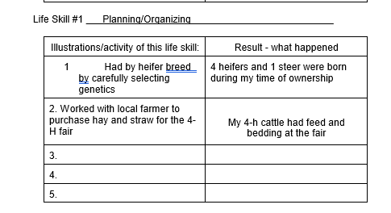
List Examples under Life Skill
Scholarship Category Applying for: Animal Science- Meat and Milk Production Category
Life Skill: Planning/Organizing

Slide 52
Now Turn Examples into WOW Statements
Need 5 bullet points (examples)
1st two bullets – project, bullet #3 – 4- other 4-H; last – school or home.
Start with power (action) verb.
Show results and numbers.
Each bullet should include: topic, background, action verb & results.

Slide 53
Examples WOW Statements
Activity – Camp Counselor at Shakamak. Led science class. (Life Skill- Teaching, Public Speaking, Mentoring)
WOW – Taught 95 4-H members in a 30 minute hands on learning activity about lift, thrust, drag and gravity using paper airplanes.
Activity - Fed my animals daily. (Life Skill - Time Management)
WOW – Executed the daily routine of feeding, grooming and exercising my own horses, as well as maintaining clean stalls. The health of my horses is extremely important to me, and these activities help keep them at their best.

Slide 54
Create WOW Statements
Activity - Participated in Junior Leader Service Projects (Life Skill: Community Service, Volunteering).
WOW – Networked with the other Junior Leaders in Area 6 to make 80 birthday bags that could be distributed in all 8 counties for low income families to pick up at their local food pantries.
Activity - Coordinate 4-H and School Activities (Time Management skill)
WOW – Scheduled events for 4-H, school, FFA, volunteer work, part-time job, and homework while maintaining an A-B average in school.

Slide 55
Format Suggestions
Top: Name, Address, Phone Number
Skills should stand out
Font large enough to read (Font size must be a minimum of 10 point.) (prefer – Arial)
Can only be 2 pages
Goals - include a short term and long term
Awards - keep to minimum and only what is project related. Remember: Review team wants to know what you learned not what you earned
Put strongest skill first and 2nd strongest last with weakest in the middle

Slide 56
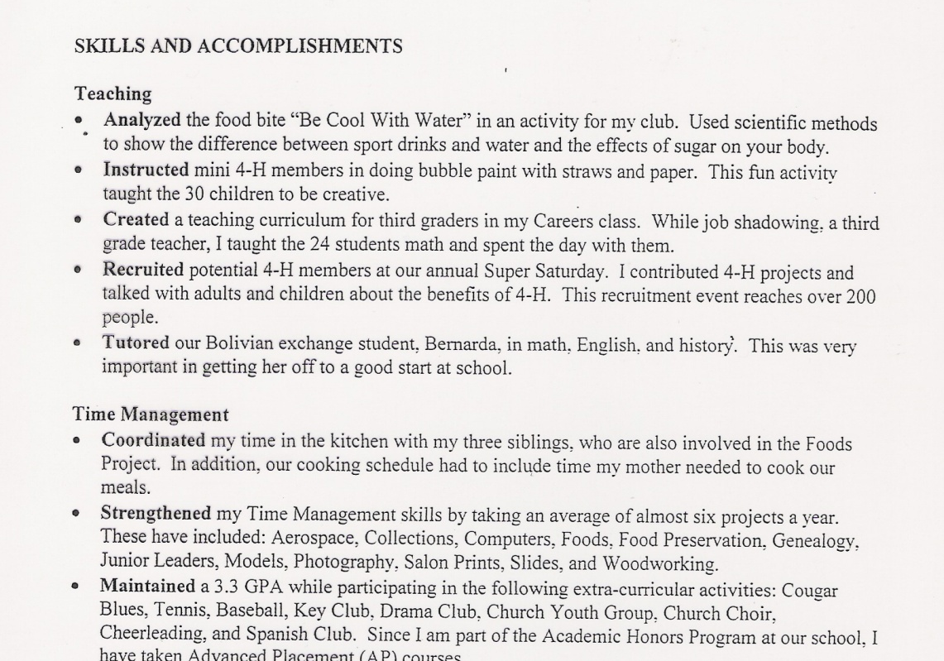
Good Example – Power Verbs are bolded

Slide 57
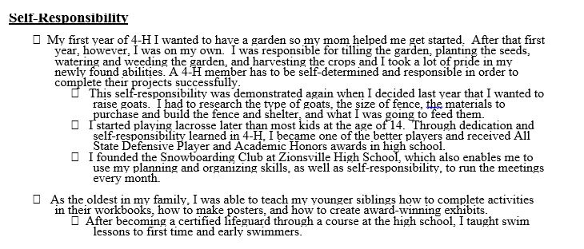
Bad Example – Not Concise

Slide 58
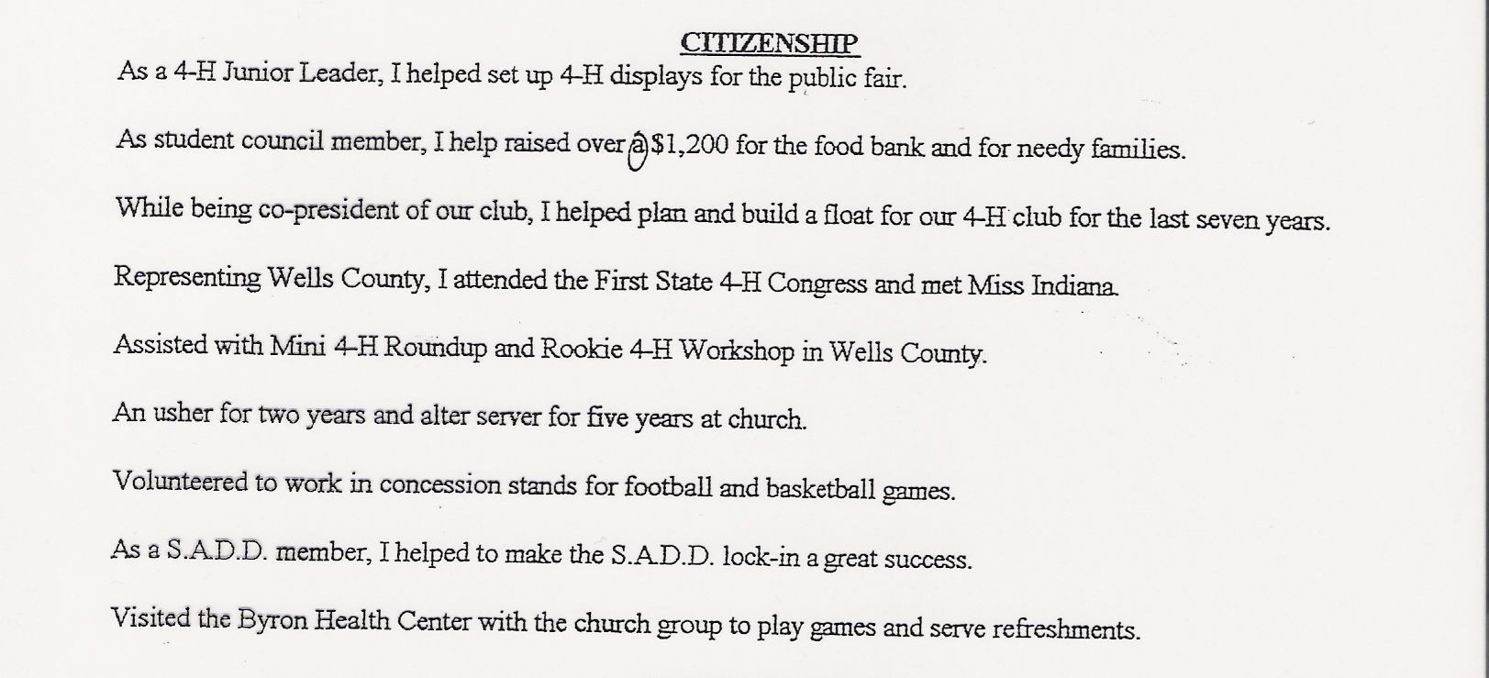
Bad Example – No WOW & Errors

Slide 59
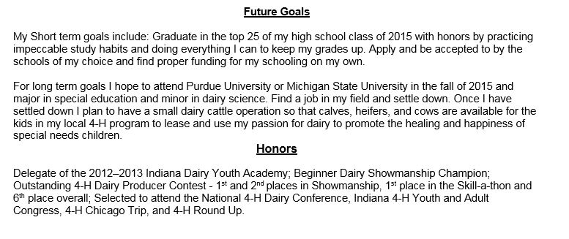
Good Example – Goals & Honors

Slide 60
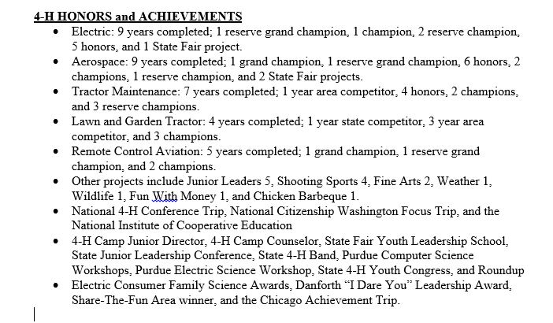
Bad Example – Too Many Honors

Slide 61
The Cover Letter…
Introduces you to the reader.
Must mention 3 life skills from resumes. Do NOT repeat examples.
Need to catch readers interest.

Slide 62
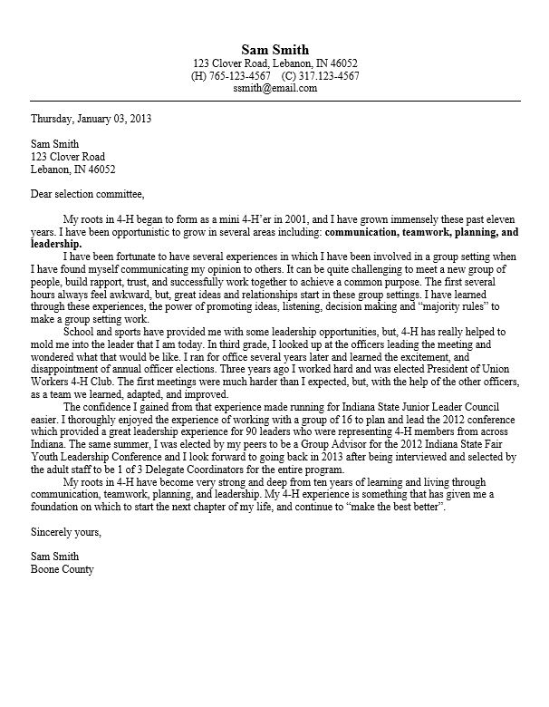
Cover Letter

Slide 63
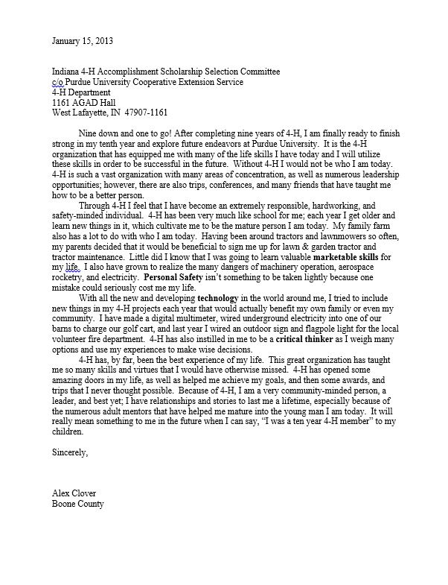
Samples – Catchy Intro

Slide 64
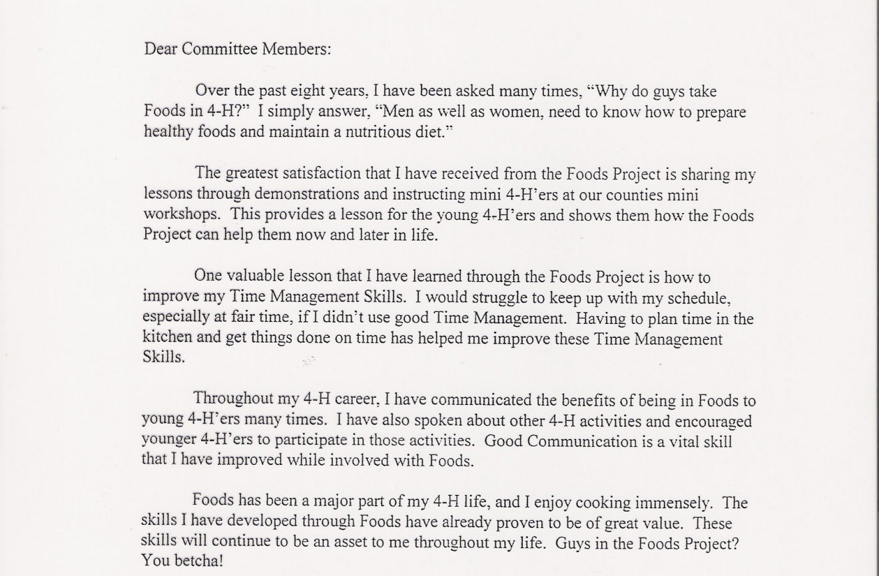
Samples – Catchy Intro

Slide 65
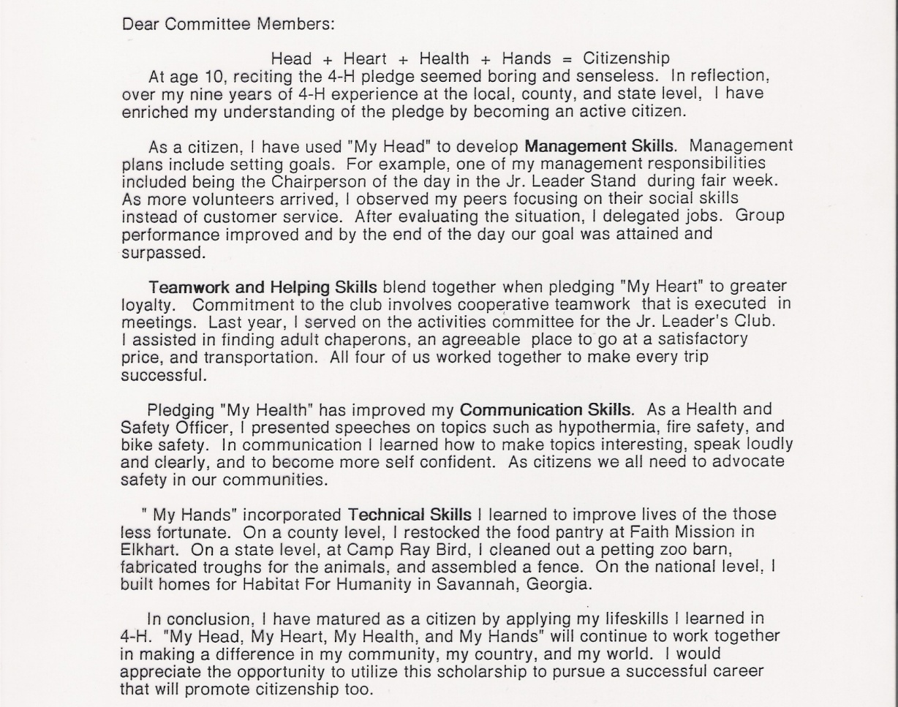
Samples – Bold Skills

Slide 66
Other Details…

Slide 67
Demographics Page
Not judged. However, do NOT have spelling errors.
It is used if you win to introduce you at the public presentation.
For “Area” put “6”

Slide 68
Submission Process
Suggest working on applications over winter break
Ask Extension Educator, teacher, parents, etc. to review, and review, and review.
Finished application is to be in a single PDF formatted document.
Upload through 4HOnline no later than January 25. Must be enrolled and APPROVED as a 4-H member before this date. College Freshman email me to set you up as a contact by January 15th.

Slide 69
Evaluation Process
Team of 4-6 people (Educators) score each of the applications in a project category.
The top three or more applicants in each category will be invited to participate in the Interview Process and must create a 1-2 minute video demonstrating life skills developed from participating in 4-H
The top scores after the Interview process will receive the scholarship.

Slide 70
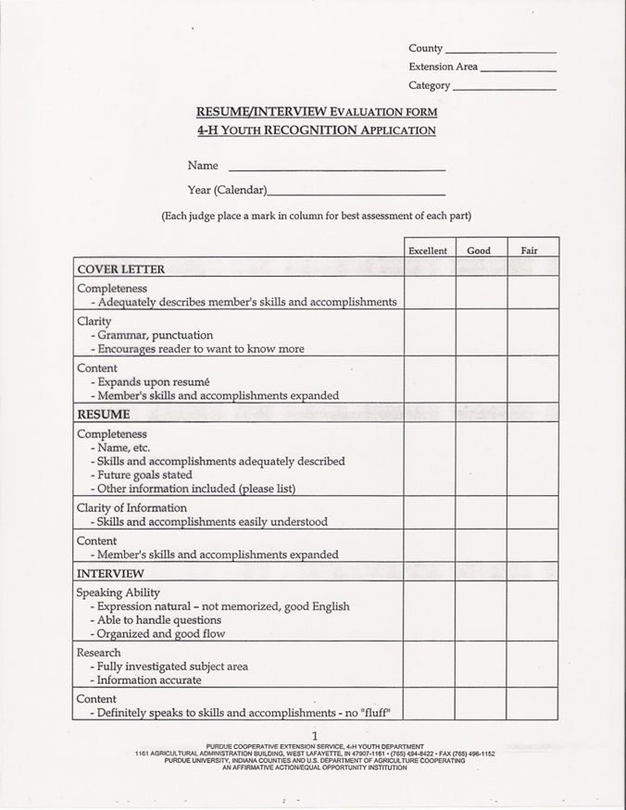
Score Sheet

Slide 71
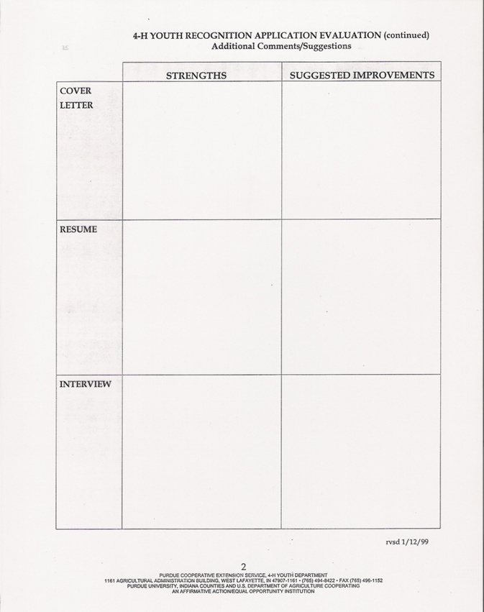
Score Sheet

Slide 72
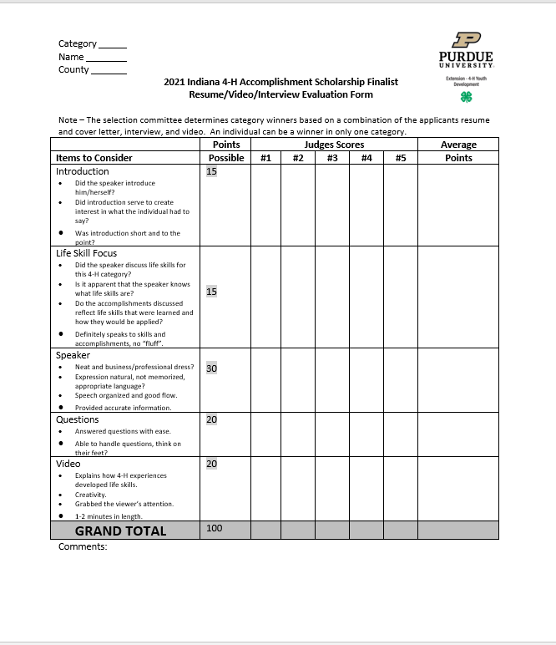
Interview
10 minutes per interviewee
Give 2 – 3 minute speech;
Answer questions for 3 – 4 minutes.

Slide 73
Judging Committee Likes
On question 1 when listing projects, list your main projects first especially those related to the scholarship.
Heart warming 4-H stories with evidence of learning.
Evidence that you have learned a skill in 4-H.
State & national trips and awards combined with evidence of learning.
A resume & cover letter that is very specific to the project category

Slide 74
Judging Committee Does NOT Like
Lists of awards ... a focus on winning, not learning.
The same resume used over and over in multiple areas.
Lists of what you did without stating what you learned.

Slide 75
Time Frame
Dec. 3 - First draft due to Stephanie stephanieg@purdue.edu
Dec. 10 - First draft is returned to you.
Dec. 13 - Ask your English teacher to read your draft for grammatical mistakes.
Jan. 3 - Submit second draft to Stephanie stephanieg@purdue.edu
Jan. 10- Second draft is returned to you.
Jan. 15- Make sure you are enrolled in 4-H
Jan. 25 - Final draft must be uploaded on 4HOnline
Jan 25- Boone County 4-H Scholarships due to Extension Office
March 1 - Semi-finalists are notified (accomplishment scholarship only)
March 11- Video due to State 4-H Office
March 19 – Virtual Interviews (has to be that day) (accomplishment scholarship only)
Notification of winners in late March
December- awards claimed

Slide 76
THANK YOU for coming tonight!
Contact me with any questions!
765-482-0750 stephanieg@purdue.edu
Please help by putting away chairs and tables!

