Slide 1
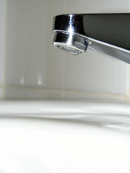
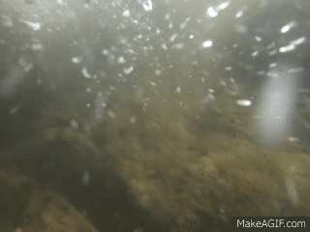
Healthy Water Happy Home
Ways to Improve Water Quality from Home

Slide 2
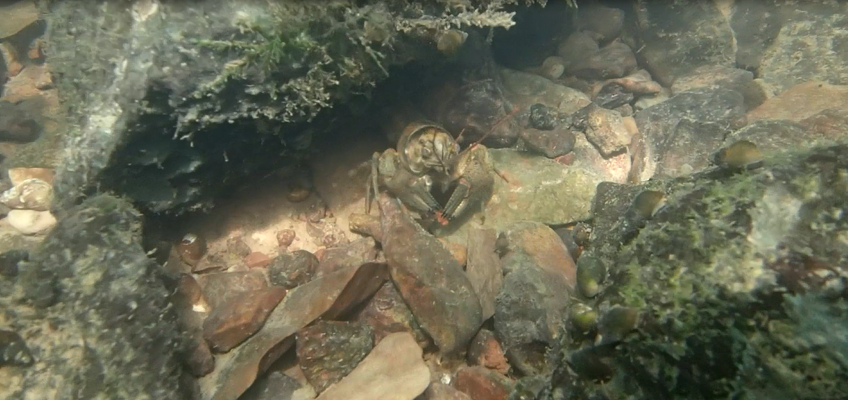
Water quality
Notes:
Rebecca Busse

Slide 3
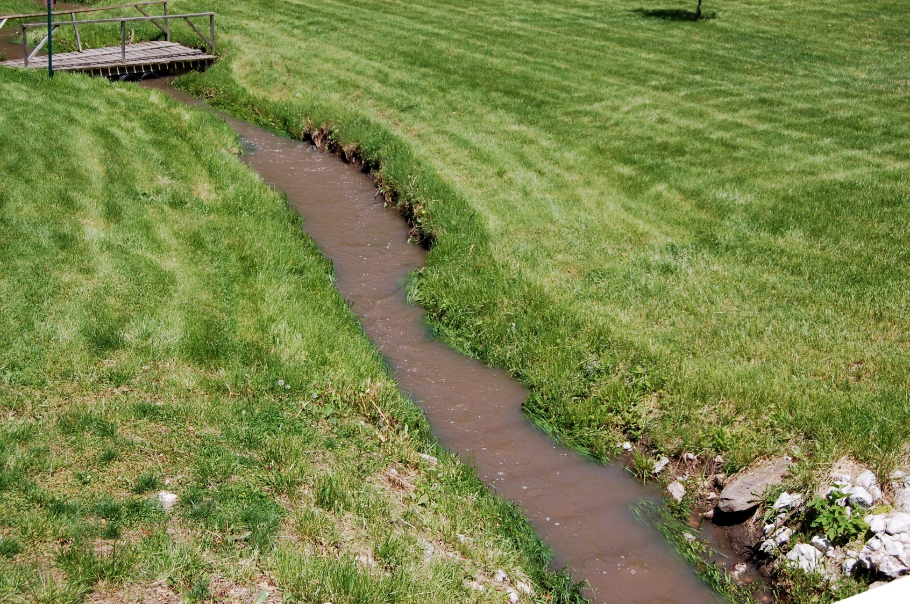
Runoff
Notes:
Wabash River Enhancement Corporation-WREC Special Thanks to Sara Peel for use of phoeo

Slide 4
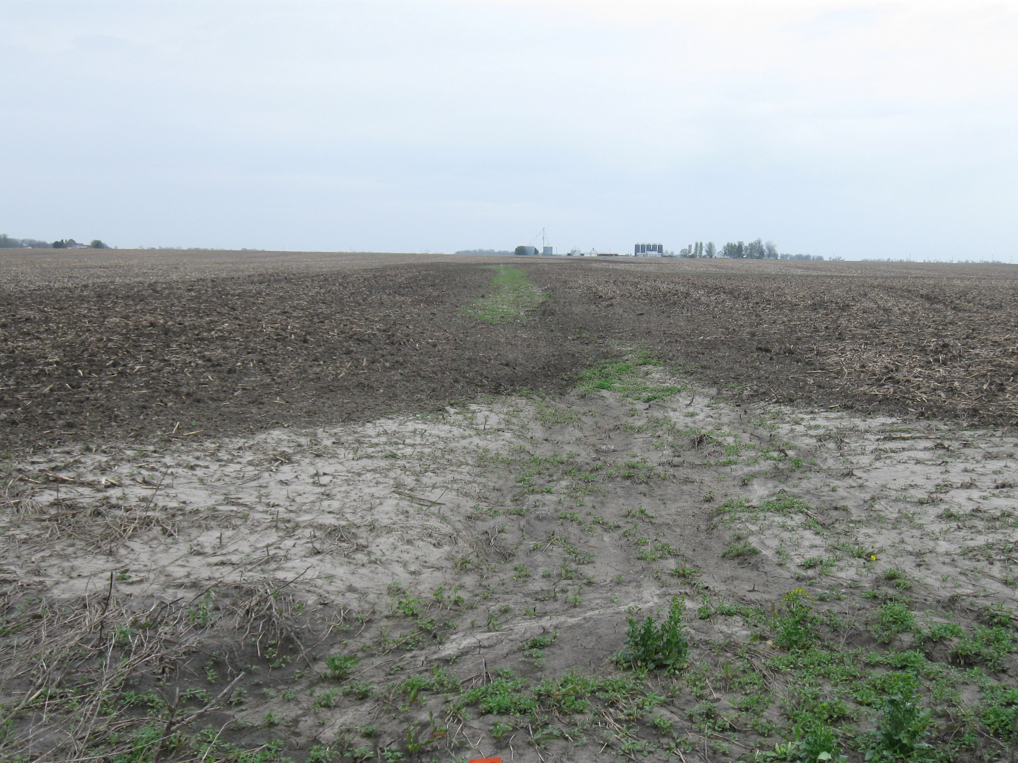
Sedimentation
Notes:
WREC

Slide 5
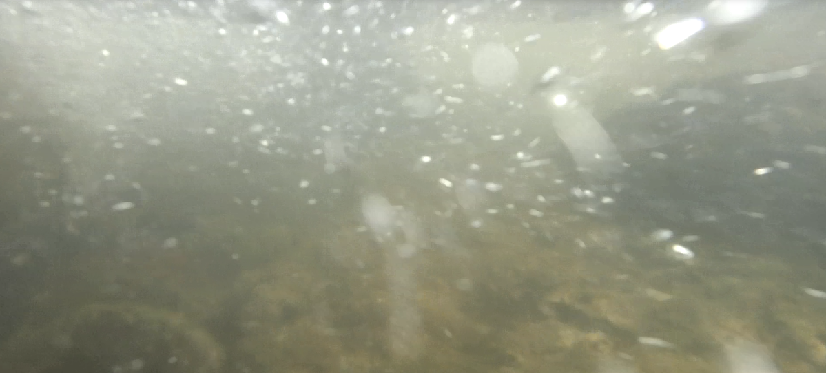
Dissolved Oxygen
Notes:
Rebecca Busse

Slide 6
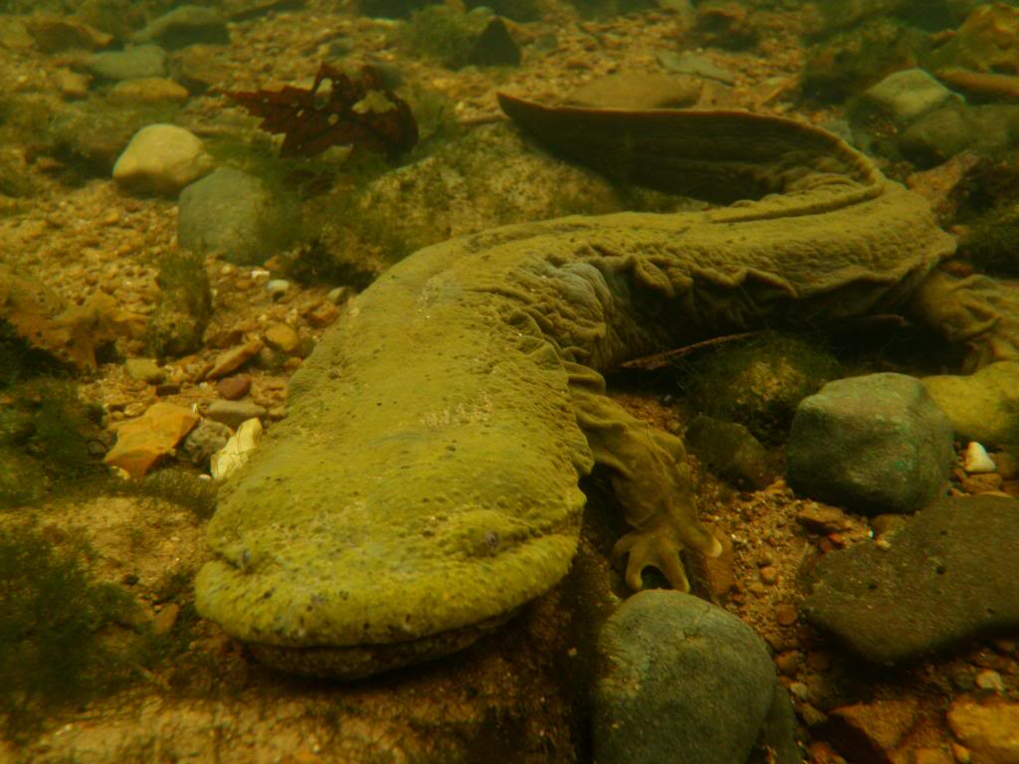
The Eastern Hellbender
Indicator species
Notes:
Bart Kraus

Slide 7
Aquatic habitat
Notes:
Rebecca Busse

Slide 8
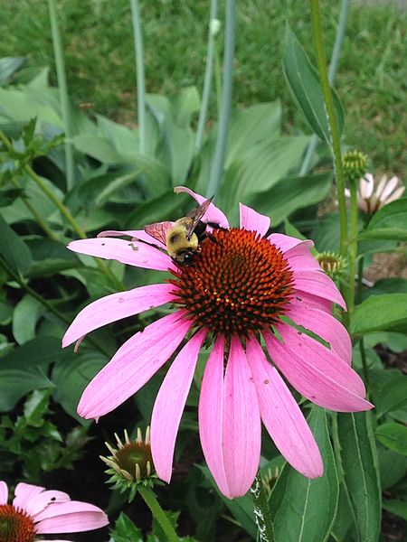
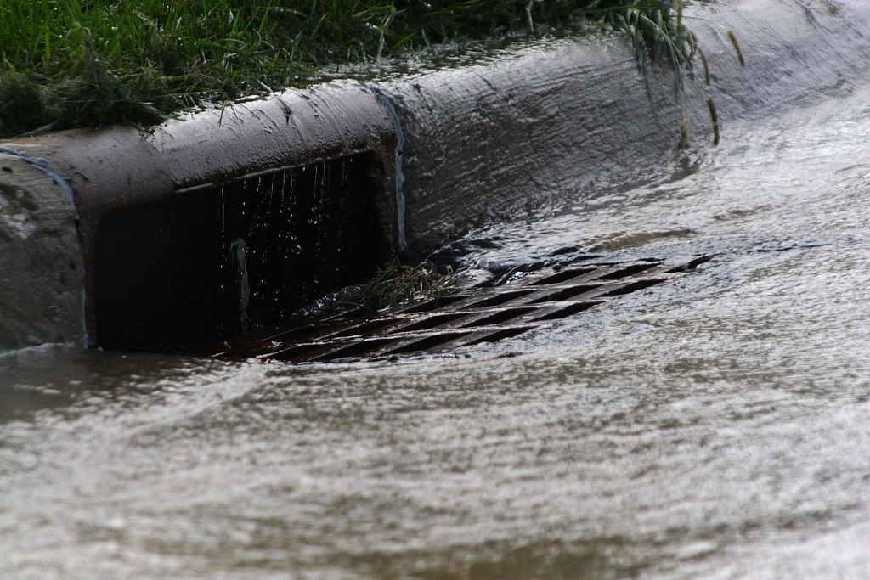
Healthy Water Choices
Everyday Practices

Slide 9
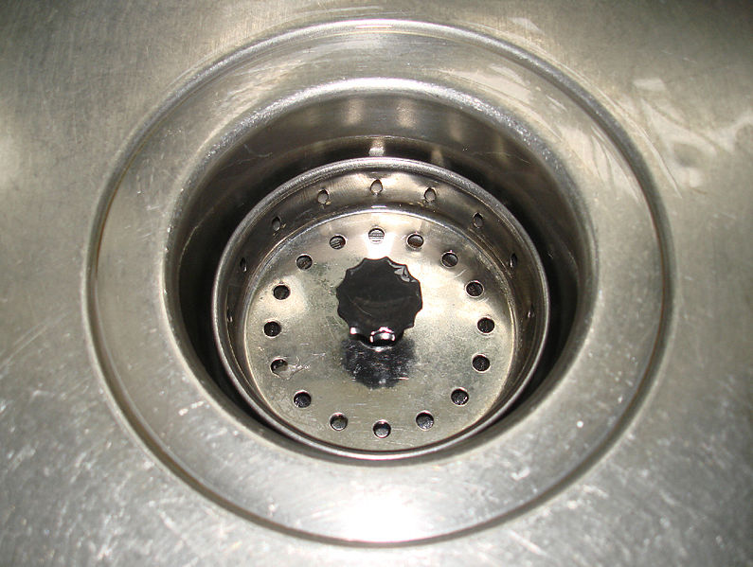
Know what you’re putting down the drain
Notes:
Stilfehler-Wikimedia Commons

Slide 10
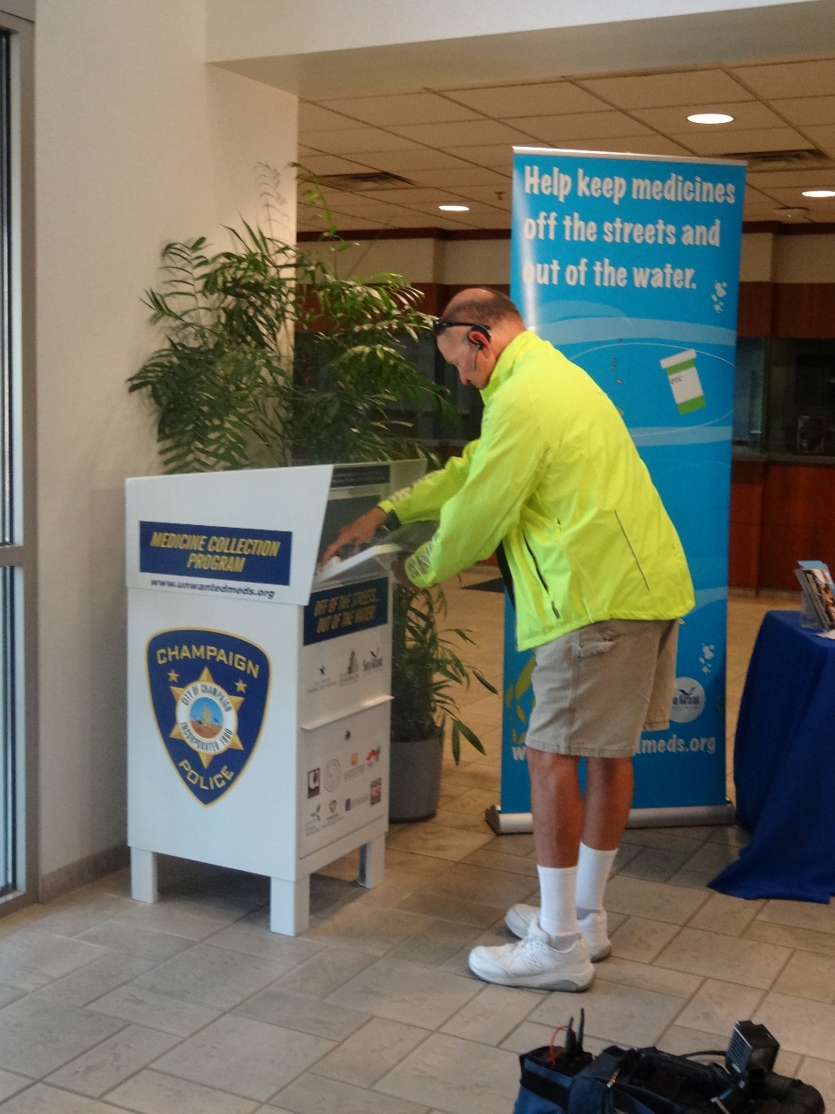
Participate in a medicine
take-back program
Notes:
Illinois-Indiana Sea Grant-Special thanks to Laura Kammin for use of photo

Slide 11
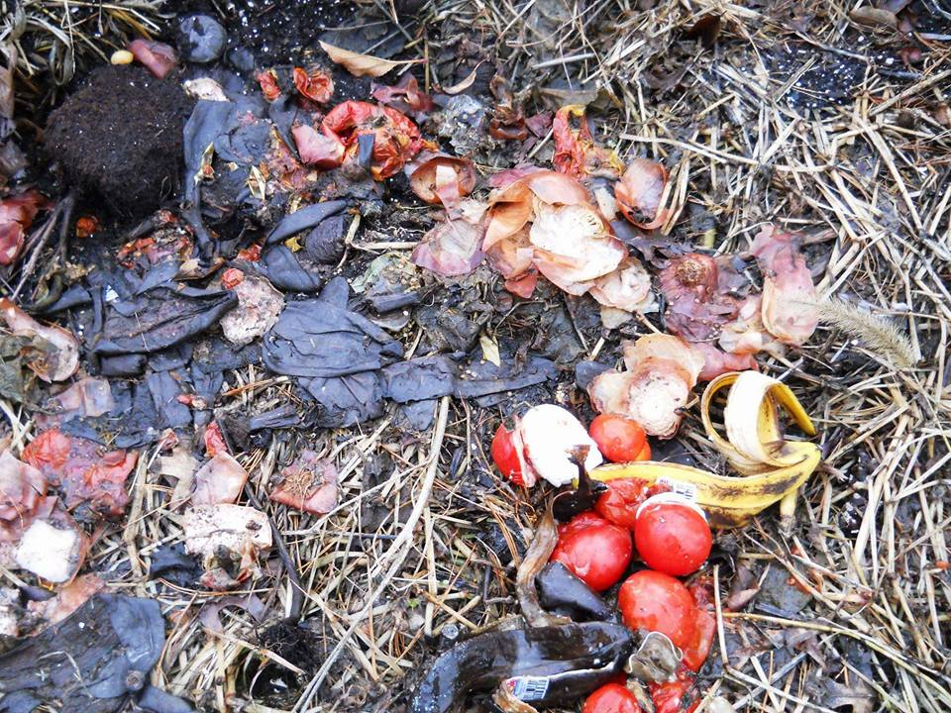
Compost
Notes:
Karen Tormoehlen

Slide 12
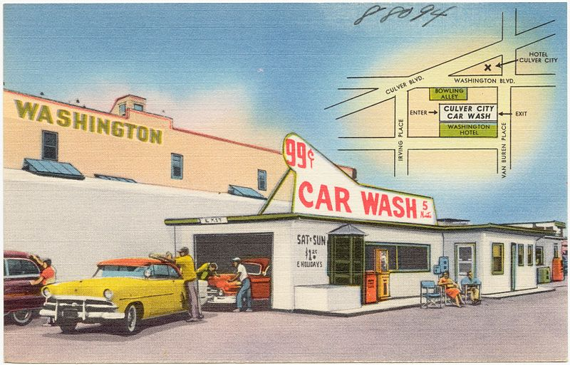
Wash your car on the lawn or take it to a car wash
Notes:
Public domain. Tichnor Brothers, Publisher.

Slide 13
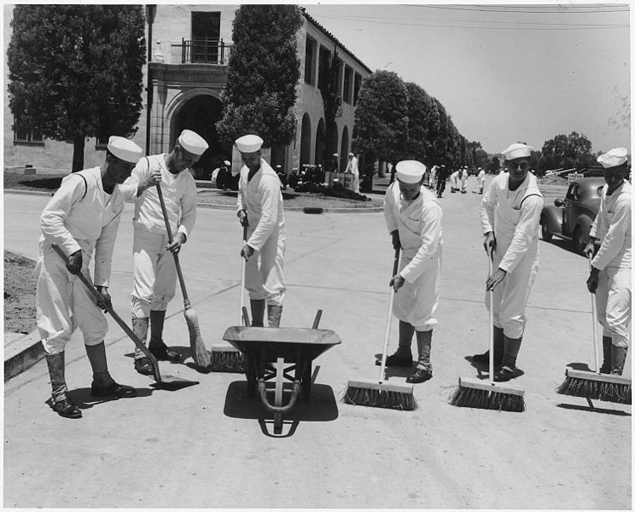
Sweep your driveway and sidewalk instead of spraying
Notes:
Public Domain-Wikimedia Commons

Slide 14
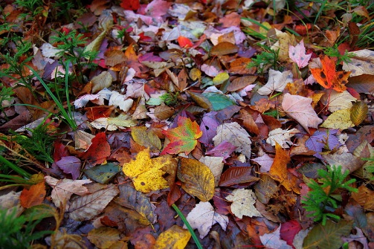
Leave grass clippings and leaves OR put them in yard waste bags
Notes:
ForestWander-Wikimedia Commons

Slide 15
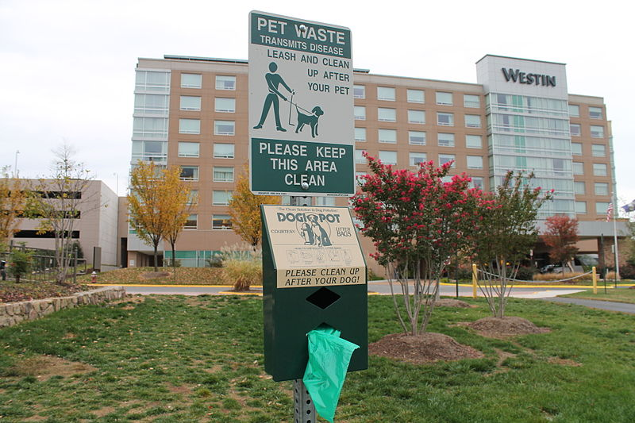
Pick up pet waste
Notes:
Elvert Barnes from Hyattsville MD, USA-Wikimedia Commons

Slide 16
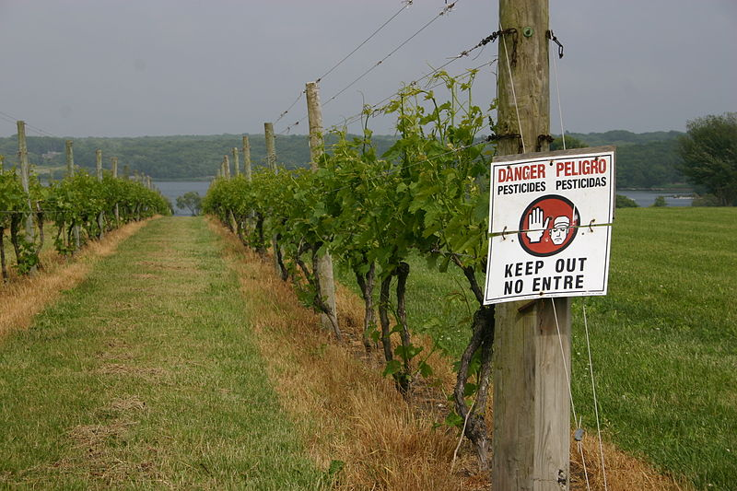
Minimize fertilizer and pesticide use
Notes:
"Sakonnet Vineyards Tour (4755507582)" by National Institute for Occupational Safety and Health (NIOSH) from USA - Sakonnet Vineyards Tour. Licensed under Public Domain via Wikimedia Commons - https://commons.wikimedia.org/wiki/File:Sakonnet_Vineyards_Tour_(4755507582).jpg#/media/File:Sakonnet_Vineyards_Tour_(4755507582).jpg

Slide 17
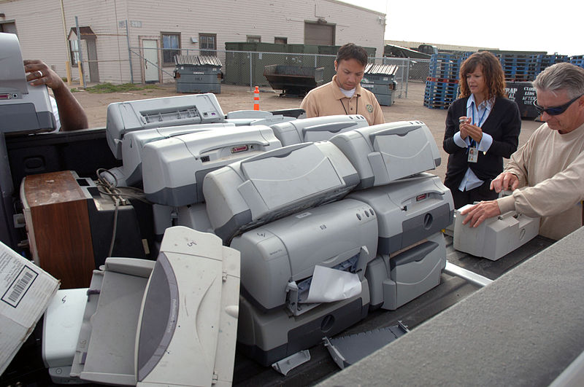
Recycle Electronics
Notes:
U.S. Navy

Slide 18
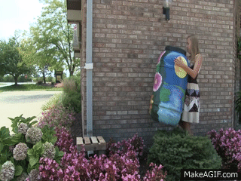
Healthy Water Choices
Bigger Projects

Slide 19
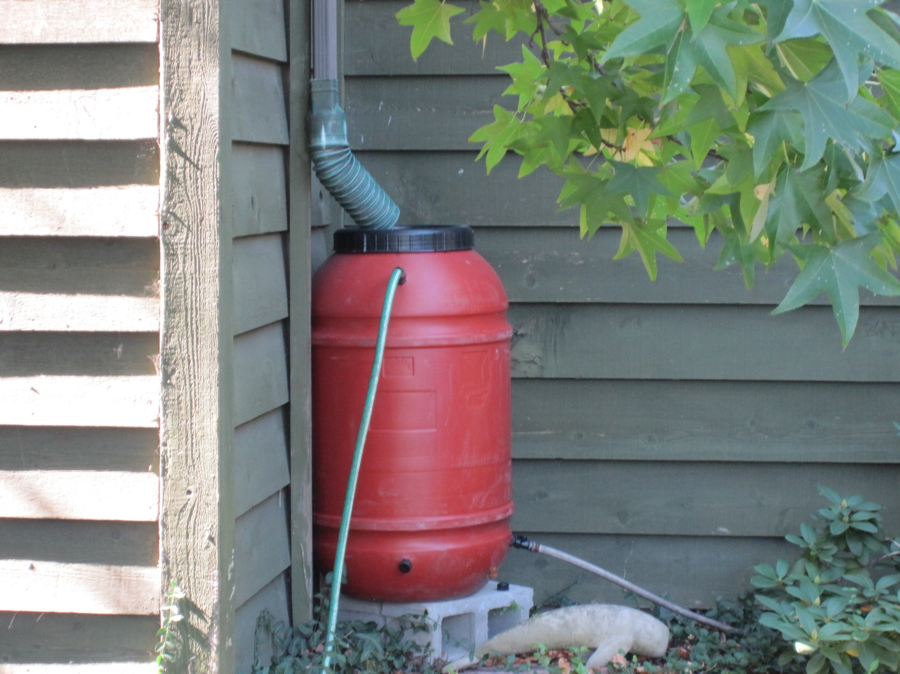
Rain barrel
Notes:
Allison Turner

Slide 20
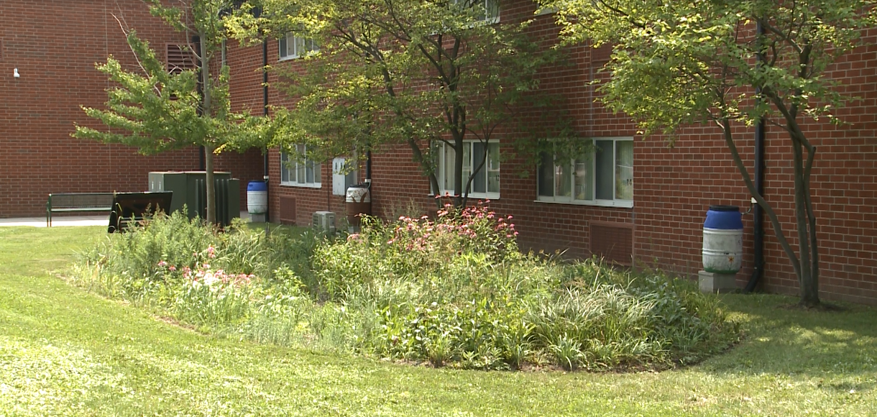
Rain garden
Notes:
Purdue Agricultural Communication

Slide 21
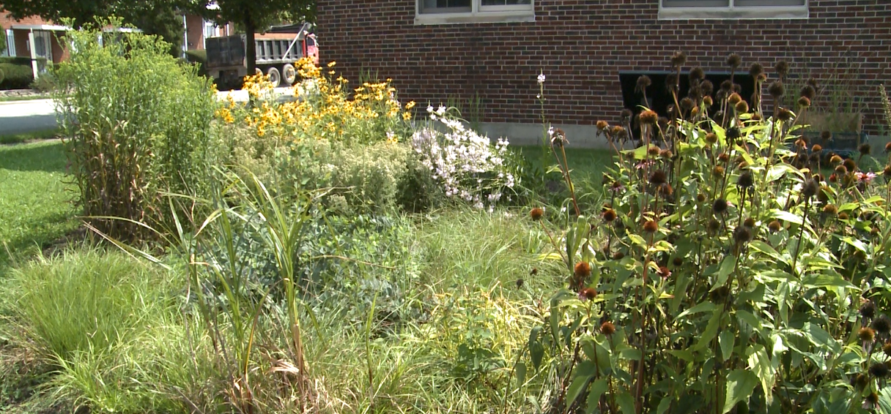
Native plants and trees
Notes:
Purdue Agricultural Communication

Slide 22
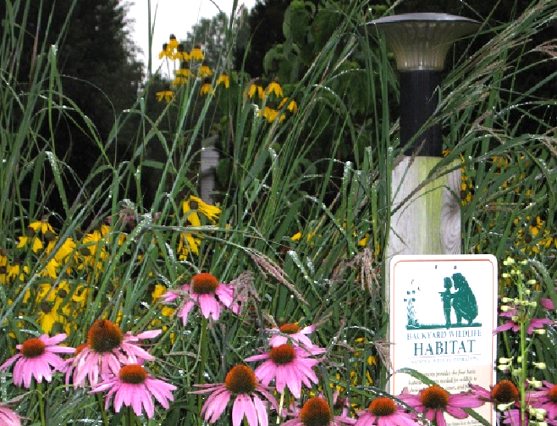
Certified backyard wildlife habitat
Notes:
Helpthehellbender.org

Slide 23
Now Let’s Review with a Game!
Partners, player pieces, rolling dice, and moving to the center
Drawing cards
Which cards are which?
The time crunch
Answer boxes-when to look and when to cover

