Slide 1

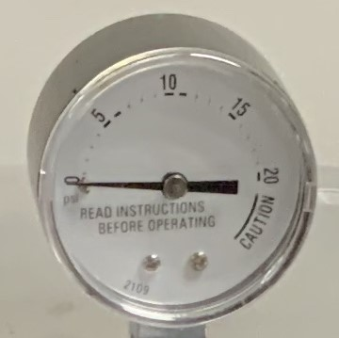
Home Food Preservation
Pressure Canning Basics
See you at the fair!
When
Where
July 8, 2024
1-2:30 CT
Toyota Events Center*
Gibson County Fair
This session includes:
canning basics
food safety guidelines for home canning
where to find trusted resources
lecture, discussion, and handouts
Pressure canner dial gauge testing will be available after the program for a $5 fee per gauge.
*Event will be held at the Open Class Exhibition in the Toyota Events Center. 709 N. Embree St., Princeton, IN 47670
If you need a reasonable accommodation to attend this program please contact Angie at 812-385-3491 at least 10 business days prior to the event.

