Slide 1
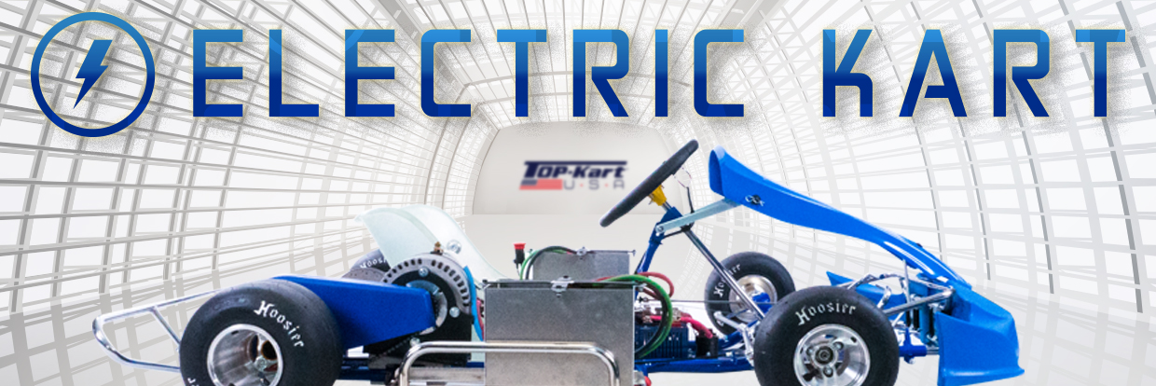
Welcome to THE PORTER COUNTY 4-H MOTORSPORTS OPEN HOUSE – EV Grand Prix Project
PRESENTER: ERIC HORNBACK, PROJECT SUPERINTENTENT

Slide 2
Project Description:
The EV Grand Prix Project is a fun and educational opportunity for a group of selected 4-H members to learn hands-on concepts in the engineering design process, teamwork, problem solving, racing concepts, kart setups, marketing, and much more. There will be project workshops and activities coordinated by the project superintendent. The electric kart(s) will be shown at the Porter County Fair, sponsorship events, and other community outreaches. The main event will be held at Purdue Motorsports’ track located at the Indianapolis Speedway.
During the main event, the team will compete in the following categories to claim the championship trophy:
- Community Outreach (15%)
- Engineering & Setup (15%)
- Project Management & Marketing (15%)
- Creative Expression (5%)
- Energy Efficiency (15%)
- Series Placement (35%)

Slide 3
Project Focus GROUPS:
COMMUNITY OUTREACH GROUP
PROJECT MANAGEMENT, MARKETING, & CREATIVE EXPRESSION GROUP
ENGINEERING, SETUP, AND ENERGY EFFICIENCY GROUP

Slide 4
COMMUNITY OUTREACH GROUP:
This group will be responsible on how the team promotes their STEM education and their project to the community. Members will be required to present at conferences, local events, and maintain a social media presence. Other activities will include media updates, videos, pictures, contact list, newsletters, public relations, etc.

Slide 5
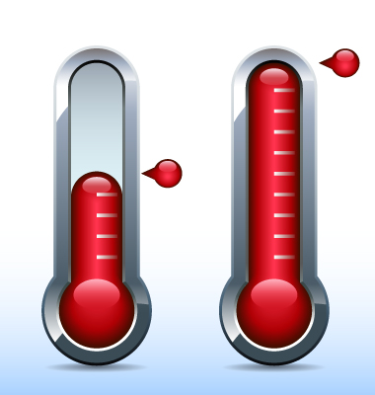
Project Management, marketing, & Creative expression group:
This group will be responsible for overall project management, marketing, and visual aids. Other activities will include fundraising, sponsorships, sponsor relations, project updates, budgeting, resources, ordering, spare parts, kart graphics, coloring, logos, t-shirts, banners, etc.

Slide 6
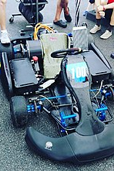
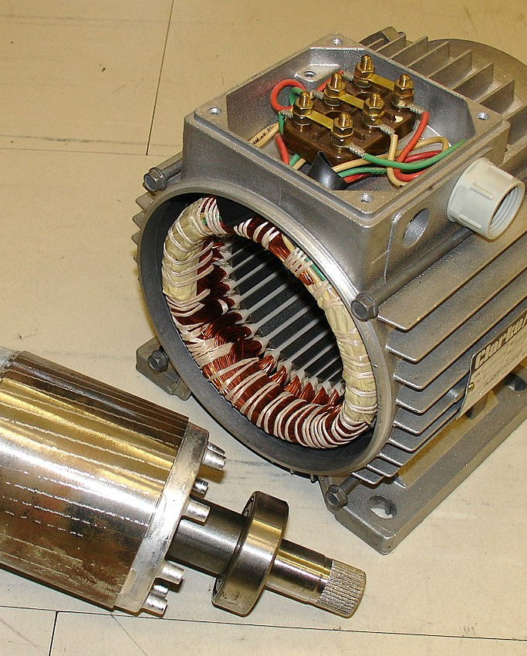
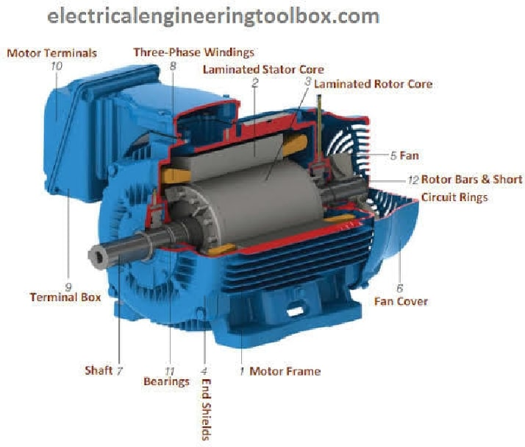
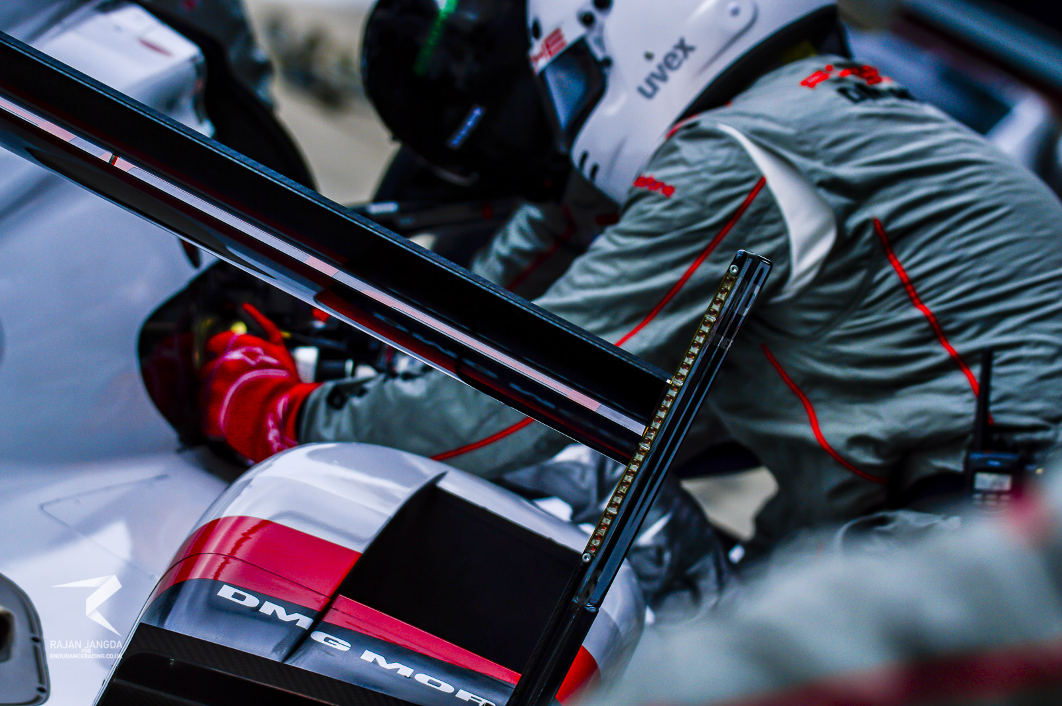
Engineering, setup, and energy efficiency group:
This group will mainly consist of: Drivers and Crew Members. This group will utilize detailed technical drawings, data collection, mechanical knowledge to present to a panel of judges. This group will also be tasked with tracking and reducing energy consumption to complete the race in the shortest amount of time, while using the least amount of energy to do so.

Slide 7
PROJECT RULES:
1) The project is open to a select group of 4-H members in grades 9th through 12th. Jr. High students (7th & 8th grade) are eligible to participate in the focus groups, but are not eligible to be a group leader, driver, or crew chief. All candidates are required to go through an application process to be considered for the project. Drivers, Crew Members, and Group Leaders are required to travel.
2) Each racing team must have a minimum of (5) members: Driver, Crew Chief, 3 Crew Members at all events. The quantity of racing teams will be decided based upon sponsorship and fundraising capital. Positions will be based upon qualifying events and team members knowledge and experience shown in the workshops.
3) Drivers are encouraged to a participate in local sanctioned karting events during the off season.
4) All project members must attend workshops, sponsorship events, and fundraising events. Racing Team members must attend test & tune events, practices, and racing events. Members can be removed from the project, due to lack of attendance, participation, or other reasons as deemed by the project superintendent and 4-H administration.
5) Members will be required to follow the rules and regulations of the Purdue Motorsports, World Karting Association (WKA), and local tracks.

Slide 8
APPLICATION PROCESS:
Project MEMBERS
RACING TEAM MEMBERS
2-Minute Application Video
Written Application
Fundraising Commitment
4-H Membership (if chosen)
$25 WKA Membership (if chosen)
Project Member Requirements
2 STEM Recommendation Letters
Sworn statements
Parental consent forms
Medical Insurance Info. (if chosen)
Focus Group Leaders must attend the main racing event for presenting their group project to the judges.

Slide 9
Project KEY DATES:
12/18/2019 – Kick Off Event
12/31/2019 – Application Deadline
01/14/2020 – Team Members Selected
01/18/2020 to 03/28/20 – 10 Workshops (Sat. Mornings, 9am-11am)
04/04, 04/11, 04/18/20 – Test & Tune Practices (Purdue, Whiteland, Columbus)
04/22/2020 – World Finals (Indianapolis Motor Speedway) – During School
06/04/2020 – Sponsorship Event (5pm-8pm)
07/2020 – Porter County Fair

Slide 10
THANK YOU SPONSORS!
KART SPONSOR
KART SPONSOR
PROJECT SPONSORS:
SUPPORTERS:

